Slide 1

A Concise View of the Russian Revolutions of 1917
Hunt Tooley

Slide 2
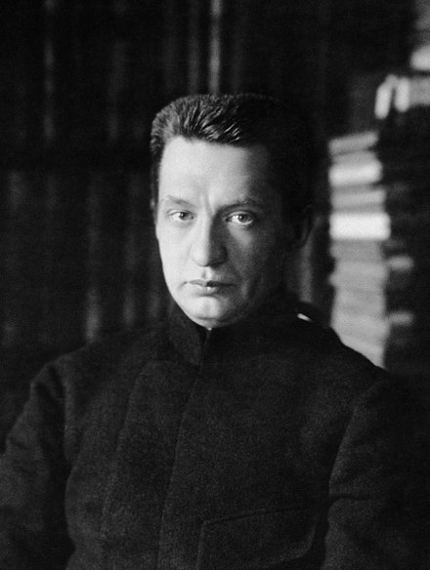
Two Revolutions in Russia:
1917
The February Revolution: This one resulted from the disintegration of the army, increasing misery among most classes at home, distrust in Tsar Nicholas, and the increasing feeling among Russian elites that the regime must change to avoid disaster. The Tsar was forced to abdicate, and the monarchy ended.
The October Revolution: This one was the Bolshevik Revolution and overthrew the Provisional Government under Kerensky. The Bolsheviks, or Communists led by Lenin assserted power, but this was precarious until they managed to gain power of the workers and soldiers committee and imprisoned or killed the leadership of the much.

Slide 3
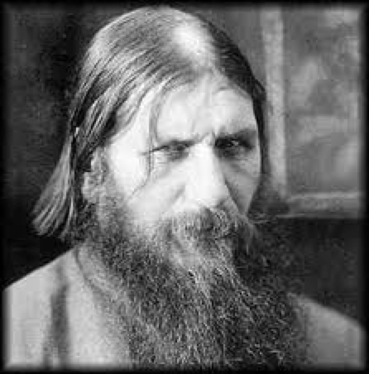
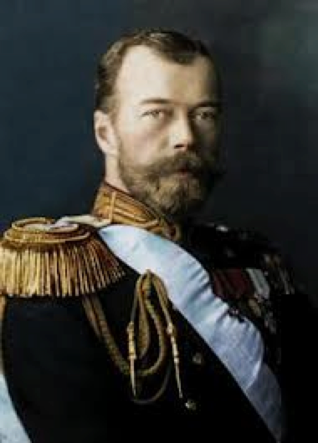
Russia and the War
the Rasputin problem
Sept 1915, Nicholas appoints himself commander-in-chief
The Brusilov Offensive
1917, Fifteen million men drafted from the countryside as replacements
Things fall apart at home

Slide 4
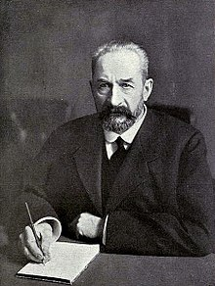
Aug. 1915 Tsar Nicholas II leaves the Russian heartland for the wartime front
June/July 1916 The Brusilov Offensive signifies the last major Russian military success of the war
Jan. 1917 The Mensheviks call for nation-wide revolution in Russia
Feb. 23, 1917 The February Revolution begins in Saint Petersburg on International--the Provisional Government under Prince Lvov is established as the ruling administrative power in the empire
Feb. 27, 1917 The Tsar orders the use of violence to quell civil unrest
Feb. 28, 1917 Soldiers mutiny against the government and the Petrograd Soviet
is formed
March 2, 1917 Tsar Nicholas II abdicates the throne

Slide 5
Apr. 4, 1917 Lenin publishes his April Theses condemning the Provisional Government for its incapacity to call an end to the "imperialist" war and calls for further revolution in Russia
June 1917 The June Offensive fails, further exacerbating Russian hardship caused by an increasingly costly war
Aug. 1917 General Lavr Kornilov attempts to seize control of power from the Provisional Government in what is deemed the Kornilov Affair
Oct. 24, 1917 Provisional forces move against the Bolsheviks in Saint Petersburg
Oct. 25, 1917 Bolshevik revolutionaries storm the Winter Palace and seize control of power from the Provisional Government
Mar. 3, 1918 The Treaty of Brest-Litovsk is signed, withdrawing Russia from the First World War, ceding much of the former territory of the Russian Empire
Mar. 1918 Russian Civil War rages until the Bolsheviks consolidate power, forming the Union of – Oct. 1922 Soviet Socialist Republics on December 30, 1922

Slide 6
Russian Revolutions 1917
See the Wikipedia expanded Bolshevik Rev. Chronology
Feb Revolution=Lvov Govt.=Const. Rev
assembly, press, etc.
Bolsheviks and other revolutionaries rush back to Russia
Summer 1917 Bolsheviks call for “Land, Peace, and Bread”
Summer 1917 Army on the fronts disintegrates
People’s Councils (Soviets) gain power
Govt moves coalition center leftward, eventually mostly Menshevik and Social Revolutionary (under Kerensky)
October Bolsheviks seize power
Civil War results almost immediately: Reds vs. the Whites

Slide 7
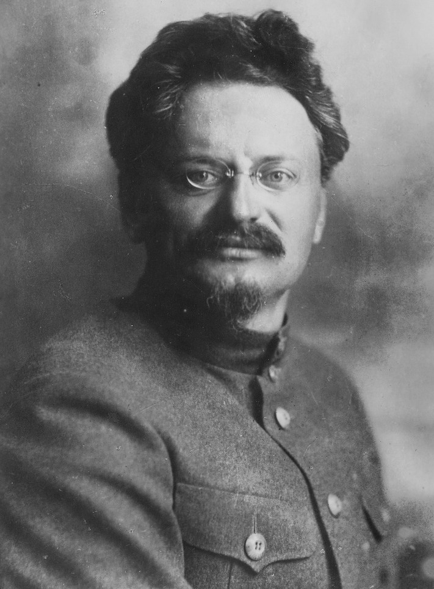
Revolutionaries return Home:
LaND, PEACE, AND BREAD

Slide 8
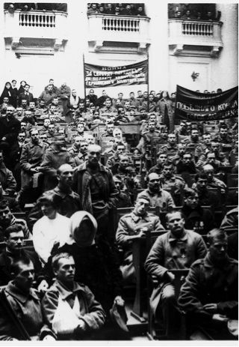
Petrograd Soviet

Slide 9
Bolshevik Seizure of Power
October Revolution = Nov. 7, 1917
Slogans: All Power to the Soviets (meaning the councils, including the Petrograd Council)
Bolsheviks outmaneuver the Left SRs, the SRs, the Mensheviks, and others, Nov. 1917 to 1919—one-party rule from 1919
Creation of the Extraordinary Commission, the CheKa, which enforced Bolshevik supremacy internally
With the onset of the Civil War in Feb. 1918, the Bolsheviks take charge of the military campaigns against the Whites, via the creation of the Red Army by Trotsky.

Slide 10
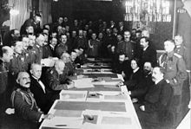
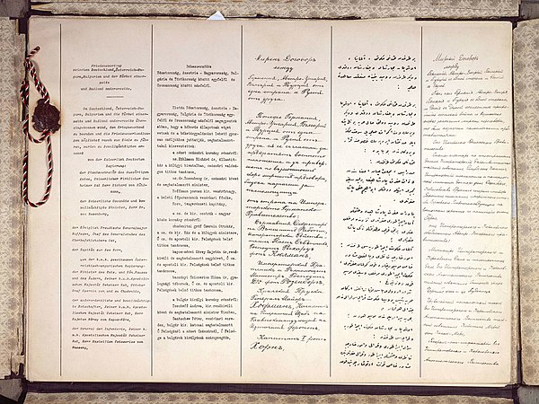
Treaty of Brest-Litovsk
Germans pour on the pressure on the Eastern Front
Bolsheviks agree to ceasefire, or Armistice in December 1917
Lev Kamenev and then Trotsky come to Brest-Litovsk and preach: NO PEACE, NO WAR
Germans restart offensive operations
Bolsheviks buy time by giving away a third of European Russia
Treaty of Brest-Litovsk signed on March 3, 1918

