Slide 1
The Far East

Slide 2
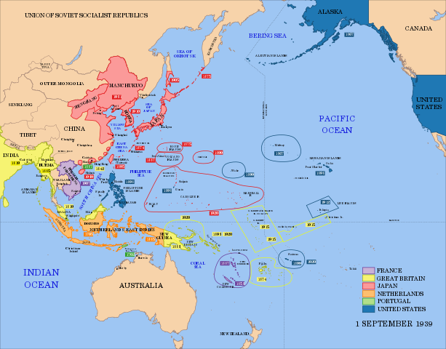
The Coming of World War II in the Far East

Slide 3
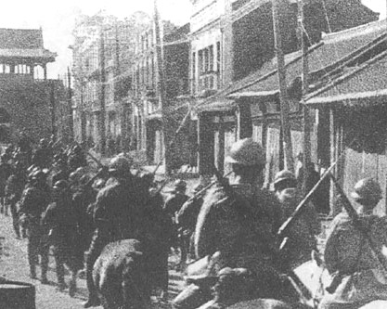
Japan
Japan fought in World War I on the side of the Allies
Postwar, the politics of the country aimed increasingly at expanding in China and the Pacific
Bellicose politicians, generals, and admirals called the new empire The Greater East Asian Co-Prosperity Sphere
In 1931, Japan invaded northwest China, called Manchuria, and attached it to the empire, calling it Manchukuo
This and other conquests brought Japan to the borders of the Soviet Union, in addition to taking a part of China
Japanese troops entering a city in Manchuria, 1931

Slide 4
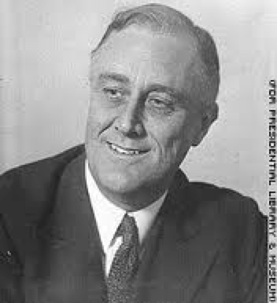
FDR--Naval and Economic Pressure on Japan
1935 on the eve of the naval disarmament conference
1937 FDR contemplates a blockade of Japan in light of renewed Japanese hostilities with China
1938 New joint Army-Navy plan adopted in the case Japan should attack without warning
Multiple movements of fleet elements to Far East 1939. Whole fleet base moved to Pearl Harbor, October 1939(British are urging that the Fleet base itself in Singapore)
The War Plans Division: Victory Plan... for Europe
Eventually, the US sends missions to tempt the Japanese, freezes Japanese assets, etc.

Slide 5
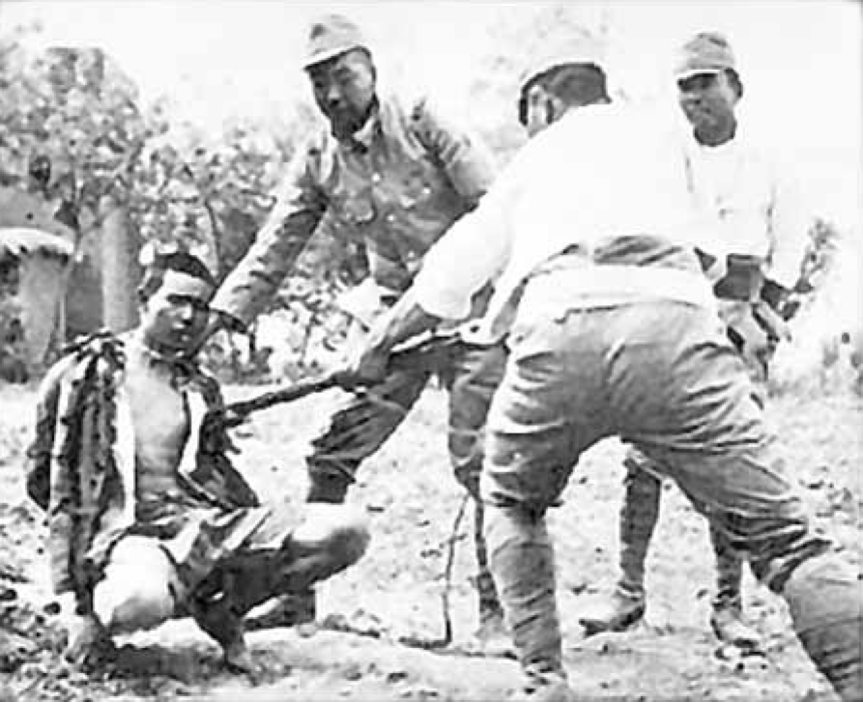
World War II Starts Early for Japan and China
1937--Marco Polo Bridge Incident leads to Japanese invasion of China.
Dec. 1937--"Rape of Nanjing"--350,009 Chinese killed, 100,000 women raped.
Dec. 1937--Japan sinks the USS Panay and three Standard Oil Tankers off of Nanjing.
Nov 1938--Japan captures Canton.

Slide 6
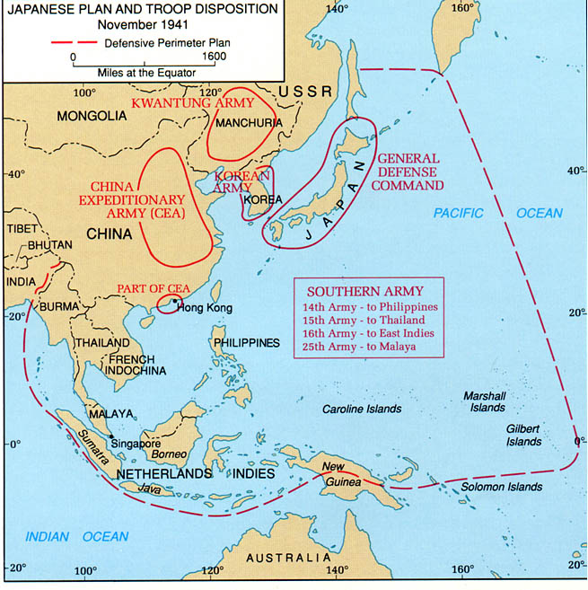
Japan in China, 1941

Slide 7
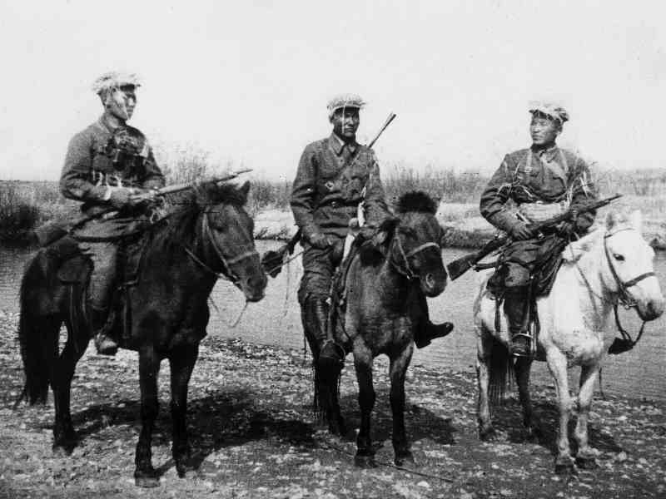
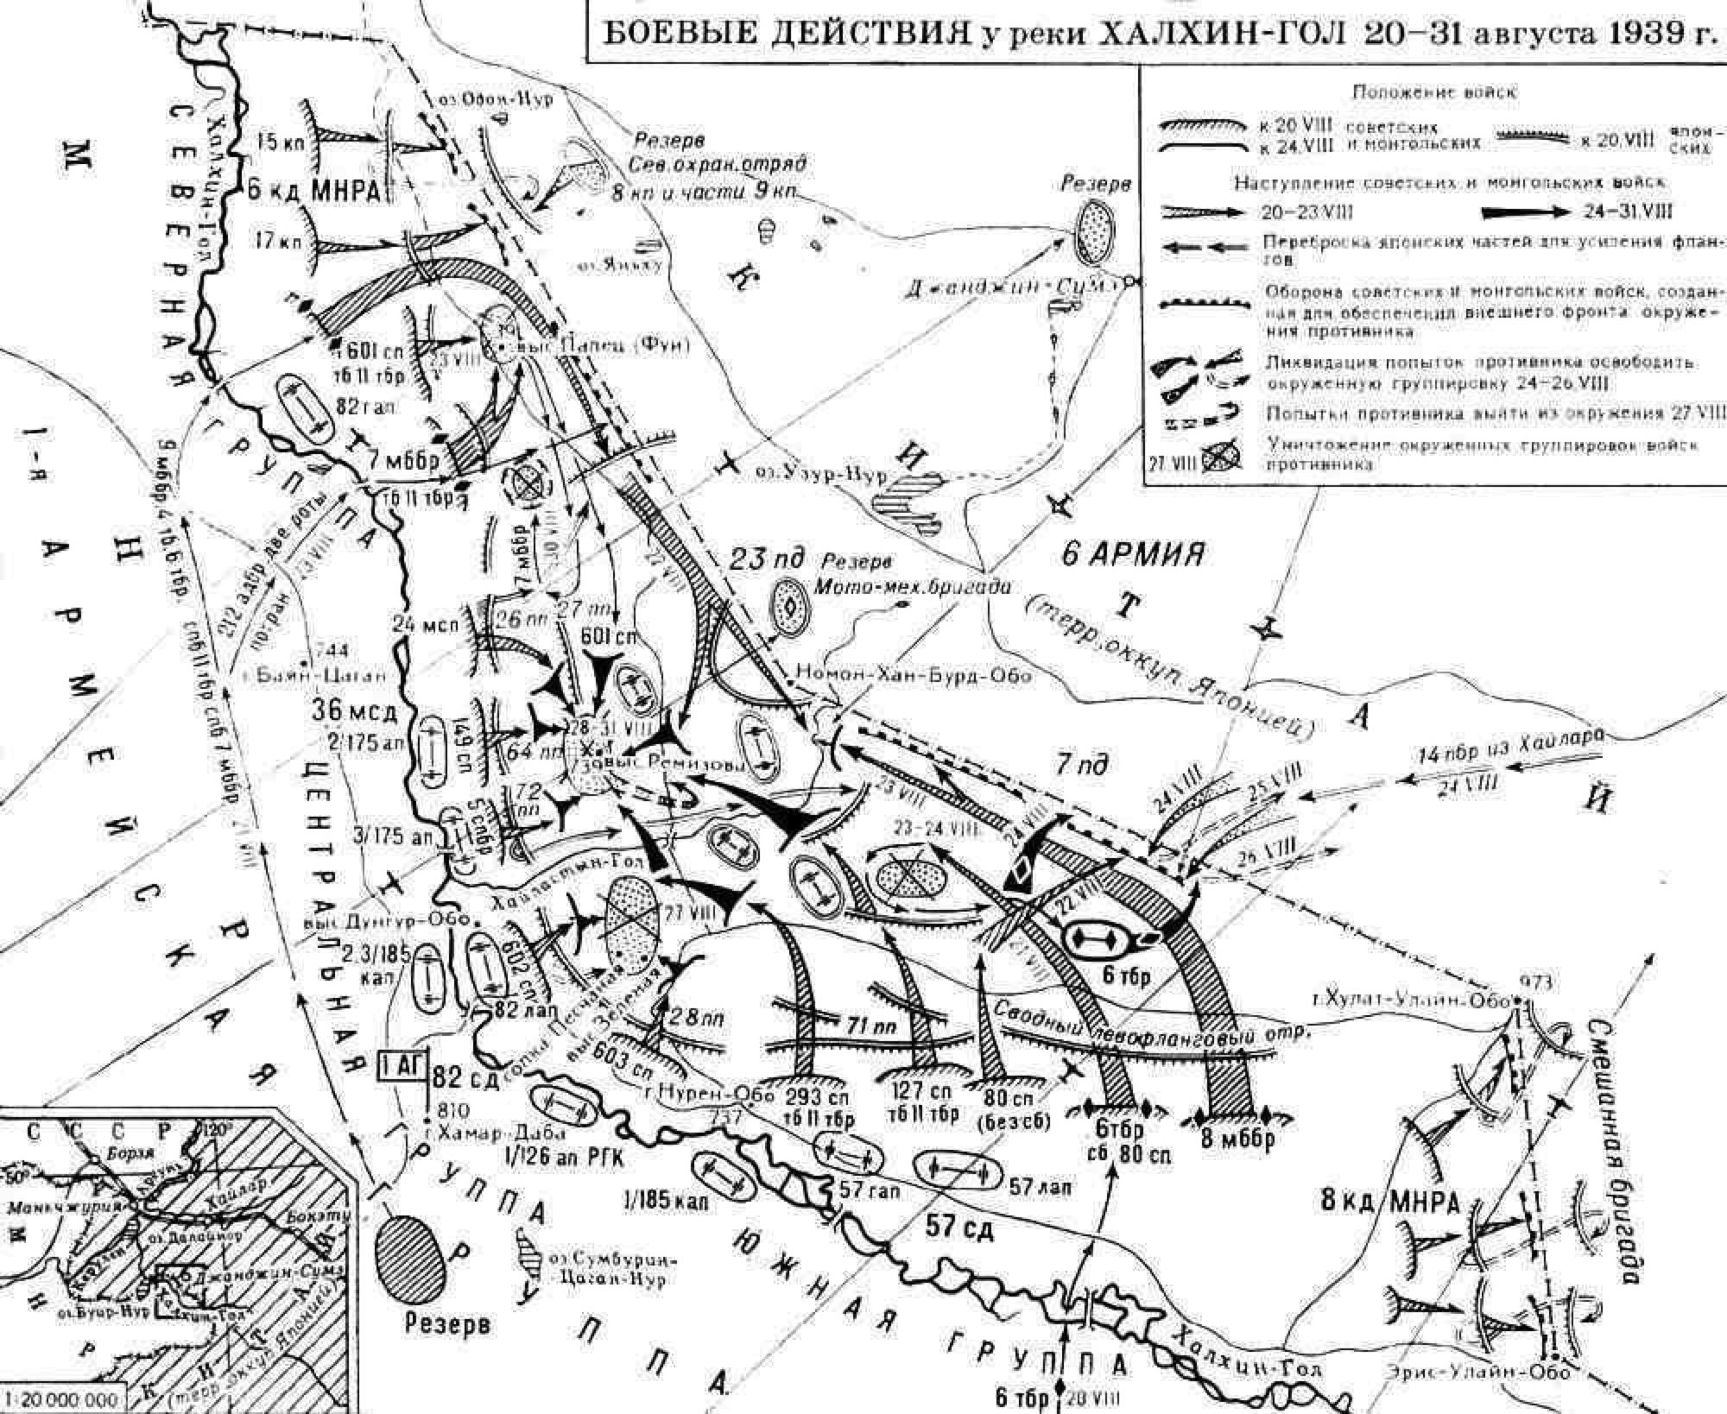
Soviet-Japanese Border conflict, 1939
from the Nomonhan Incident, May 39
to Khalkhin Gol, Aug. 39

