Slide 1
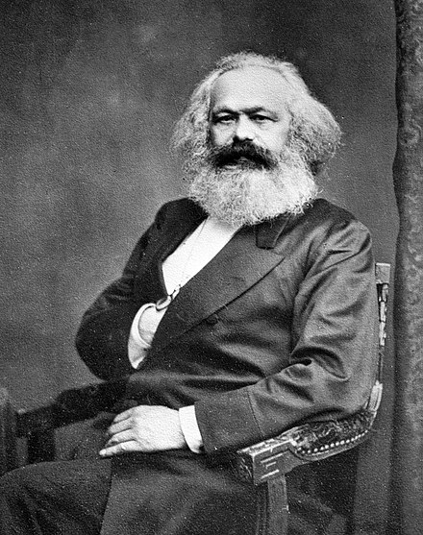

Karl Marx and The Communist Manifesto

Slide 2
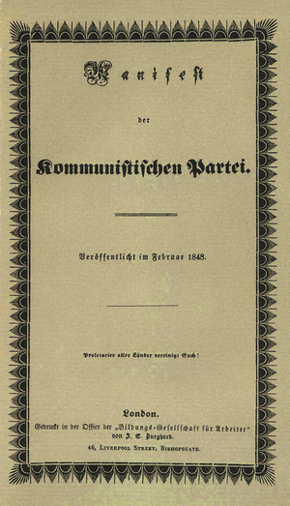
The Communist Manifesto,
February 1848

Slide 3
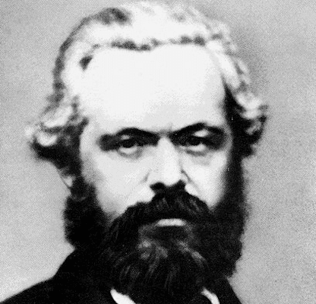
Some life facts
Born in Trier , Germany, 1817
Died in London, 1883
Besides the Manifesto, he was the author of the highly influential book, Capital
He was tone of the founders of communism, a particular form of socialism

Slide 4
Marx on History: Dialectical Materialism
Materialism: Land, Labor, and Wealth
Property as the De-Humanizing Element
Revolution as the End of Capitalism and the Beginning of the Final Historical Age

Slide 5
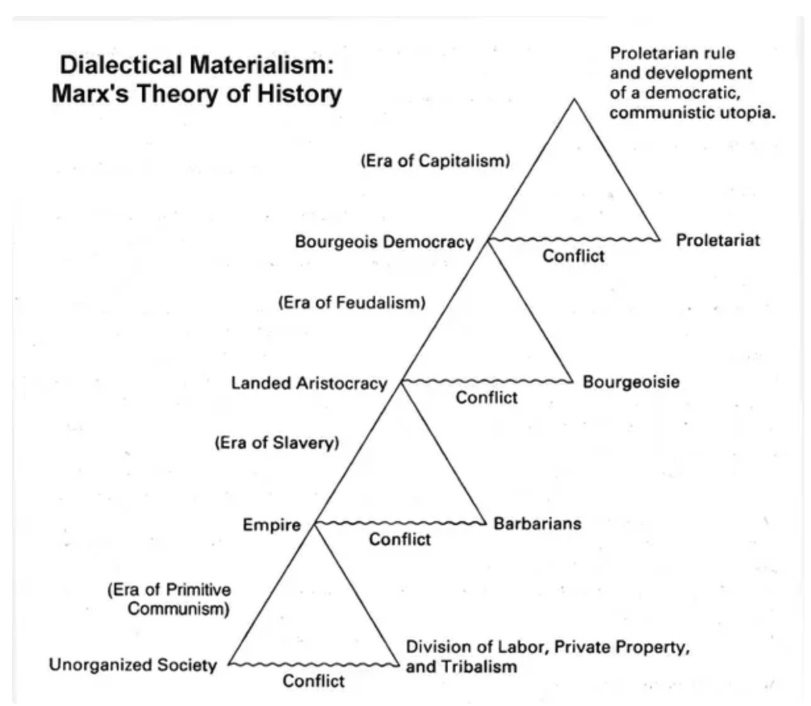
The Historical Dialectic

Slide 6
Results:
Put into practice in the twentieth century, Marxist theory created the Soviet Union and many other communist regimes. The death toll of these regimes in killing their own people in trying to reach the Marxist Utopia would amount to over a hundred million human beings.

