Slide 1
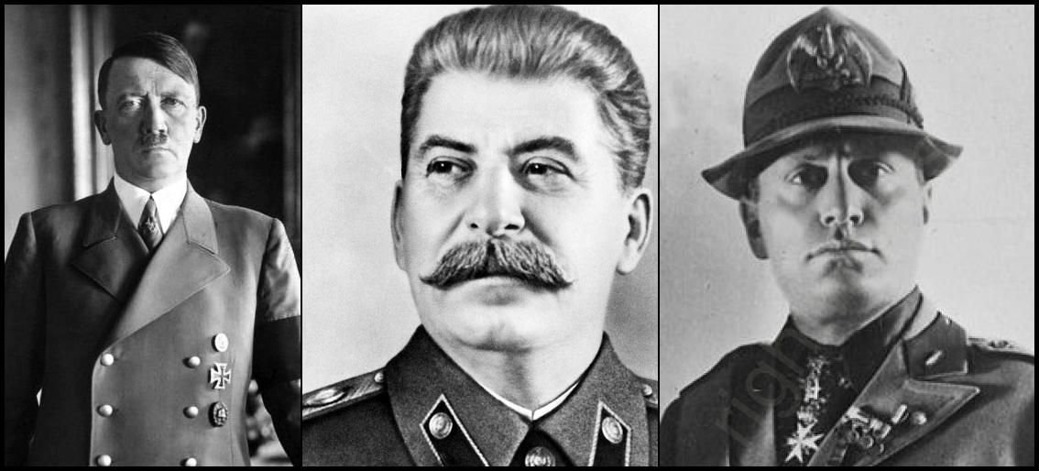

The Totalitarians consolidate power
Hunt Tooley
Hist 143

Slide 2
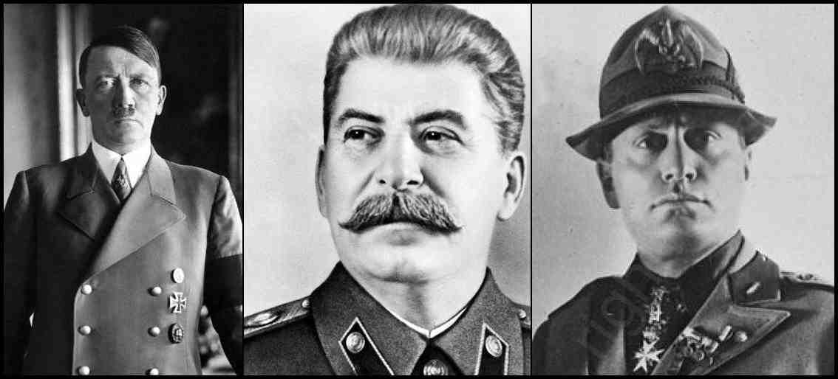
Stalin, Mussolini, and Hitler
 | Russia | Italy | Germany
 | Stalin (Djugashvili) born, 1878 | Mussolini born, 1883 | Hitler born, 1889
1919 | Stalin helps in setting up the totalitarian state | Mussolini founds first element of the Fascist movement | Hitler joins DAP and later reorganizes as NSDAP=the Nazi Party
1922 |  | Mussolini takes power as Prime Min.
1923 |  |  | Failed Beer Hall Putsch in Munich
1924 | Lenin dies; Stalin starts maneuvering |  | Hitler in house arrest
1925 | Stalin prepares to oust his rivals for full power | Mussolini begins to set up a totalitarian, 1-party state | Hitler published Mein Kampf

Slide 3
Stalin, Mussolini, and Hitler
 | Russia | Italy | Germany
1927 | Stalin triumphs over rivals. Forced collectivization. | Authoritarian police state begins, to be completed in 1929. | "We are socialists, we are enemies of today’s capitalistic economic system for the exploitation of the economically weak, with its unfair salaries, with its unseemly evaluation of a human being according to wealth and property instead of responsibility and performance, and we are determined to destroy this system under all conditions.”
1931 | Beginning of created famine in Ukraine, Belorus, etc. | beginning of reconciliation with Church (1929-1933) | Depression hit Germany hard in 1930, deepens after that. Hitler begins to win in local and national elections
1933 | Stalin prepares idea of popular front politics in We. Europe for 1934 |  | Hitler appointed Chancellor. January 30, 1933
1934 | Murder of Kirov; beginning of Purges | Muss. opposition to Hitler | Consolidation of Nazi Power and Night of Long Knives

Slide 4
Stalin, Mussolini, and Hitler
 | Russia | Italy | Germany
1935 |  | Invasion of Ethiopia | Nuremberg Laws; Saarland Plebiscite
1936 | Intervention in Spanish Civ. War--leftist side | Intervention in Spanish Civ. War--nationalist side | Intervention in Spanish Civ. War--nationalist side; signing of anti-Comintern Pact with Japan
1937 | Most intensive time of Purges begins | Italy signs on with Germany and Japan in anti-Comintern Pact
1938 |  | Munich Crisis | Anschluss with Austria Munich Crisis
1939 | Non-Aggression Pact with Germany; invasion of Poland, Sept. 17 | Italy stays out of war | Non-Aggression Pact with Soviet Union; invasion of Poland Sept. 1

Slide 5
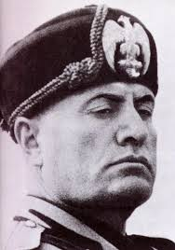
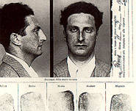
Mussolini was...
a statist, a socialist, and a
nationalist
He invented the whole totalitarian ideology and much
in the trappings of the totalitarian movements.
But he was not the killer that Stalin and
Hitler were. His squadristi killed several
hundred people in street fights and murders
over the years. But in the whole period
of Fascist Italy up until 1940, only about 10 individuals
were executed for political crimes.
Example: Writer Carlo Levi was an outspoken critic
of the Fascist regime. He was arrested and sentence to...
three years of “exile” in Southern Italy.

Slide 6
the most murderous of the three totalitarians was Stalin
After widespread arrests and murders, in 1932, beginning of the artificial famine in Ukraine, Belorus, and other areas: some 9 or 10 million dead at least.
1934 The Great Purges
1935-38 Some 6 million from many ethnic groups deported, moved, killed (about 1.5 million)
Intentional starvation, Civil War (Stalin was party Gen.Sec.)
Show trials and expansion of GuLag system, late twenties.
Forced collectivization and war against the kulaks

