Slide 1
Ireland After the Normans
Hunt Tooley
The Irish Sea

Slide 2
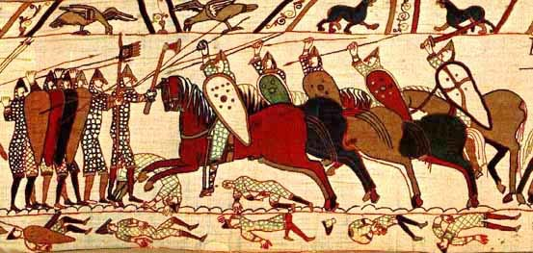
In 1066, the Normans (a ruling class of Scandinavian/Norse origin in northwestern France) took advantage of Saxon England’s royal succession struggles to invade England successfully, defeating the Saxon English at the Battle of Hastings and installing a Norman king and ruling elite.

Slide 3
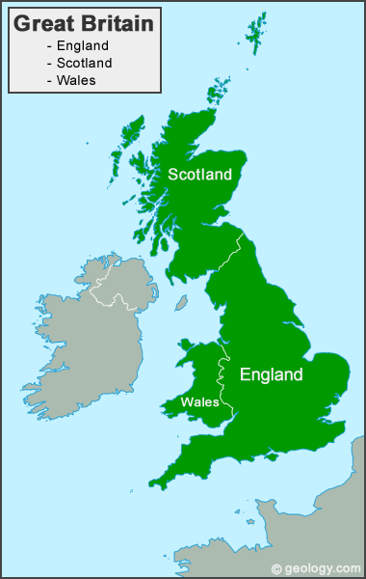
The Norman Duke, William the Conqueror, became the first Norman king of England. Looking toward Ireland, he began long-range plans to invade it as well.

Slide 4
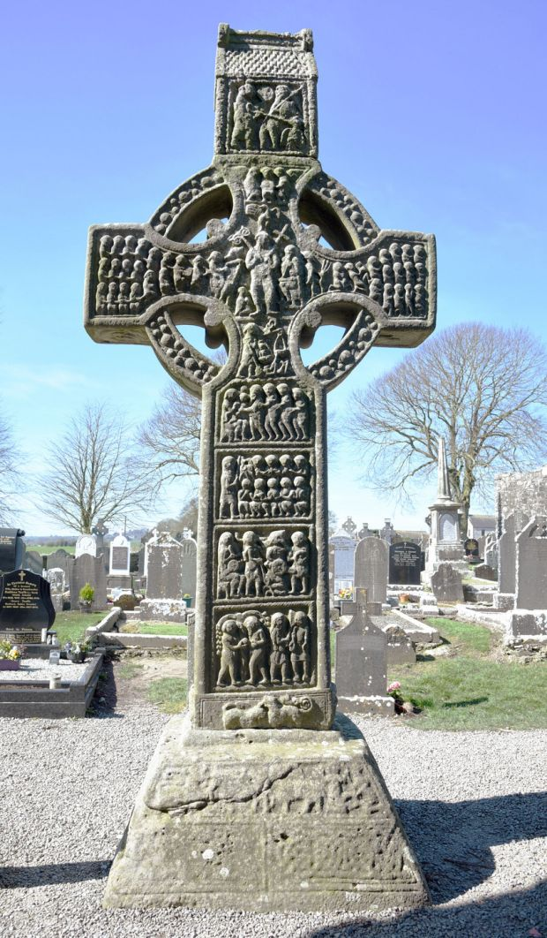
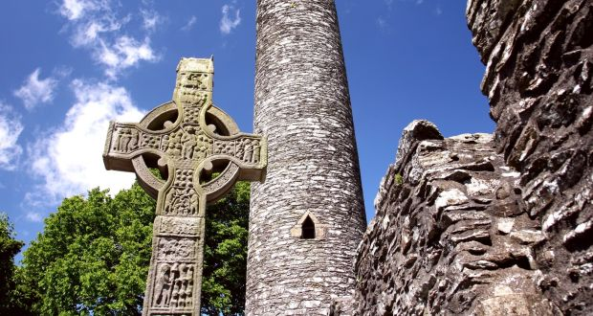
Norman kings were spurred on by the English Catholic Church leaders. All were Catholics, but the Irish Church had always maintained independence, and had not accepted the centralizing Roman church reforms of the 11th century. It was more relaxed and devoted to good works than the highly politicized Catholic Church of England the Continent.
Left: Muiredach’s cross at Monasterboice, right

Slide 5
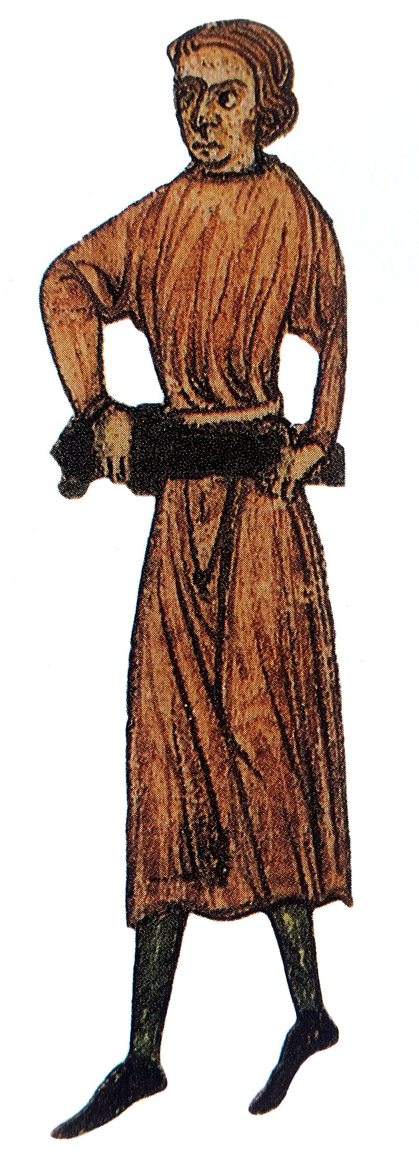
1169, a group of English mercenaries led by Earl Richard de Clare (“Strong Bow”) and sanctioned by English King Henry II invaded Ireland, deposing Irish ”kings” and beginning a period of 800 years of English (later British) off-and-on “rule”

Slide 6
Yet Norman English rule never really covered the whole country, remaining strongest in east central Ireland, centering on the port city Dublin. It grew weaker from the time of the 1169 invasion until the rule of Henry VIII in the early sixteenth century.

Slide 7
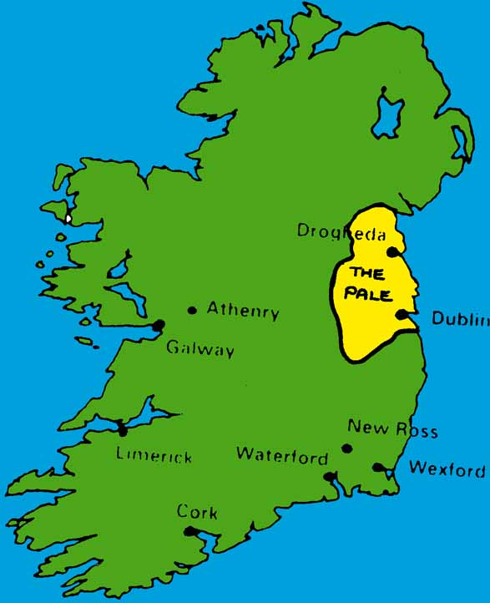
Between the thirteenth and sixteenth centuries, English rule was mostly notional in Ireland, except for Dublin and ”the Pale,” a small region defensible by a line of ditches and earthen ramparts

Slide 8
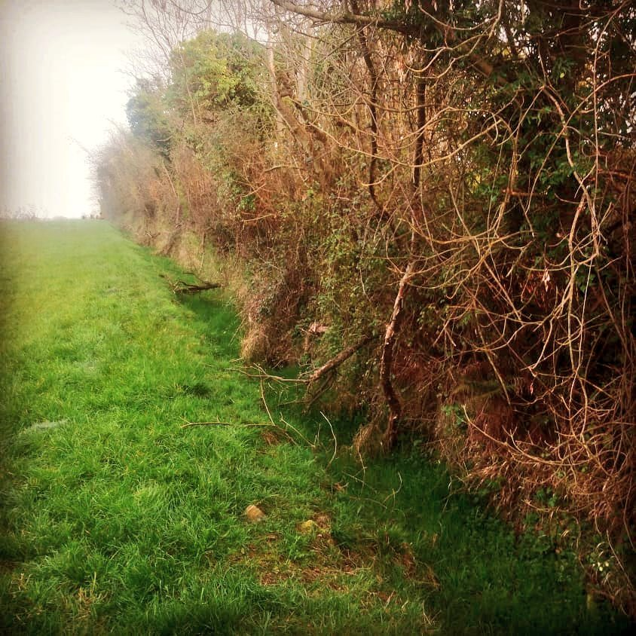
Remains of the earthworks mostly surrounding the Pale

Slide 9
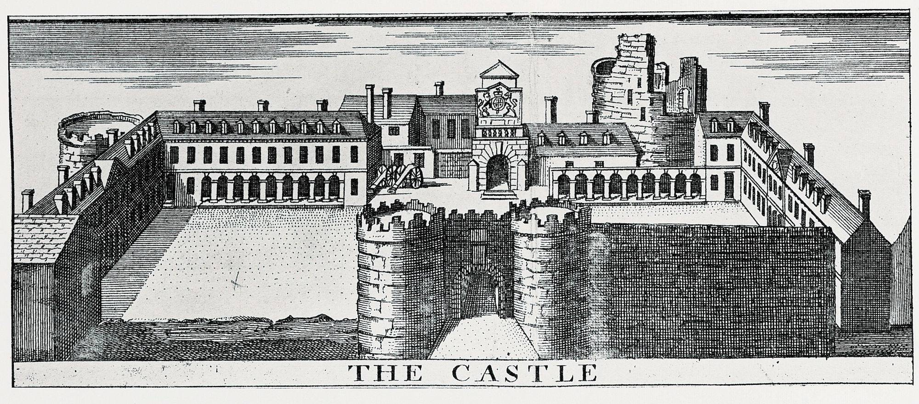
Construction on Dublin Castle started in 1204. It was the seat of English authority until 1922, when Ireland became independent.

Slide 10
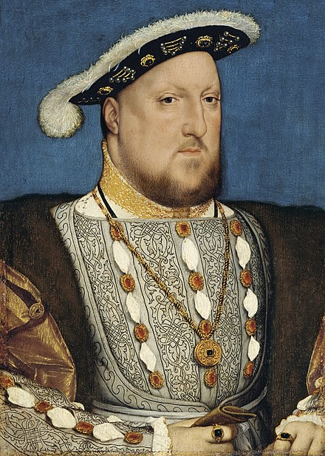
The expansionist English King Henry VIII saw opportunity as confused regional infighting took place in Ireland in the early sixteenth century. He launched a ruthless invasion in 1536 which would outlive him, finally ending in the late seventeenth century with the full subjugation of Ireland, the placement of English landowners ruling over “plantations,” and pure colonial status. Many regard Ireland as the first colony of the “British Empire.”

Slide 11
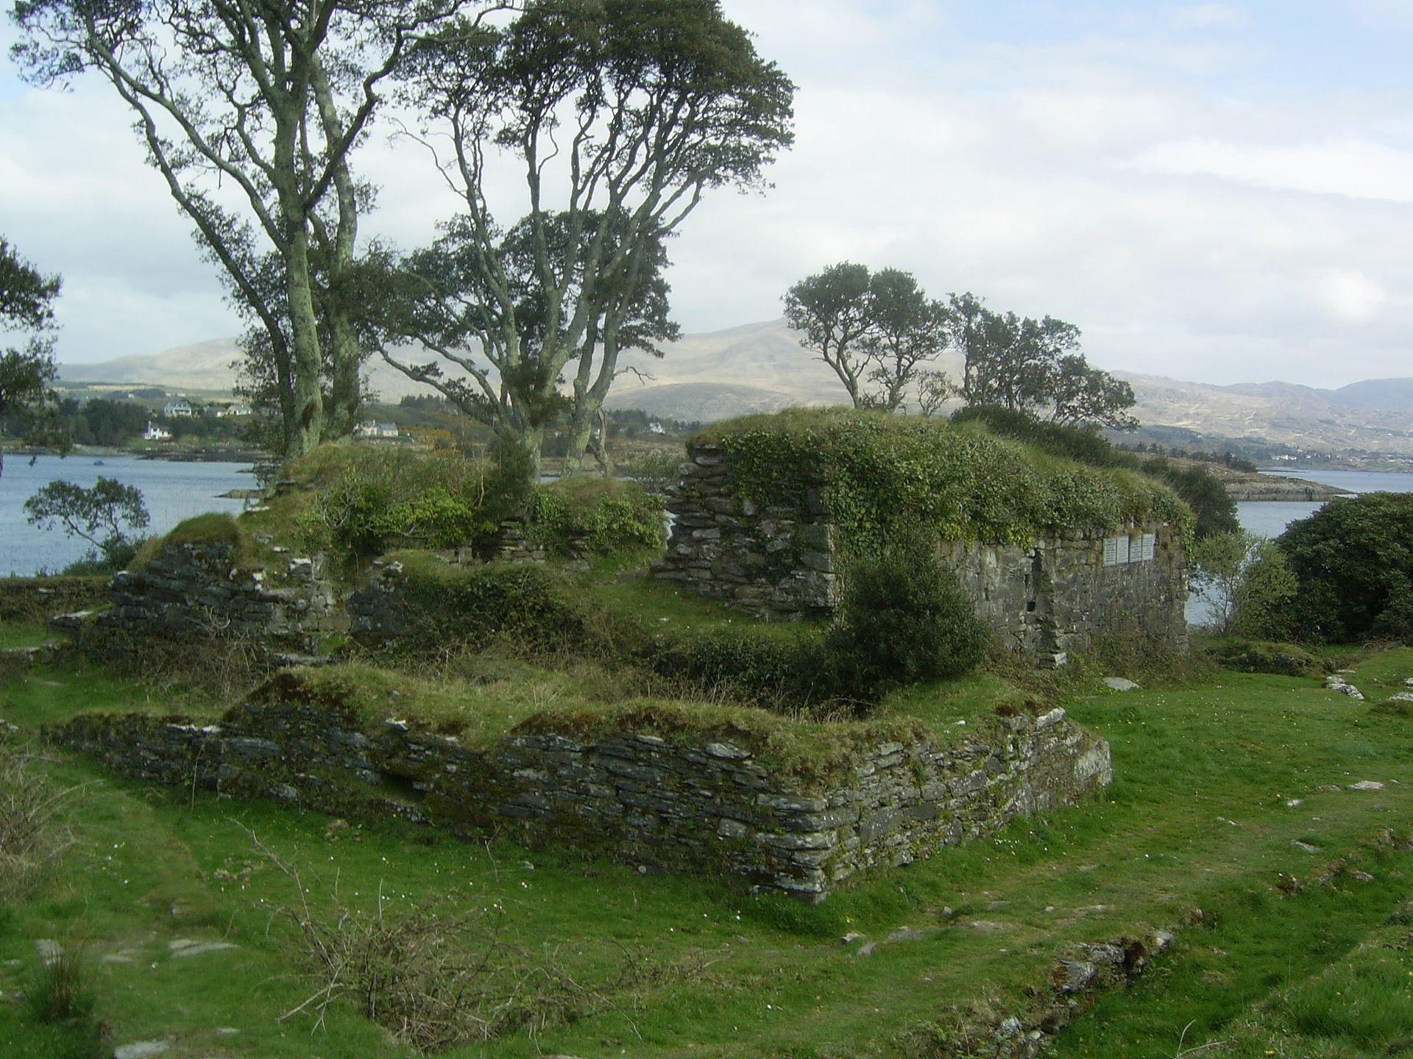
The 143 Irish defenders held off 5,000 English troops and a gunship for 13 days, but the ship finally managed to breech the walls by cannon fire, and English troops rushed in to a brutal melee inside. Fifty-three surviving Irish surrendered and were immediately taken to the square of neighboring town and executed.
As just one example of these wars, in 1602, Dunboy Castle, seat of the local O’Sullivan rulers, close to the southwest edge of Ireland, was besieged to put down the O’Sullivan rebellion.

Slide 12
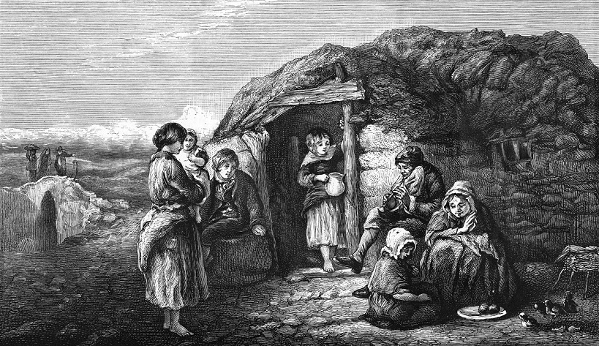
Intermittent invasions even included a brutal war against civilians carried out during the Puritan leader of England, Oliver Cromwell, from 1649 to 1653. At last the old leading families were killed off or fled. English rule was fully entrenched, and the majority of ordinary farmers and townspeople were plunged into the poverty.

Slide 13
A New Ruling Aristocracy—The Anglo Irish (aka, the Protestant Ascendancy)
From the early 17th century to the early 20th, Britain imposed on Ireland a new landed aristocracy by giving confiscated Irish land to middling level English achievers (naval an merchant families, etc.).
Most of them were Anglicans religiously, but some married into the remnant of the Irish Gaelic upper class, and some became Catholic.
Many these Anglo Irish eventually identified with the interests of Ireland, but most of them seem to have exploited Ireland in a kind of new feudalism, via English laws (esp. land tenure/religious restrictions.
And they took advantage of continuing support from London to found lucrative businesses, such as Guinness brewers, Jameson’s Whiskey, the whole railroad system, and much more.

