Slide 1
Some Physical Geography of the Irish Sea Region
Hist 250
The Irish Sea

Slide 2
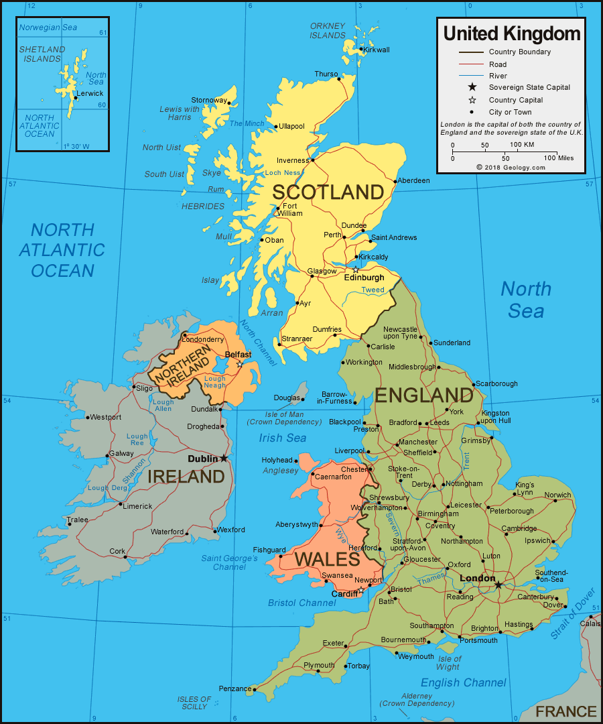

Slide 3
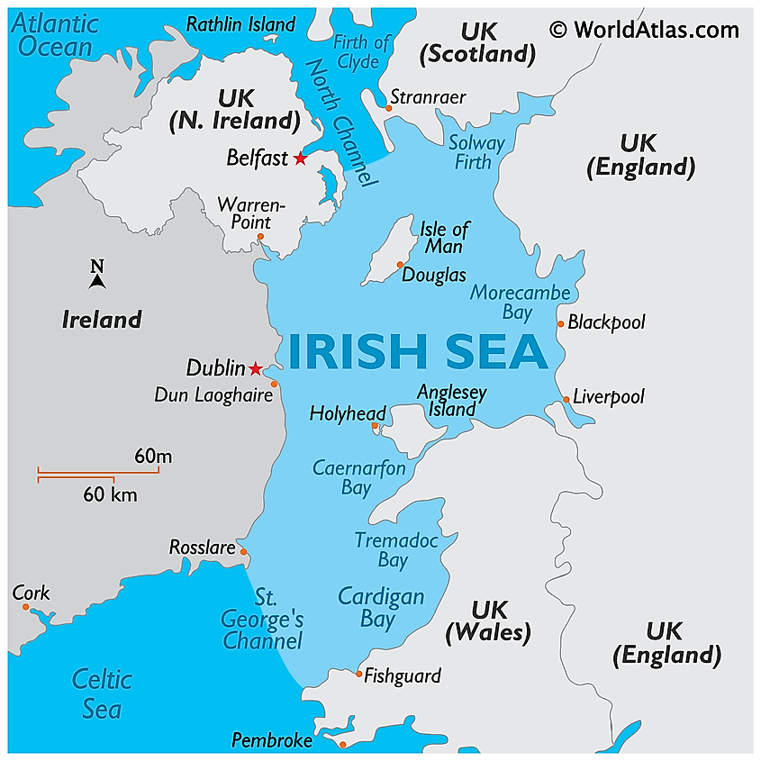

Slide 4
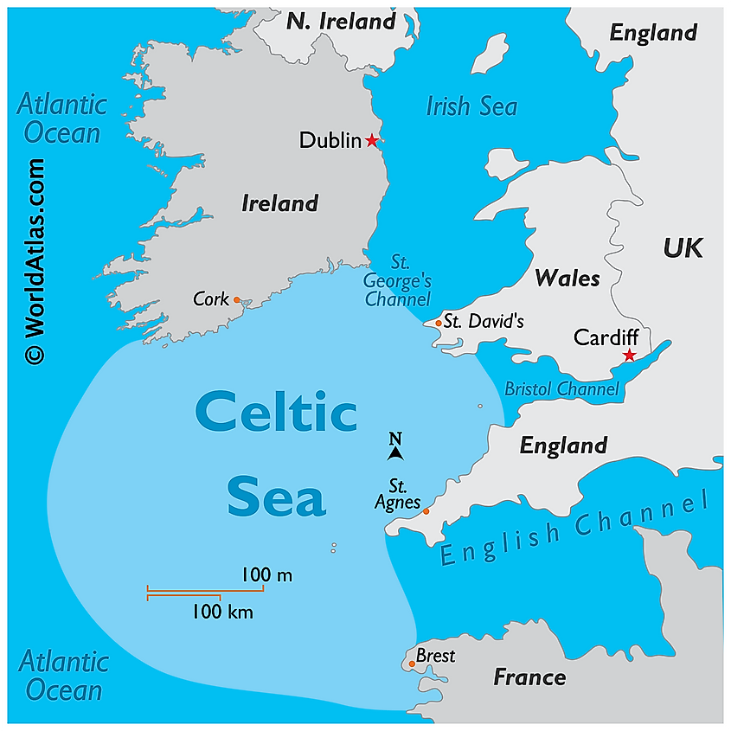

Slide 5
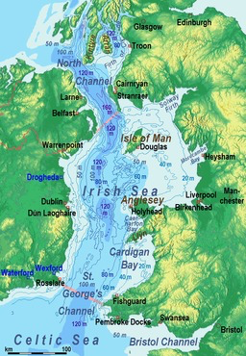
Irish Sea
From the North Channel to St. George’s Channel = about 300 miles

Slide 6
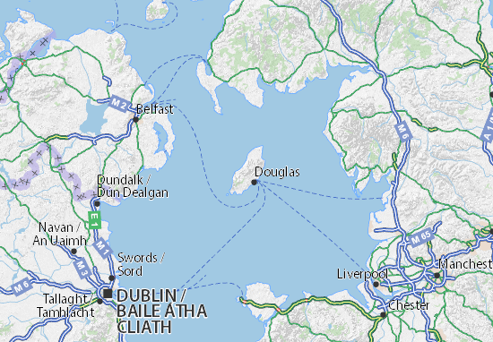
Northern Irish Sea
Isle of Man
to Dublin
= 94 miles
Belfast to Stanraer = about 160 miles

Slide 7
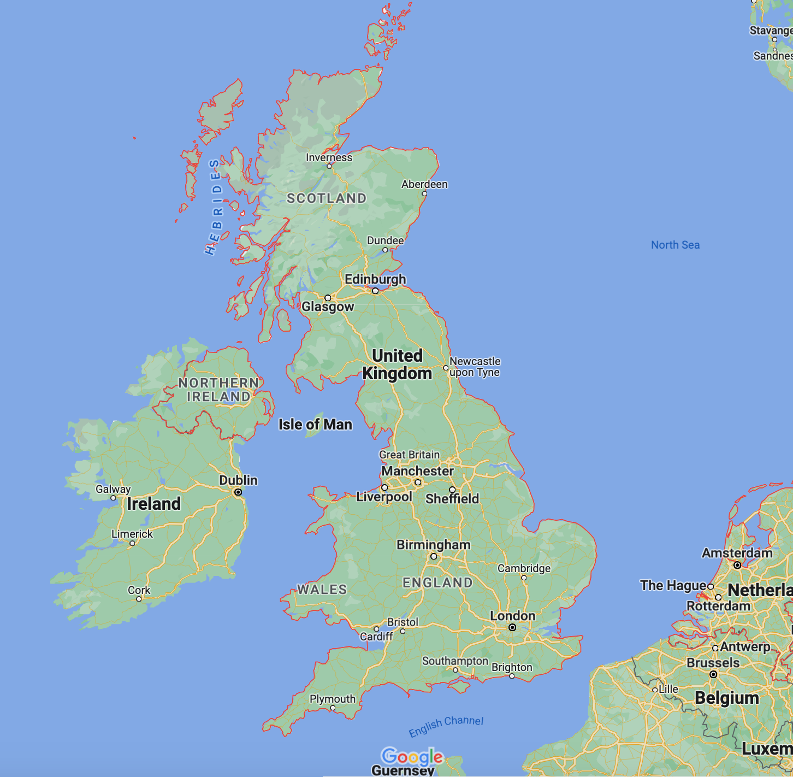
British Isles
England, Scotland, Wales from top to bottom = about 650 miles
Max. width = about 120 miles
From Glasgow to Edinburgh = 45 miles

Slide 8
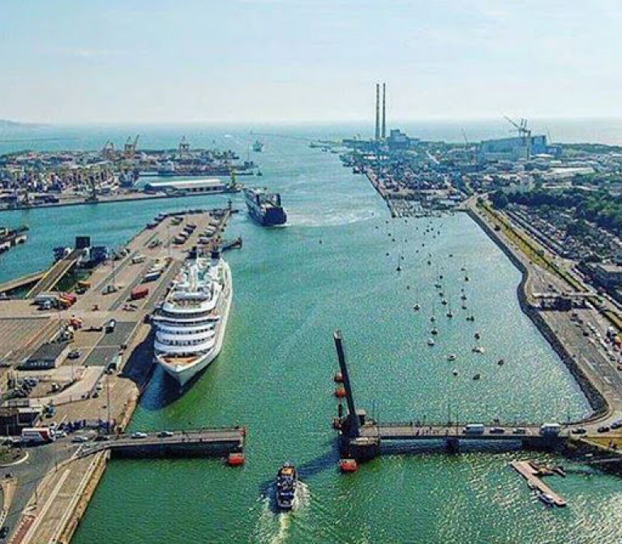
Port of Dublin

Slide 9
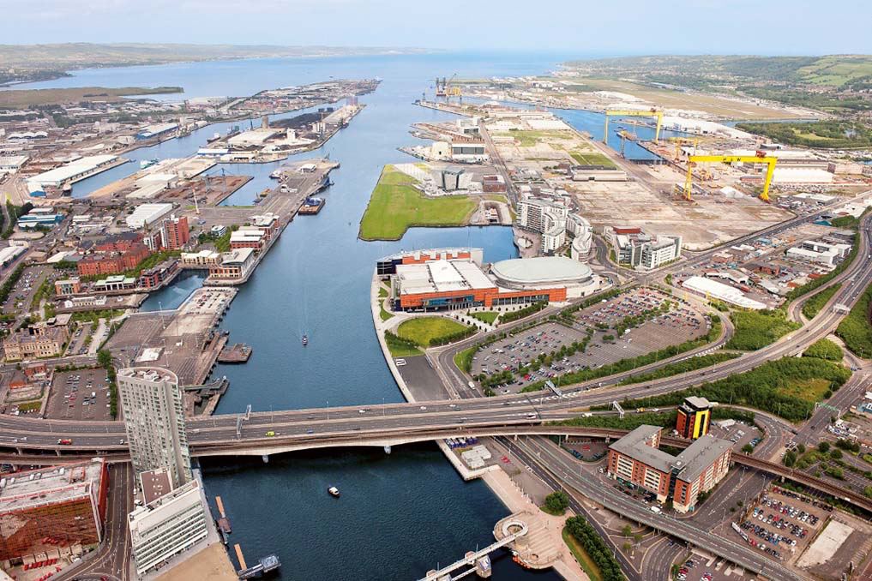
Port of Belfast

Slide 10
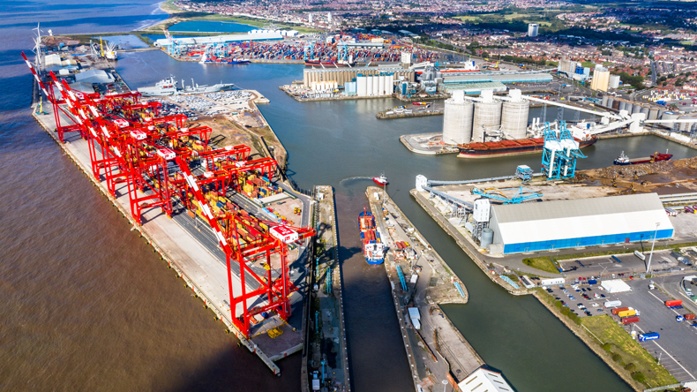
Port of Liverpool

Slide 11
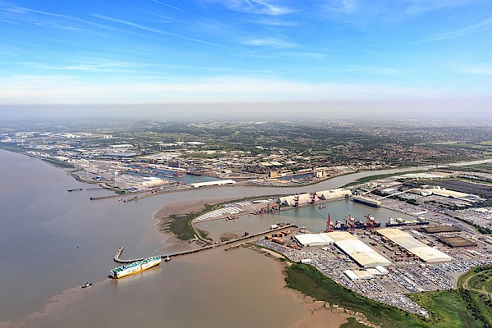
Port of Bristol

Slide 12
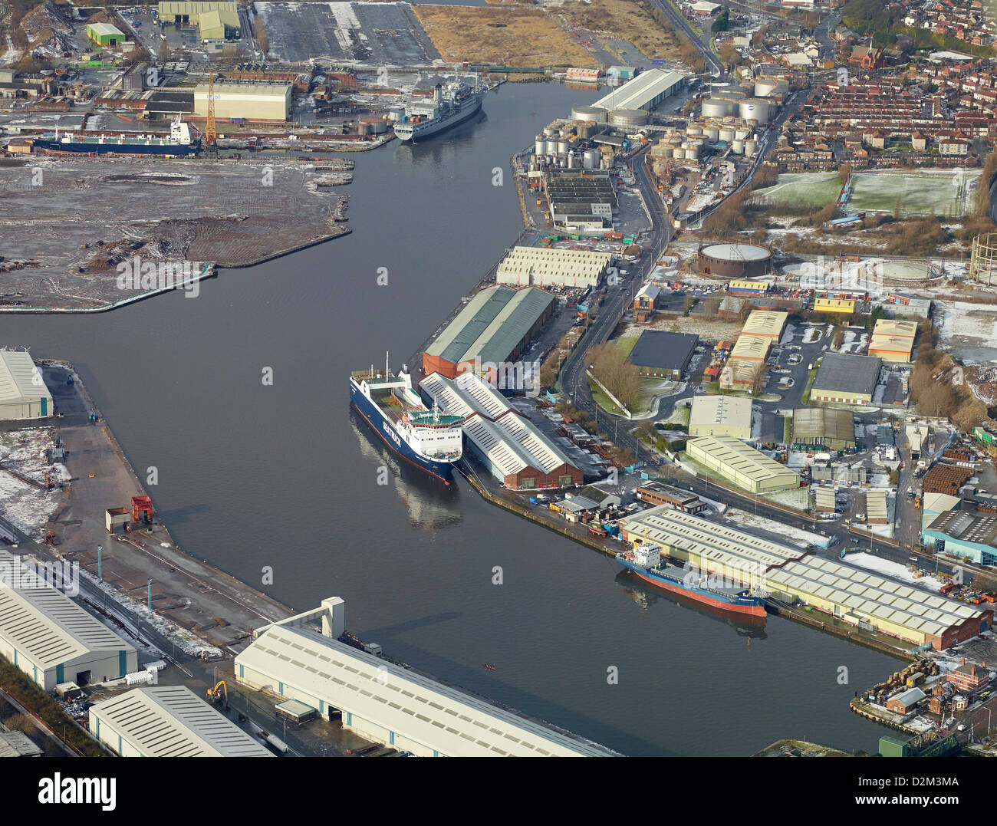
Port of Birkenhead

Slide 13
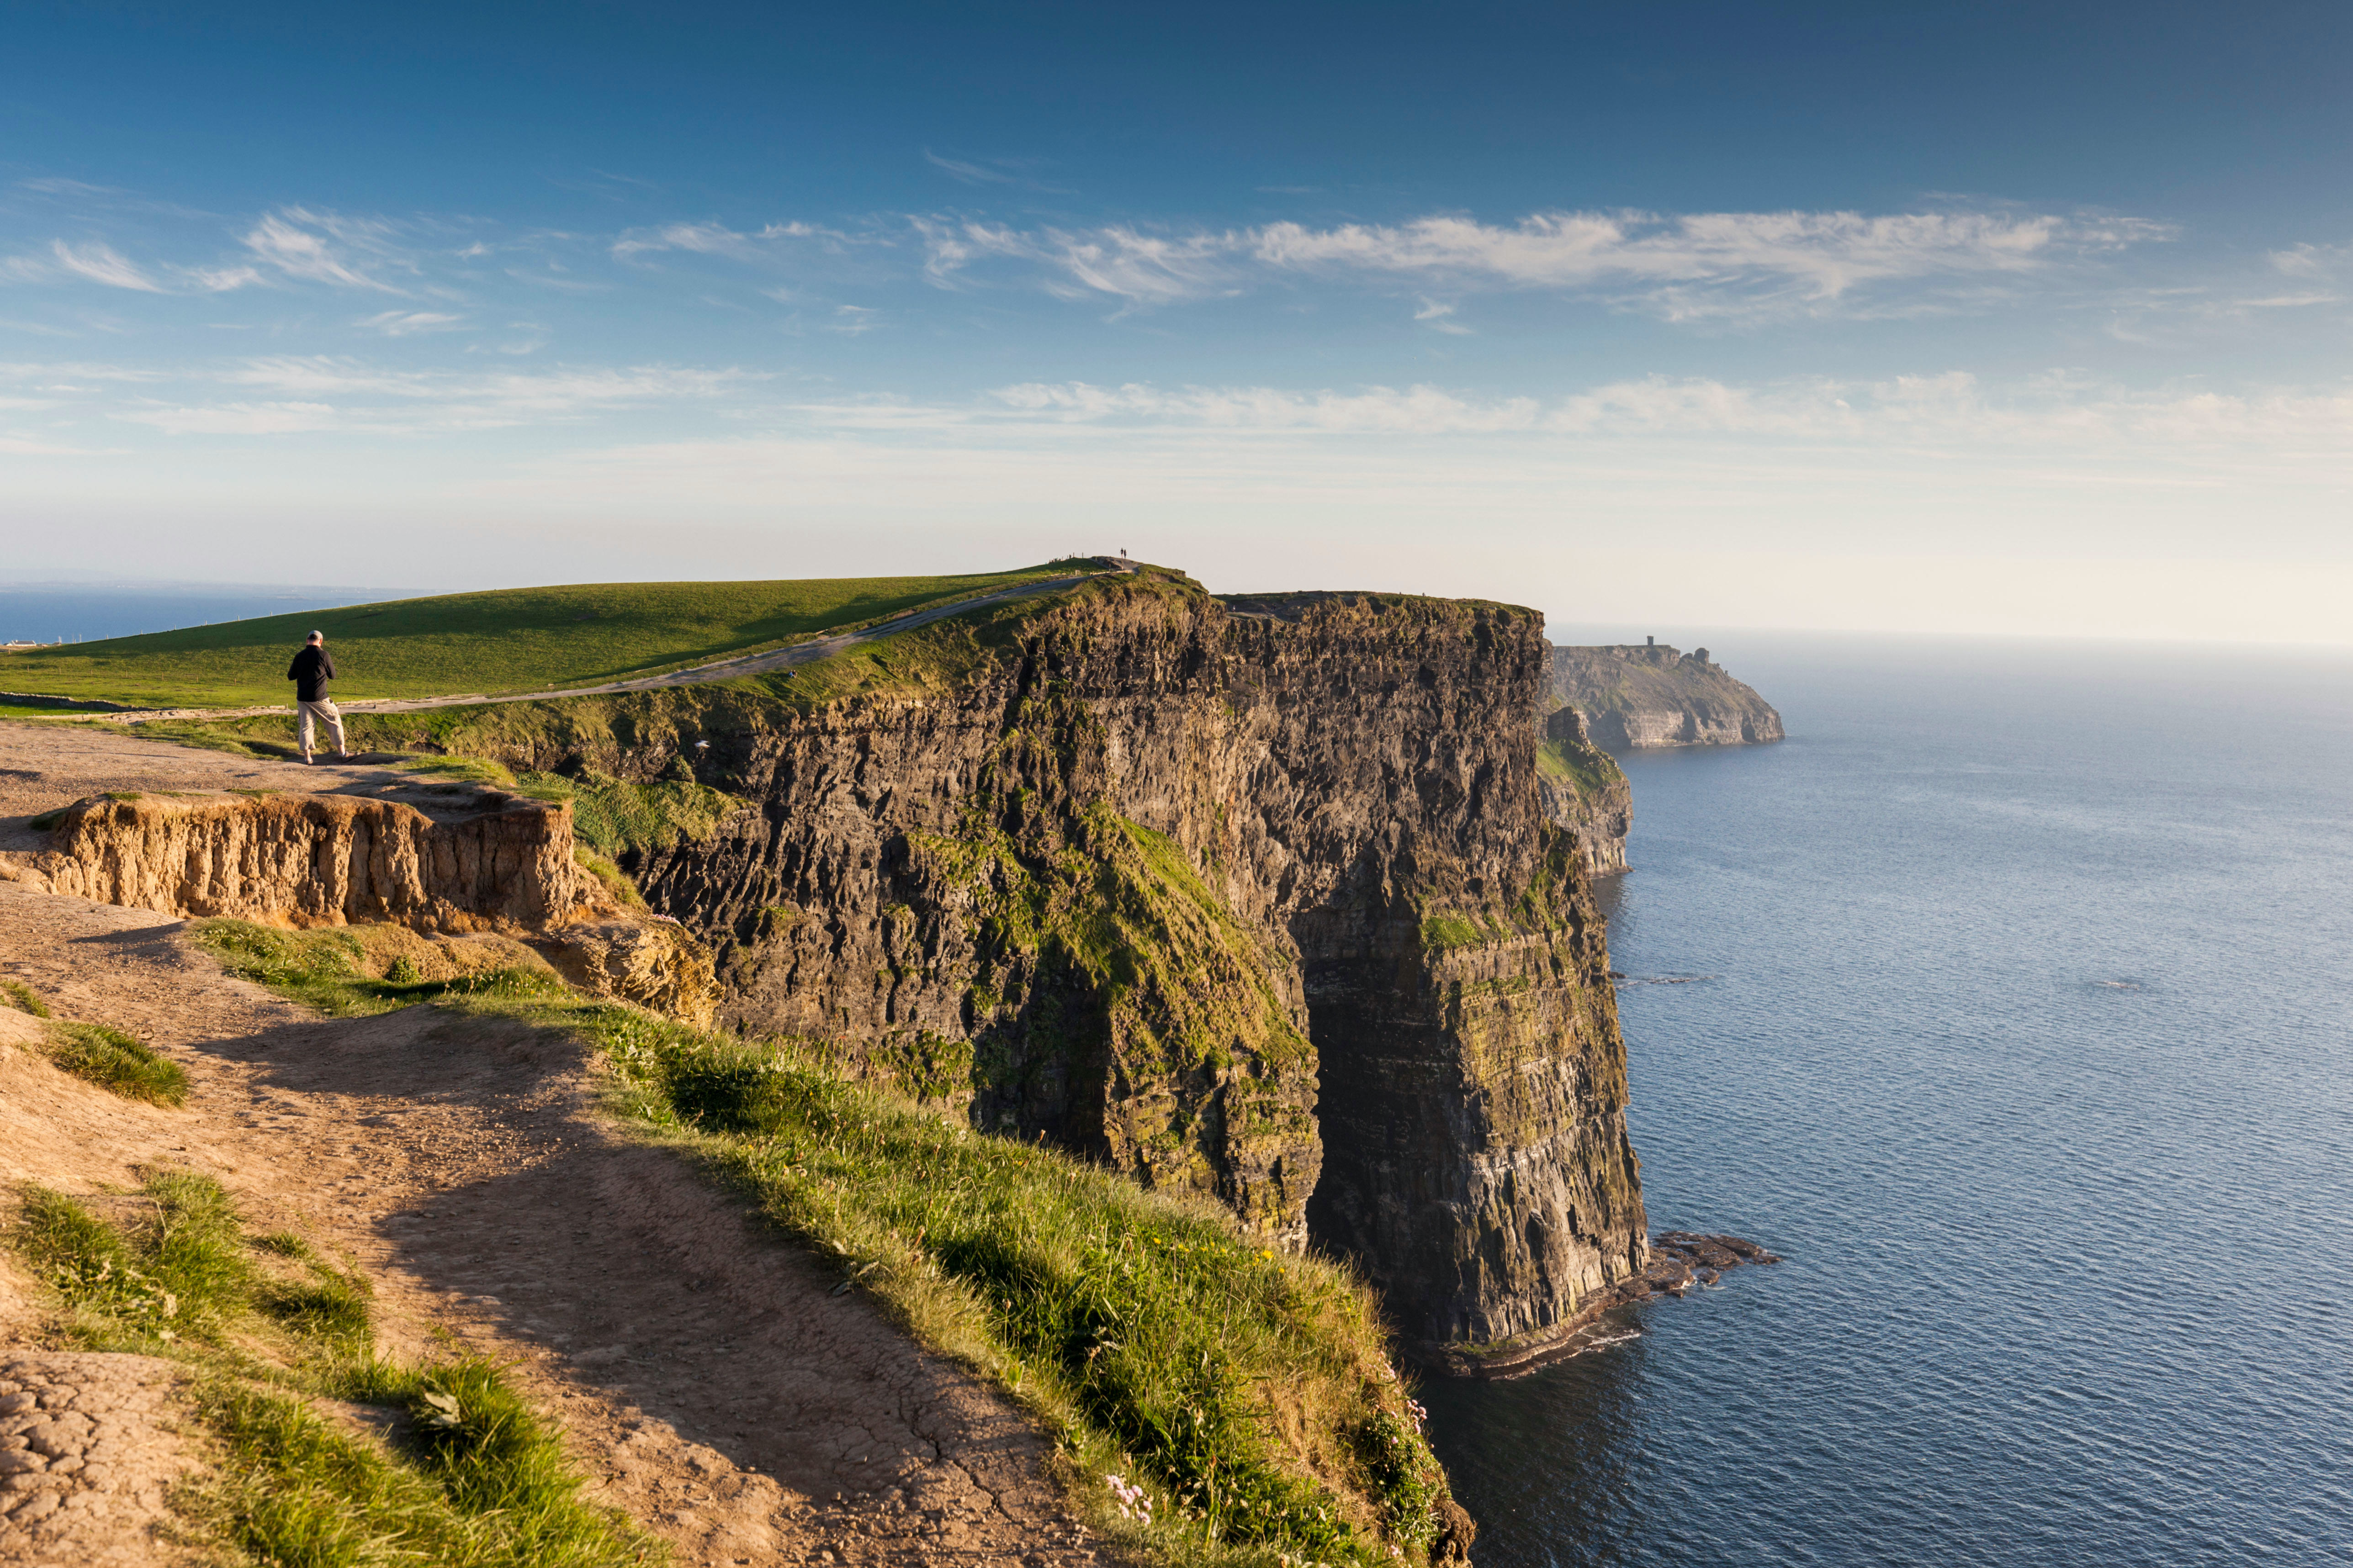
Irish Sea Coast of Ireland

Slide 14
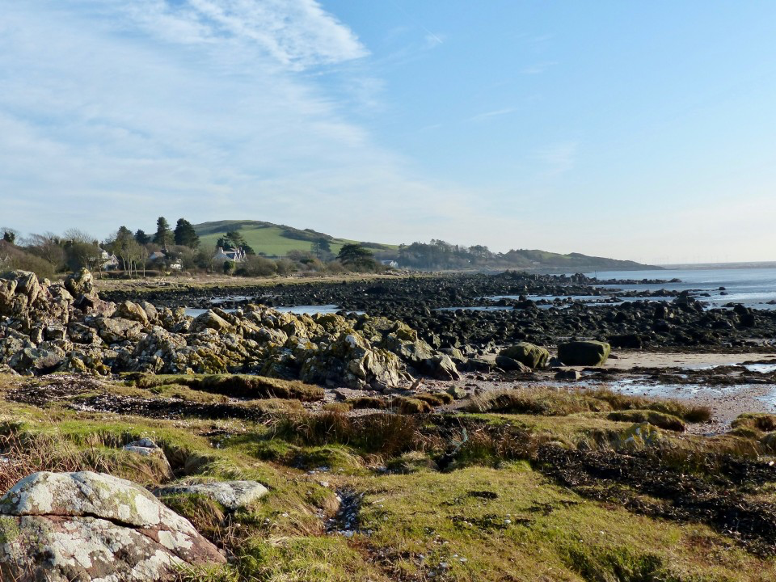
Scotland Irish Sea Coast

Slide 15
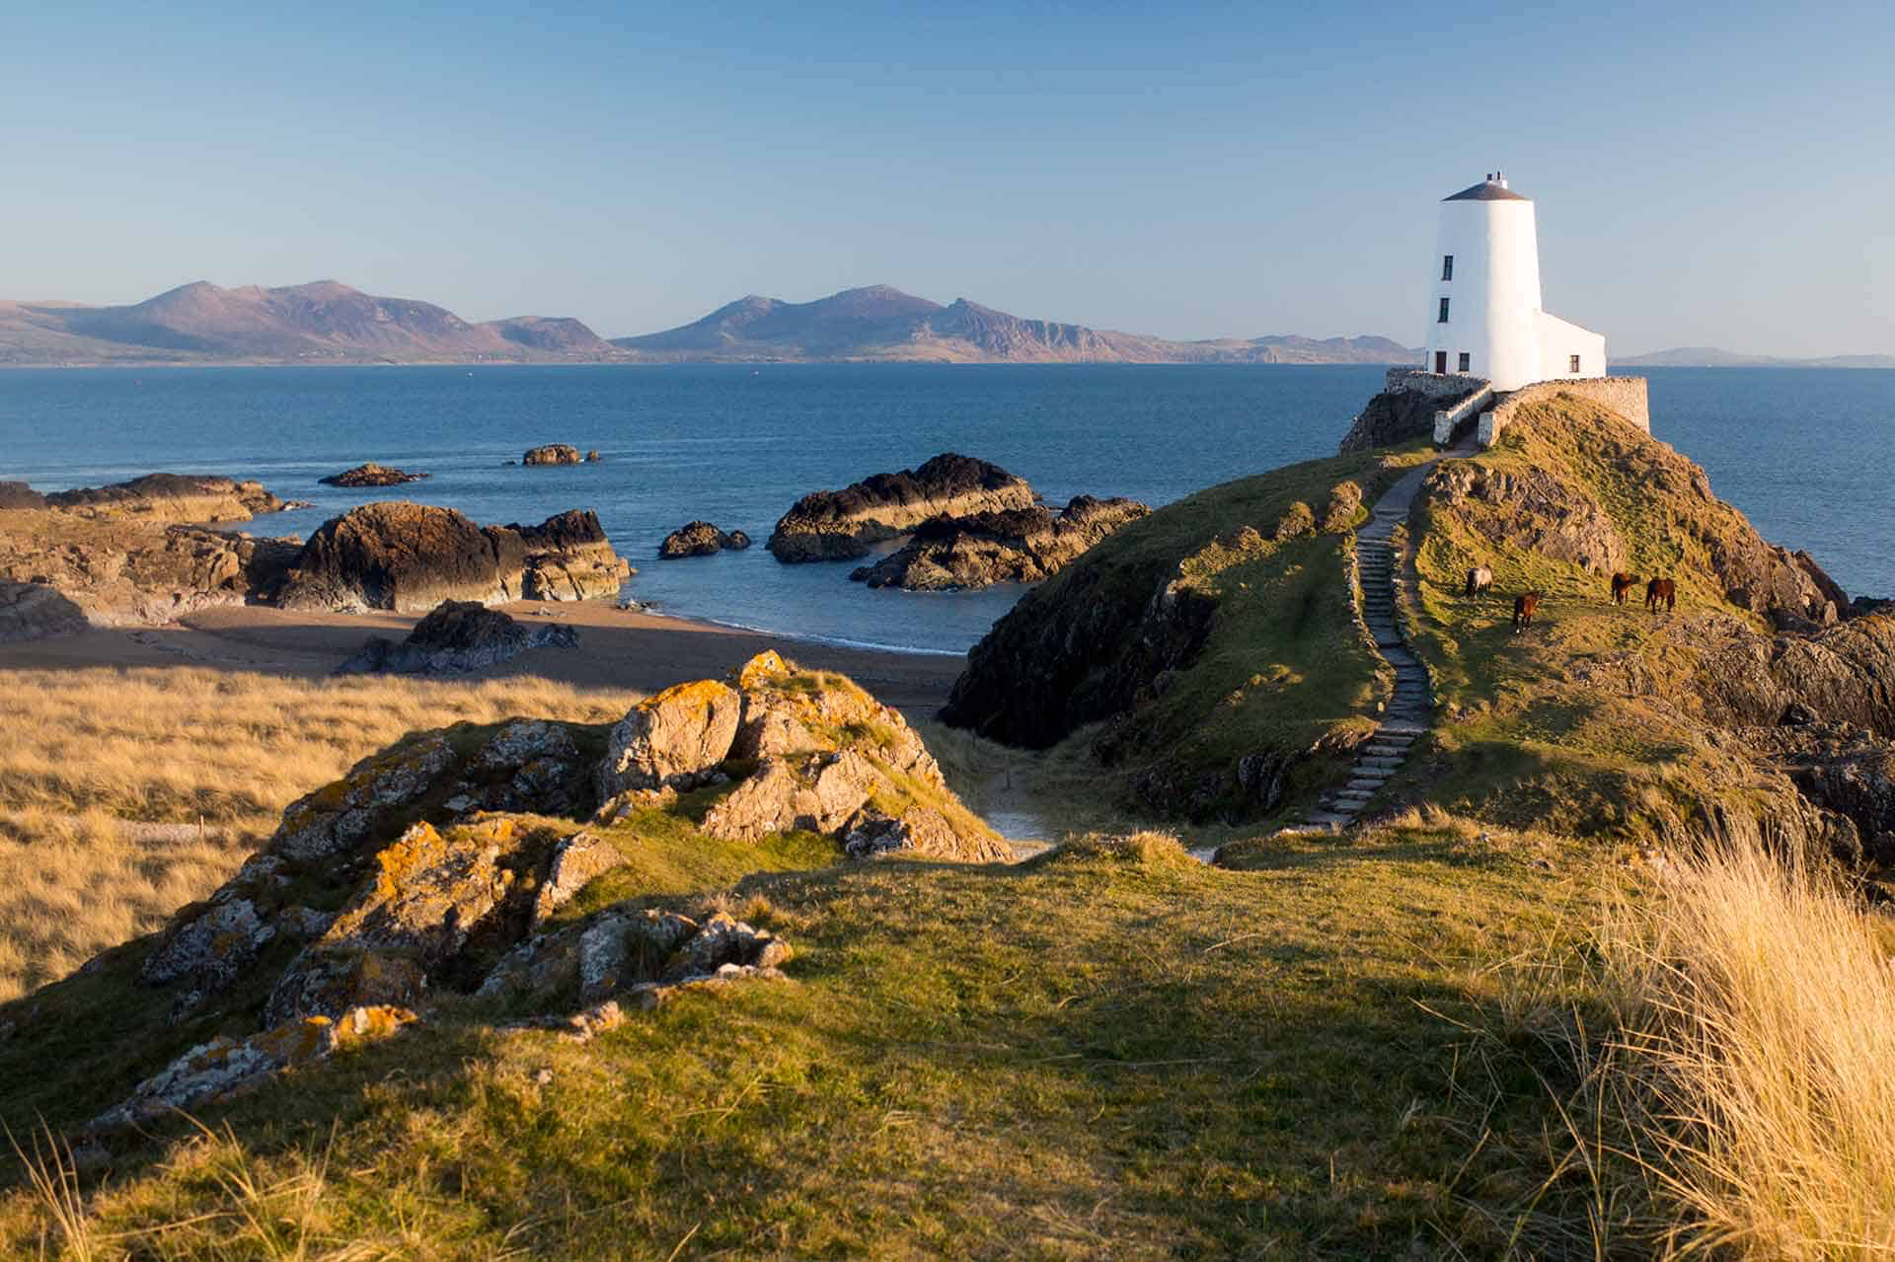
West Wales coast at Anglesey

