Slide 1
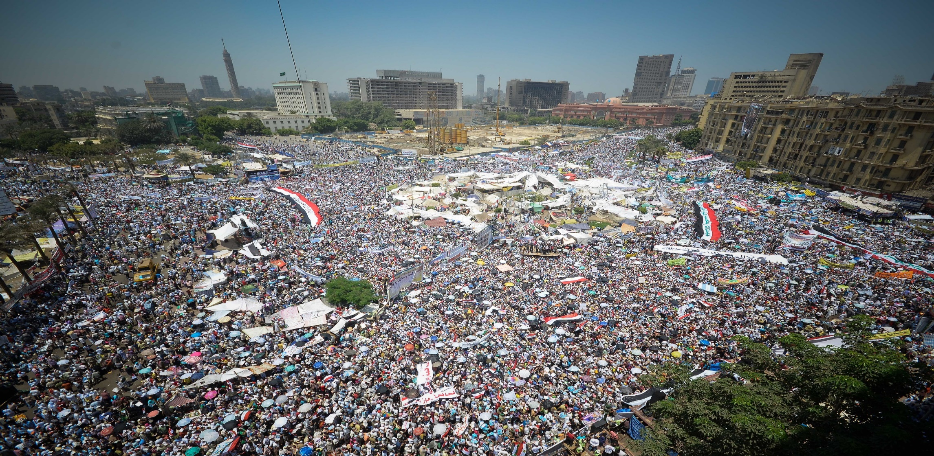
Revolutions and Continuities: Western Civilization to the Present
Tahrir Square, Cairo, 2011

Slide 2
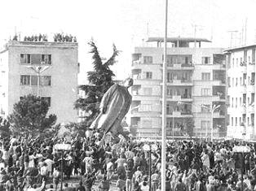
1. The Collapse of the Soviet Empire
Notes:
By GoShow (Own work) [CC BY-SA 3.0 (http://creativecommons.org/licenses/by-sa/3.0)], via Wikimedia Commons

Slide 3
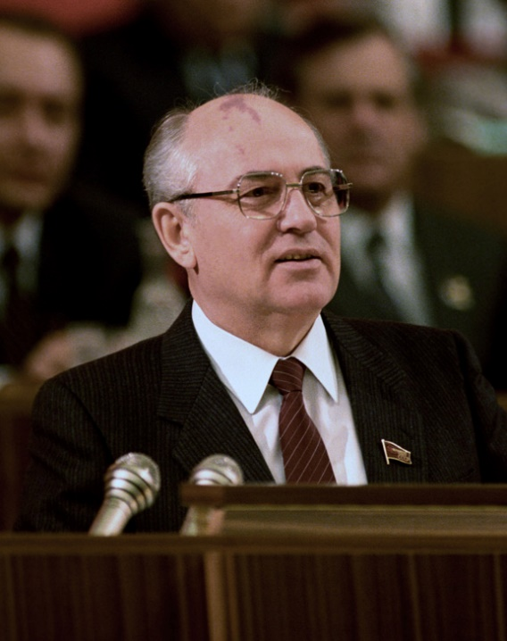
What were the aims of “Glasnost” and “Perestroika”?
Certainly to increase morale (in light of shortages, the Afghan war, etc.)
Certainly to try to “westernize” the Soviet Communist economic system a bit.
Certainly to try to scale down military and defense expenses by lowering the East/West Cold War tension.
But not to end Communism in the USSR, as he said on several occasions.
Notes:
RIA Novosti archive, image # / CC-BY-SA 3.0 [CC BY-SA 3.0 (http://creativecommons.org/licenses/by-sa/3.0) or CC BY-SA 3.0 (http://creativecommons.org/licenses/by-sa/3.0)], via Wikimedia Commons

Slide 4
New Year’s Day, 1986—Greetings
Reagan: Good evening. This is Ronald Reagan, President of the United States of America. I'm pleased to speak to you on the occasion of the New Year. This is a time for reflection and for hope. As we look back on the year just concluded and on the year that is to come, I want to share with you my hopes for the New Year, hopes for peace, prosperity, and good will that the American and Soviet people share....
Gorbachev: Dear Americans, I see a good augury in the way we are beginning the New Year, which has been declared the Year of Peace. We are starting it with an exchange of direct messages, President Reagan's to the Soviet people and mine to you. This, I believe, is a hopeful sign of change which, though small, is nonetheless a change for the better in our relations....

Slide 5
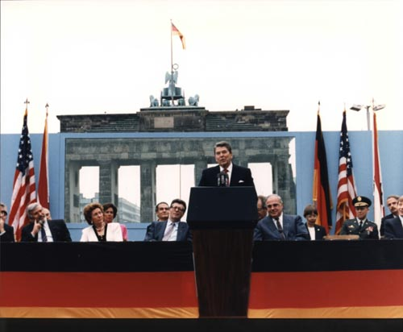
“Mr. Gorbachev, Tear Down This Wall!”
Berlin, June 12, 1987

Slide 6
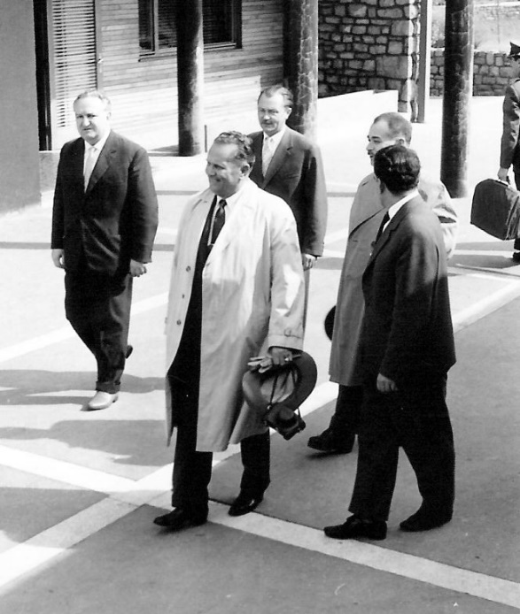
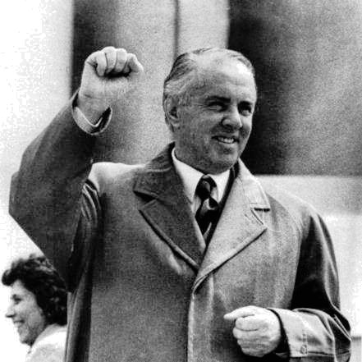
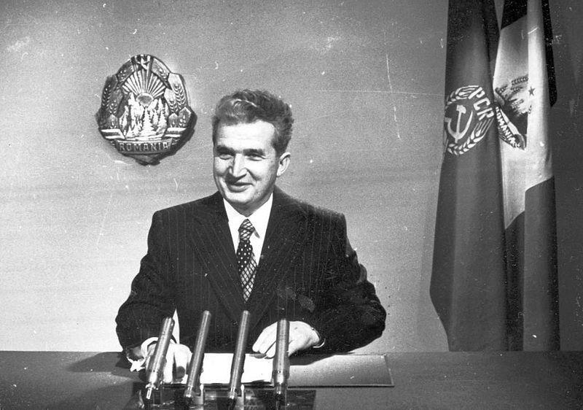
Tremors Within the Empire: I
Yugoslavia—Tito and his “Separate Road to Socialism:
Albania—Enver Hoxha and isolation Communism
Romania—Nicolae Ceaușescu and his dalliance with China
Notes:
Yugoslavia: Flodur44 at the German language Wikipedia [GFDL (http://www.gnu.org/copyleft/fdl.html) or CC-BY-SA-3.0 (http://creativecommons.org/licenses/by-sa/3.0/)], via Wikimedia Commons
Albania: Forrásjelölés Hasonló [CC BY-SA 3.0 (http://creativecommons.org/licenses/by-sa/3.0)], via Wikimedia Commons
Romania: By unknown, image comes from the National Archives [Attribution], via Wikimedia Commons

Slide 7
Tremors Within the Empire: II
Poland—strikes led by the opposition “union” Solidarity—in 1988 and early 1989
Czechoslovakia—”civic” organizations led by dissidents work against the dictatorship in the 1980s—more as 1989 approached
Hungary—already pulling away from Moscow in the 1980s, and even individuals within the bureaucracy were working for economic and other reforms by 1988.
✔ Lithuania—the campaign for “national independence” was already producing large-scale demonstrations by summer 1988.

Slide 8
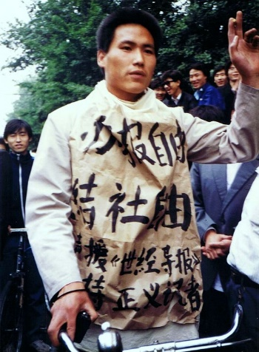
Tiananmen Square
June 3rd/4th, 1989
Protests had begun in April after the death of a government reformer (in the direction of freedom of speech, assembly, etc.)
Many of the protesters were students, many were workers. They camped out on the great Square in the center of Beijing, talking about reforms and freedoms.
Things came to a head on June 3, and on June 4, the leader Deng Xiaoping announced that the protesters were counterrevolutionary hooligans and sent in elite troops, tanks, etc. About 200 protesters were killed that day. Long prison sentences and a good many death sentences followed (among the workers especially).
Notes:
By The original uploader was Sa8 at Chinese Wikipedia；Original author was 蔡淑芳@sfchoi8964 (http://img.ly/Zr1) [CC BY 2.5 (http://creativecommons.org/licenses/by/2.5)], via Wikimedia Commons

Slide 9
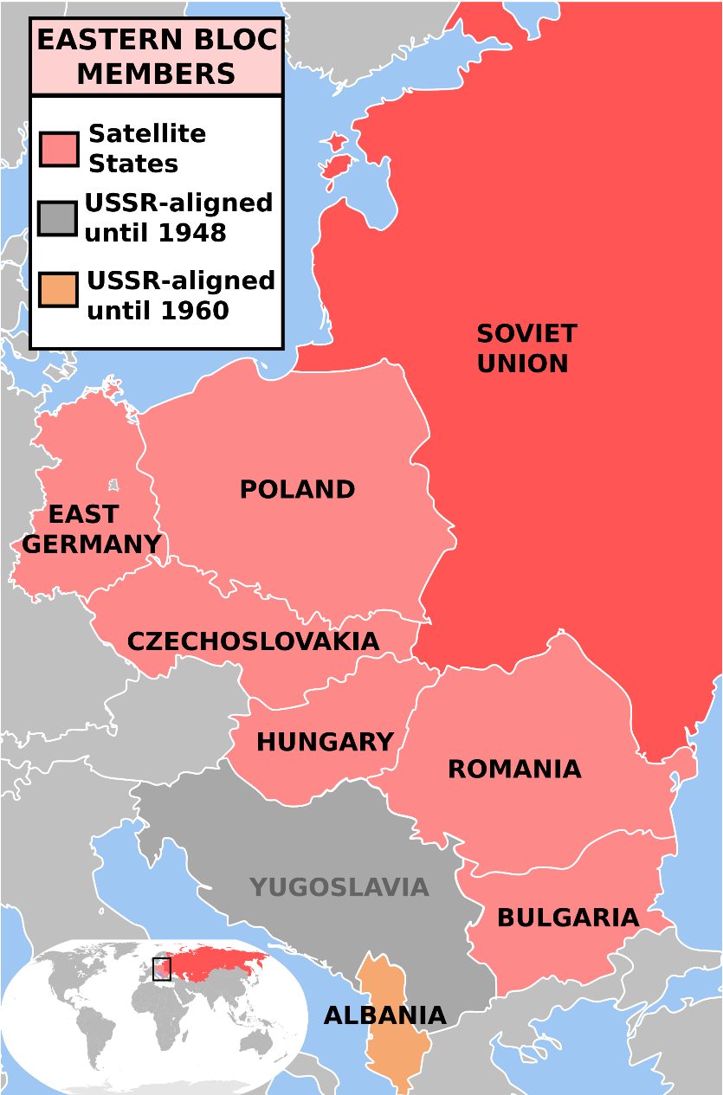
Summer 1989
With unrest already spreading in the satellite states, Tiananmen seemed to up the ante, showing what dictatorships could do to stop mass protest.
Hungary, among the earliest of satellites to pull itself away from Moscow in late 1988/early 1989, began dismantling its guarded borders in the late spring.
✔ Thousands of Soviet bloc citizens, especially East Germans began to “go on vacation” to Hungary and drive out into Austria and Germany. Some went to the West German Embassy in Prague asking for political asylum.

Slide 10
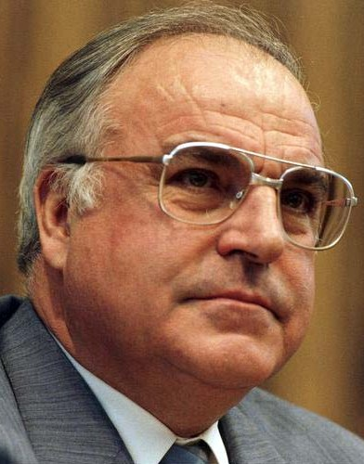
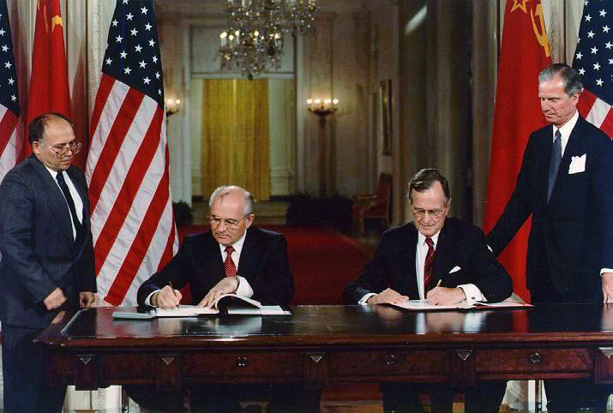
Bush to Bonn / Gorbachev to Bonn
Mikhail Gorbachev and George Bush Sr.
Helmut Kohl
Notes:
Gorbachev/Bush: [Public domain], via Wikimedia Commons
Kohl: Bundesarchiv, / CC-BY-SA [CC BY-SA 3.0 de (http://creativecommons.org/licenses/by-sa/3.0/de/deed.en)], via Wikimedia Commons

Slide 11
The Berlin Wall
Protests in Leipzig, Dresden, and other East German cities, 1989:
“Wir sind das Volk!”--(We are the People!)
East German Communist dictator Erich Honecker was of the old school, however: Prepare to fire on the protesters.
But East Germans were fleeing the DDR through Hungary, which had dismantled its armed border, many driving into Austria and then Germany.
Nov 9, a seemingly random remark by an official led Wall guards to allow some people through. East Berliners rushed to the Wall—the crowd forced its way through. The celebrations began.

Slide 12
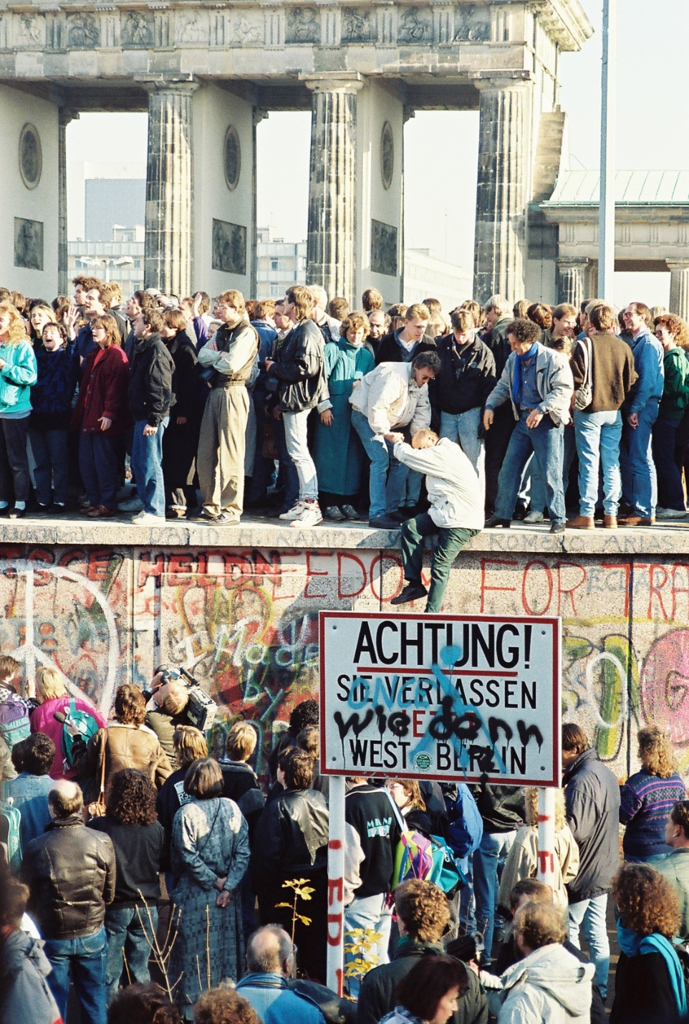
November 9/10, 1989

Slide 13
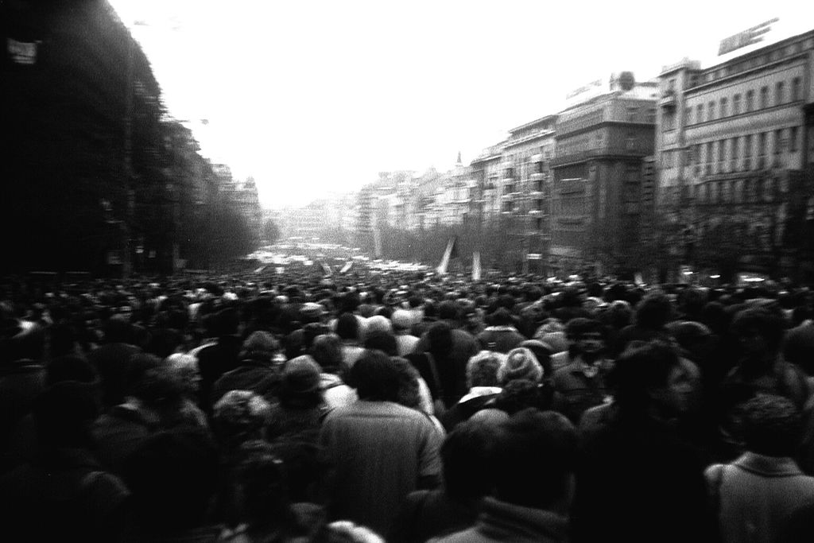
In Czechoslovakia—The “Velvet Revolution”
An officially permitted student gathering in central Prague turned into a call for the end of Communism on November 17. Police and riot squad troops came out, but the demonstrations increased over the next days, and much planning by the opposition groups, like Charter 77 and individuals like playwright Vaclav Havel gave the street demonstrations direction: ultimately, the Communist government gave in by November 29.
Notes:
By ŠJů (cs:ŠJů) [CC BY-SA 3.0 (http://creativecommons.org/licenses/by-sa/3.0)], via Wikimedia Commons

Slide 14
After November...
It took many months before the East German regime was completely gone, and Germany was unified 1990. Many problems of property ownership, fairness, and all kinds of leftover issues of the totalitarian regime remained, even into the 2000s.
in the Baltic countries, freedom-minded people organized a peaceful political demonstration on August 23, 1989. Approximately two million people joined their hands to form a human chain spanning 420 miles, through the three capitals of Estonia, Latvia, and Lithuania. The Baltics were soon independent of the Soviet Union.

Slide 15
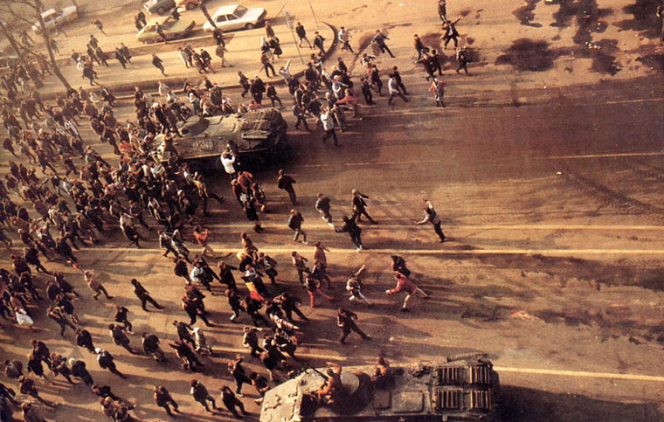
After November...
In Romania, the fanatical Communist dictator Nicolae Ceausescu tried to hold onto power, but many-sided violence broke out when ordinary people went out into the streets to fight state power, and when part of the Communist hierarchy broke from Ceausescu and fought against him. The dictator and his wife were executed after a drumhead tribunal. The ravages of this brutal regime were shocking to behold for years afterward.
Notes:
By Denoel Paris and other photographers [CC BY-SA 3.0 (http://creativecommons.org/licenses/by-sa/3.0)], via Wikimedia Commons

Slide 16
The Soviet Union breaks apart
With East Central Europe breaking off, events outrun Gorbachev’s ability to handle the Soviet Union. Many of the party bigwigs see the handwriting on the wall and start to feather their own nests to become mafia-type warlords, or monopoly businessmen, etc.
An attempt of the old guard Communists to re-take the country leads to the kidnaping of Gorbachev and to street violence, but the soldiers of the coup refuse to fire on the surging masses who oppose the coup. The personality to emerge was a Soviet opponent of Gorbachev, Boris Yeltsin, who would become the first President of “Russia” (until 1999, then succeeded by Vladimir Putin)
December 1991—The Soviet Union breaks into fifteen different countries. The original “socialist republic,” Russia, becomes Russia again.

Slide 17
The Costs of Communism
In human lives: Outside of combat, Soviet Communism killed somewhere between 40 million and 65 million human beings: shot, worked to death, starved on purpose, accidentally killed in various massacres and famines.
In the Cold War pattern of allowing the “free world” to come increasingly under the control of state in order to “fight” totalitarianism. Indeed, the anti-Soviet western alliance, NATO, continues to exist today.
In the terrible costs of dislocation, violence, economic distress, and the continued legacy of socialism through the 1990s and 2000s.
✜

Slide 18
A (sort of) Positive Note
Conundrum: In Russia, there is a strong “Communist Nostalgia” movement. And in the US, some polls show that about 11% of Americans feel that Communism would solve the problems of society and the economy in America. So on both sides of the Cold War, one might say, a substantial number of folks actually miss Communism!
But notably, in many peripheral parts of the Soviet empire, the lesson is: try freedom. Hence, in the Czech Republic, there has been much attention to the free market. And Estonia and Lithuania rank highly in all categories of personal freedom and liberty. Indeed, most post-Soviet satellites rank fairly highly on a world scale, though the Soviet “republics” have not really “tried freedom” to a great extent.

Slide 19
2. Migration, Economics, Ethnic Cleansing, Nationalism

Slide 20
Some Differing Trends...
As we look at the world, and especially Europe, after the fall of Communism, we see numerous trends, not always necessarily related.
European Union influenced many changes, especially economic ones. Much migration took place, mostly into Europe from the Third World.
And nationalism, thought to be dead or at least dying, revived in many ways.
Sometimes, violent, hatred-filled nationalism led to ethnic cleansing, not seen in Europe since both sides in WWII perpetrated this process of driving out or killing populations that make the nation “unclean.”

Slide 21
Economics
Even after the fall of the Communism, many newly free countries maintained socialist economies
And the welfare-state economies of Western Europe (and the European Union) were not in the end much different.
Result: limitation of markets, control from the top, neo-Mercantilism.
At times it has seemed that the Germans’ insistence on less inflation of European currencies have been the only guard against some governments’ robbing their citizens totally blind through inflation.

Slide 22
Outsourcing
One of the most significant, and most complained-about, aspects of modern economic life is “outsourcing,” usually meaning setting up manufacturing facilities in a poor country, where goods can be assembled cheaply. “We used to make stuff in America!”
Free-market thinking says: the world is much more efficient, goods are much cheaper, if the division of labor is allowed to operate.
And if outsourcing is occurring because of state intervention into the US wage structure, then outsourcing serves as an argument FOR a freer economy than the US possesses.
But one way or the other, a part of the recent history of Western Civilization is the specialization of the industrialized economy in the financial and service sectors of the economy.

Slide 23
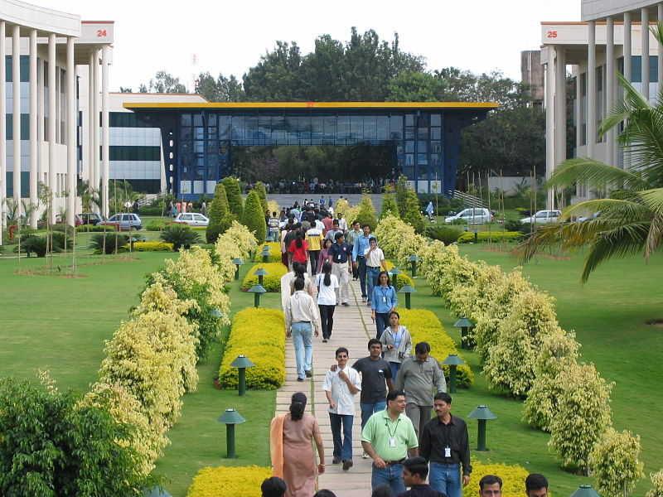
Outsourcing
Caption: Lunchtime at Infosys, Bangalore, India
Notes:
Zondor at the English language Wikipedia [GFDL (www.gnu.org/copyleft/fdl.html) or CC-BY-SA-3.0 (http://creativecommons.org/licenses/by-sa/3.0/)], via Wikimedia Commons

Slide 24
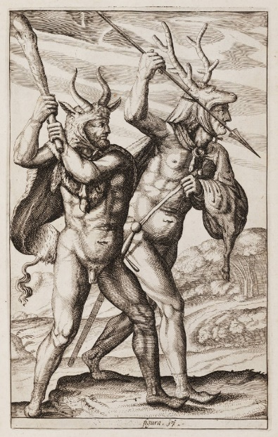
Migration: A long-term European phenomenon
European history is deeply rooted in the movement of people, migration, into, out of, or within European regions.
In Roman times and after, large groups of people were on the move, pushed by the search for food or security.
Germanic Barbarians
moving into Europe
Notes:
Philipp Clüver [Public domain], via Wikimedia Commons

Slide 25
In the early modern period of Western Civilization, several other types of migrations occurred as a result of force and violence.
Europeans brought enormous numbers of Africans as slaves to the Americas, for example.
They also forced the migration of natives to reservations, or farms. When they didn’t kill them. Some of this activity was carried out by businessmen backed by the state, an some by the state itself, from the sixteenth to the nineteenth centuries.

Slide 26
Jewish migration
Just some brief major points:
✔ Up until the early 19th century, European Jews were in most places confined to certain quarters of cities, and sometimes certain areas of the country. Increasingly, they negotiated or bought their way to better living conditions.
✔ But in some areas, these forces remained in place: In Russia, for example, Catherine the Great decreed that all Jews in the Russian Empire would be forced to move to the extreme western reaches of the empire, the so-called Pale of Settlement. This process continued, and tightened up, over the nineteenth century. Many Jews therefore left Russia just to escape the forced and relatively poor existence of the Pale.
✔ State or community violence was behind all these arrangements.

Slide 27
Migration for economic reasons
In part, this migration has been economically motivated: for example, farmers might see an advantage in migrating to a city for a job; or a European craftsman might calculate he could do better in Chicago, or Buenos Aires.
But from the congealing of the nation state in the 17th and 18th centuries, many governments persecuted minority groups—as they had long done in many cases with Jews—and forced them to leave, or otherwise made life unpalatable.
From 1815 to 1932, 60 million Europeans left Europe and immigrated to the Americas and Australia /New Zealand
Perhaps even more individuals migrated during that period within Europe, mostly to cities. Western and Central Europe were more urban than agricultural by about 1900.

Slide 28
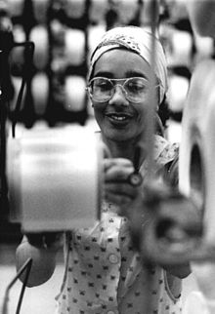
The “Gastarbeiter” Phenomenon
Beginning in Germany in the wake of the Economic Miracle, at the end of the fifties, the German economy was so “hot” that the employment rate was 100 %. So German companies recruited “Gastarbeiter,” or Guest Workers from nearby regions with low employment rates: southern Italy, rural Spain, Turkey, Yugoslavia.
Gastarbeiter came temporarily at first, but many made homes in Germany (and eventually via the same process in Switzerland, Austria, Sweden, and elsewhere).

Slide 29
The “Gastarbeiter” Phenomenon
In many European cities, Gastarbeiter and other migrants came to make up sizeable percentages of the population.
Strangely, there was an analogous pull of foreigners in the Soviet bloc, to East Germany in particular. There, people from Soviet-sponsored Third World countries came to East Germany to work or study or both. So there were many Cubans, Mozambiquans, Vietnamese, etc.
And in the lands of the former Soviet Union, by the economic revival of the 2000s, workers migrated to Russian industrial cities to do work, and were called Gastarbeiter, in fact, just transliterated:
гастарбайтер

Slide 30
Political Refugees and Asylants
In countless cases, individuals migrating to Europe came for reasons of danger in their home countries. These political migrations added to the number of foreigners.
In then end, as with many other modern cases (including the US), admission of foreigners to “take our jobs” is often protested. Many good arguments can be made against it, especially since most of the world lives in welfare state conditions. No doubt, these immigrants most often arrive and work hard, doing jobs many “native” “out of work” people will not do. But if European, or any, borders are opened up—in the current conditions of the nation-state—what is to be done?
Hence Western Civilization once again faces the issue of migration.

Slide 31
The Re-Emergence of Nationalism
Nationalism was intimately involved in causing the two world wars.
Nationalism is about making your “nation” (your ethnic group) equal your state, and your state equal your nation.
Nationalist statism had led to all kinds of ethnic strife in Europe, but the Soviet-sponsored regimes at least kept this sort of thing to a minimum.
But after 1989, many of the old hatreds re-emerged.
In particular, in Yugoslavia.

Slide 32
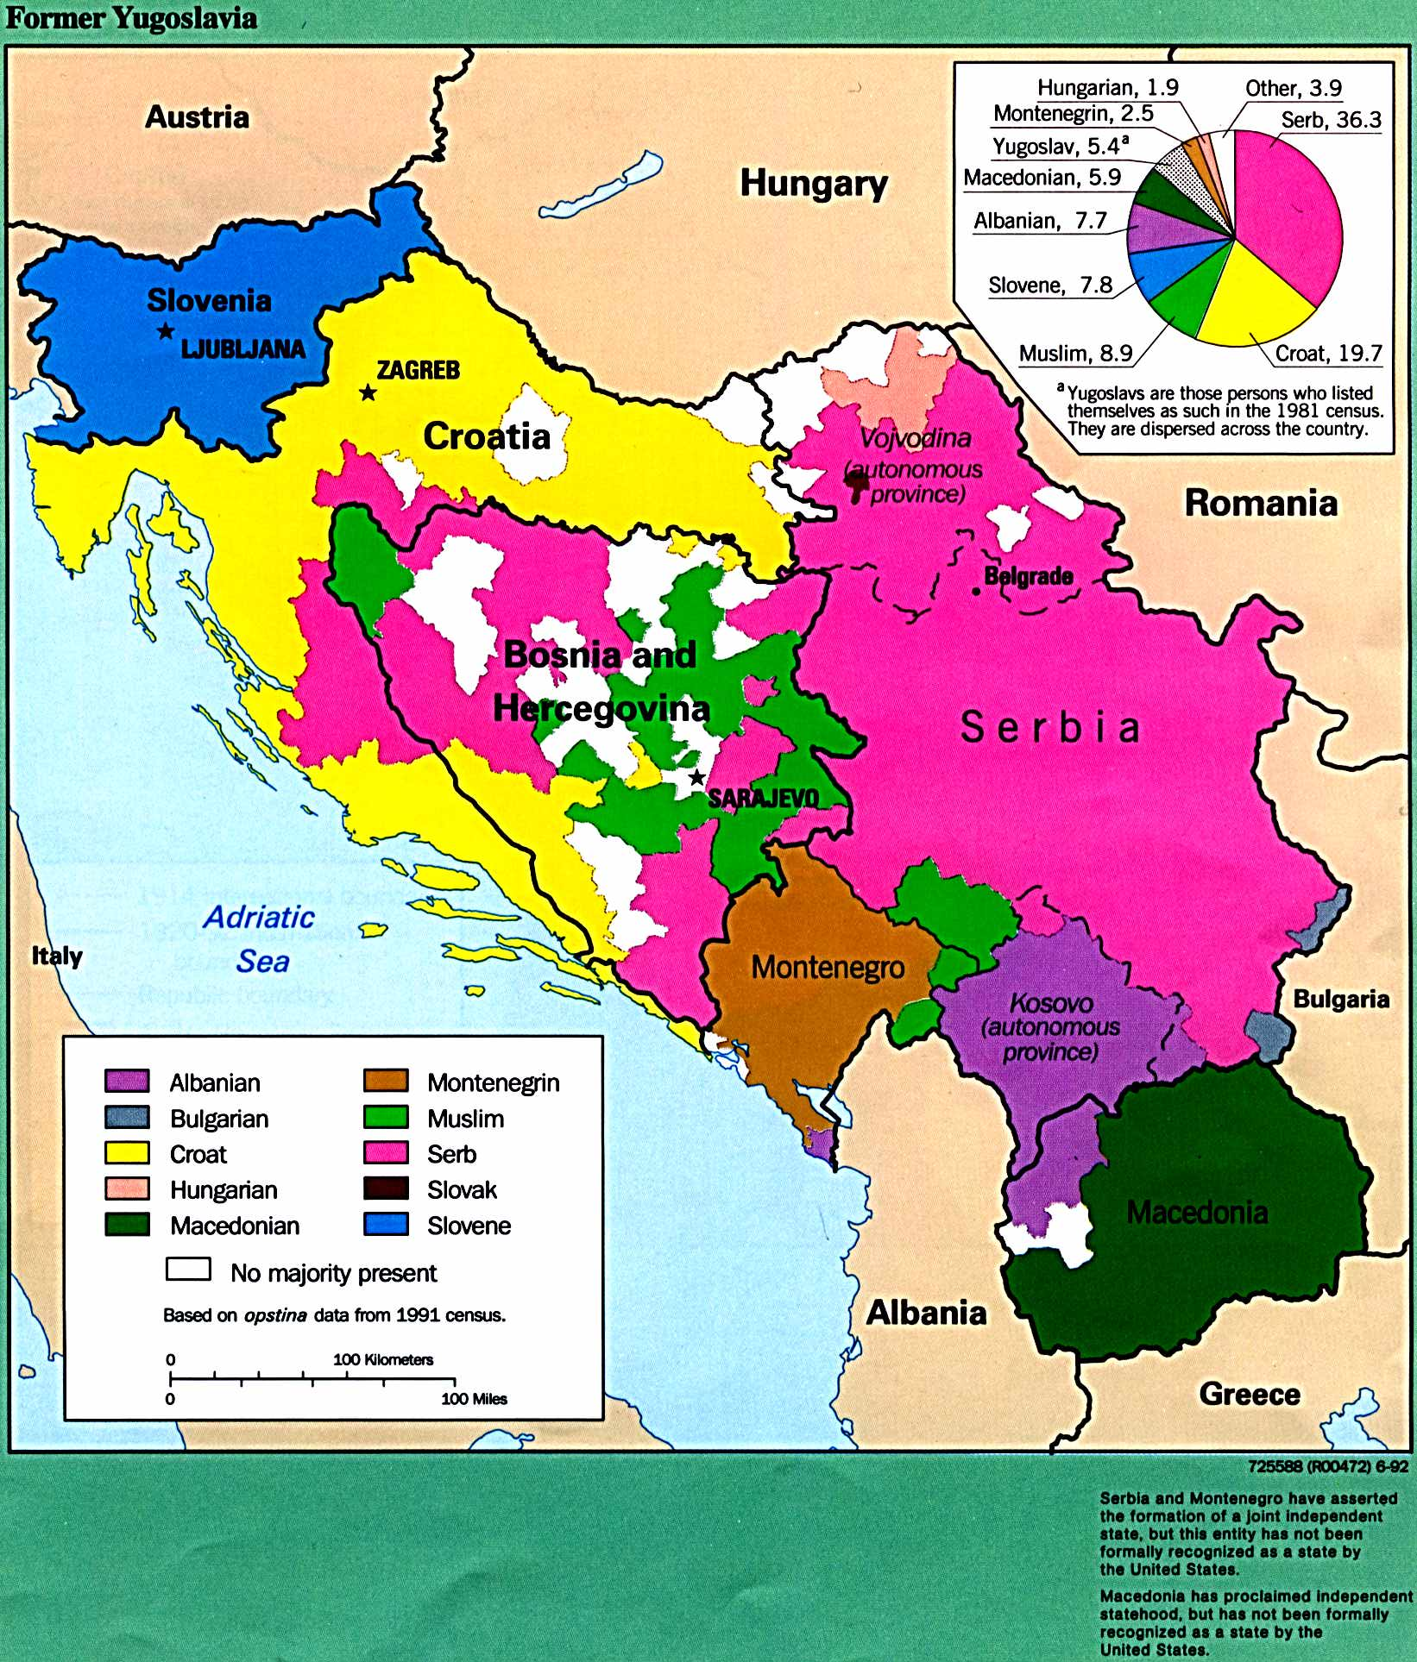
Tito’s Yugoslavia

Slide 33
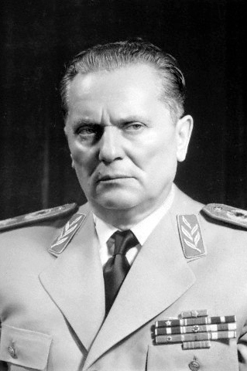
Tito’s government managed to keep the peace, by and large, among the ethnic groups of Yugoslavia, mainly by brutal police state tactics.
Some groups he drove out (e.g., Germans along the Danube)
Some he keep under strict policing and martial law.
In fact, Yugoslavia had the name for being a relaxed version of Communism, but it is estimated that Tito’s state (from 1945 to 1980) killed somewhere between 585,000 and 2,130,000 Yugoslav citizens, for ethnic reasons as well as political reasons.
Josip Broz Tito

Slide 34
Chronology of Yugoslav Breakup
Tito died in 1980
The successor was (eventually) Slobodan Milošević
Milošević gradually adopted a kind of Serbian nationalism to squelch rising autonomist movements within the different regions.
Once Communism fell, keeping this artificial country together was impossible.
In 1991, Slovenia seceded. Yugoslav forces could not bring it back. Croatia was next, etc.

Slide 35
Ethnic Violence
In these processes of secession, ethnic violence broke in many forms. The state encouraged this. Pockets of brutal ethnic violence continued from 1991 to 1995.
But the worst tended to be Serbian violence, rape, and ethnic cleansing in Bosnia, divided ethnically between Bosnians (Muslims) and Bosnian Serbs (Orthodox).
Indeed, in Bosnia, local Serbs and Yugoslav army units engaged in mass killing as well (famously, 8,000 dead at Srebenica).

Slide 36
International Intervention
NATO, including US forces, intervened in 1992.
The situation was highly confusing, and many in American argued that American troops should not be there.
And NATO troops did not always stop massacres.
Europe was seeing regular military action for the first time since World War II.
The international community forced the Yugoslav belligerents to negotiate an end to the fighting and killing. This happened with the Dayton Accords in 1995, confirming the independence and borders of Croatia, Montenegro, Slovenia, etc.

Slide 37
The Kosovo Crisis and the NATO Bombing of Serbia, 1999
In one further crisis, the Kosovar (Albania) minority in the south of Serbia had been in particular conflict with the local Serbians, and ethnic strife went back some decades. The Albanians were, like the Bosnians, Muslims.
When the Serbians tried to police Kosovar gangland style activity and violence, NATO (at the behest of American President Clinton) bombed Serbia, killing several thousand Serbian civilians and severely damaging many world heritage sites as well as damaging economic infrastructure.
✜

Slide 38
We begin to lose perspective...
So we can look at many trends in Western Civilization in the 1990s and 2000s, but NOTE WELL: historical analysis is based on perspective. And when we get to our own lifetimes, and contemporary controversies, it is often very difficult to carry out a objective historical analysis.
For one thing, we don’t have all the documents and the evidence yet: historical documentation is often released only fifty or sixty years after an event.
It may be possible in some cases to make good historical sense of recent events, but we should all be wary!

Slide 39
4. Lessons: The Individual, Technology, Society, and the State

Slide 40
Periods of political and social revolution in recent times
1986—People’s Power revolution in Philippines outs Fernando Marcos govt.
1988—Uprising in Burma/Myanmar (against dictatorship)
1989/90—China, East Central Europe: against Communist dictatorship
2001—Philippines revolution ousted the President
2001—Riots in Argentina ousted the government
2003—”Color Revolutions” in Balkans and former Soviet states
2011—Occupy Wallstreet protests—US, but with related events in Spain, Canada etc.
2011/13--Arab Spring, revolutions across the Middle East
2013—Large scale protests in Brazil, Turkey, Venezuela
2014/15-Protests, Ferguson, MO, and Baltimore over police killings.

Slide 41
Individualism vs. Collectivism
We can organize a good bit of our analysis of Western Civilization around this tension.
It is not just Marx who represents collectivism, but nationalism, fascism, corporatism, religious dictatorships, Keynesian economics—in some sense the state itself.
The period since the 1980s has seen many revolutions and many kinds of revolutions—we would be well served to inquire rationally into the content of each event or trend to estimate the “ratio” of the individualist content versus collectivist content.

Slide 42
Example, the Digital Revolution, 1960-Now
The Computer came of age after WWII, but the revolutionary breakthrough came with hand-held “pocket” calculators in 1970.
The market drove the digital age. Military and government demand for high-tech devices added to this demand. But mainly, companies worked furiously to make devices adaptable to useful for daily life.
Scroll forward to the Internet, which emerged as a useable tool for individual use in the early 90s. From 1995 to the present, lives, business, communications have been completely revolutionized. The related phone technologies producing the cell phone are nearly as sweeping.
https://upload.wikimedia.org/wikipedia/commons/2/27/Enigma-plugboard.jpg

Slide 43
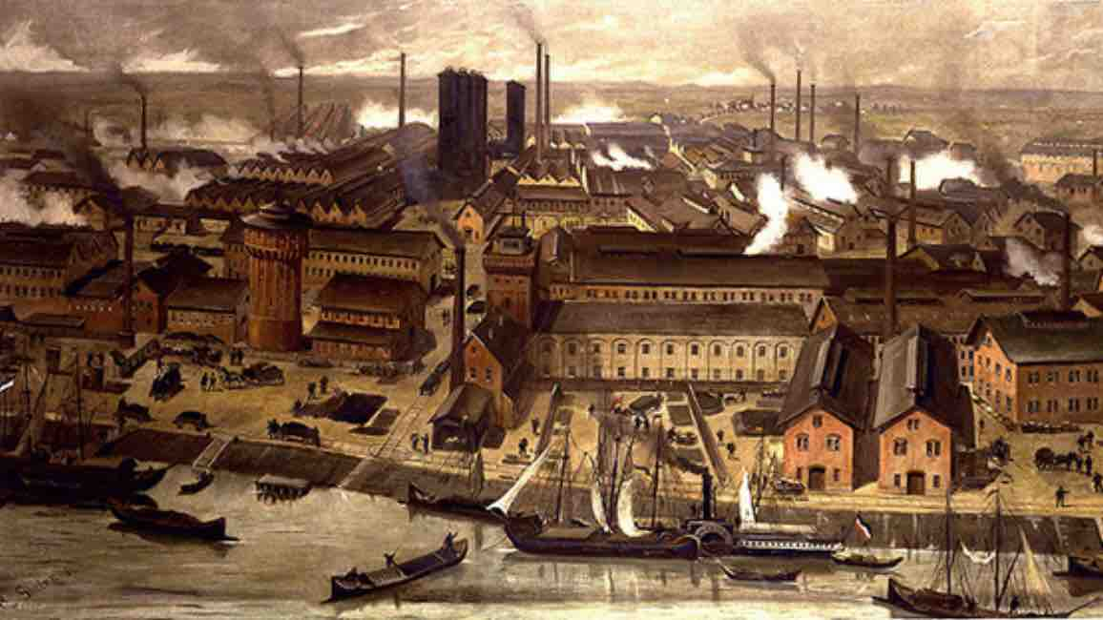
The long-term effects of the Industrial Revolution globally
Think: the imitation and extension of Western Civilization’s ideas about the market represent a potentially huge step forward the well-being of humans.
In fact, what we are seeing in the Asia economic superstars (the Tigers etc.) is the acceptance of the great classical liberal tradition, the Austrians economists, the tradition of liberty.
Meanwhile, many scholars are suggesting that for the first time in known human history, with the exception of purely man-made (artificial) situations, famine has been essentially wiped out.
And all of this is not by war, or central planning, but predominantly by individual decision-making, and by societies that insist on their governments staying out of their private affairs.
Notes:
The BASF-chemical factories in Ludwigshafen, Germany, 1881
Robert Friedrich Stieler (1847–1908) - alte Postkarte, https://www.basf.com/de/company/about-us/history/1865-1901.html
BASF Werk Ludwigshafen 1881, Gemälde im BASF-Archiv

