Slide 1
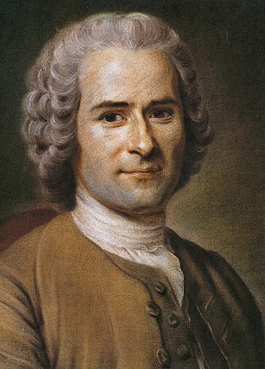
Hist 143 Tooley Jean-Jacques Rousseau and the Late Enlightenment

Slide 2
Some life facts about Rousseau
1712-1778
Born and died in Geneva, Switzerland, though he lived in Paris and other places during parts of his life
Though fluid in religious affiliations, more or less agnostic
In Paris especially he befriended Diderot and other famous Englightenment philosophes
In the UK, he befriended, then quarreled with Hume
He became one of the most read and discussed writers in Europe
He died in France in 1778

Slide 3
Most significant works
• Julie, or the New Heloise (Julie, ou la nouvelle Héloïse), 1761
Emile, or On Education (Émile, ou de l'éducation), 1762
The Social Contract, or Principles of Political Right (Du contrat social), 1762
Pygmalion: a Lyric Scene, 1762
Confessions of Jean-Jacques Rousseau (Les Confessions), 1770, published 1782

Slide 4
Contradictions
Political theorist who believed in the “general will” and government as a “social contract,” but whose thought later justified popular dictators, such as Robespierre and Napoleon
Campaigner for closer families and nurturing, especially by promoting nursing by upper-class women and less emphasis on women as objects while basically saying women should be confined to the domestic sphere;
Friend of “rationalists” such as Diderot but the real founder of the “sensibility” movement
Wrote extensively on childhood education but gave up his children (all illegitimate) to orphanages since it seemed more “convenient” for him

Slide 5
Take-aways
Though he died over a decade before the French Revolution, his influence on revolutionary thought was great. He became a kind of patron saint of the radical-left Jacobin revolutionaries, and his ideas figured into the thought of both Maximilien Robespierre and Napoleon Bonaparte.
His influence was equally great on German poet/playwright J. W. Goethe, English literary figure William Wordsworth, the great Ludwig van Beethoven and many other molders of the soon-to-come cultural movement called Romanticism. Embracing the “passions”–-where the Enlightenment had wished to dampen or tame them—he opened up a whole new kind of discourse which heavily influenced European thought and language.

