Slide 1
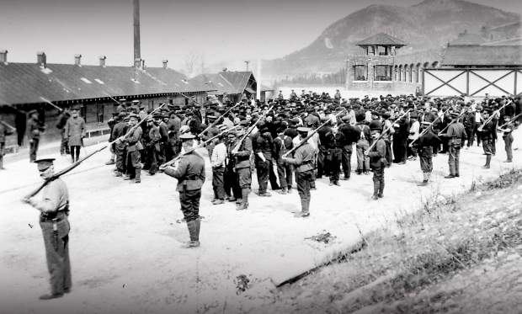
Surveillance and Internment of Enemy Civilians and Others During World War I

Slide 2
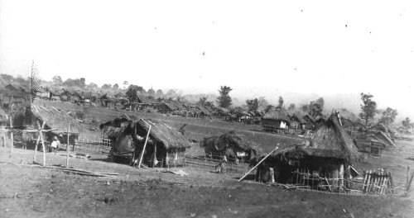
U.S. Reconcentrado camp for interning civilians in the Philippines, c. 1900

Slide 3
Civilian internees, World War I

Slide 4
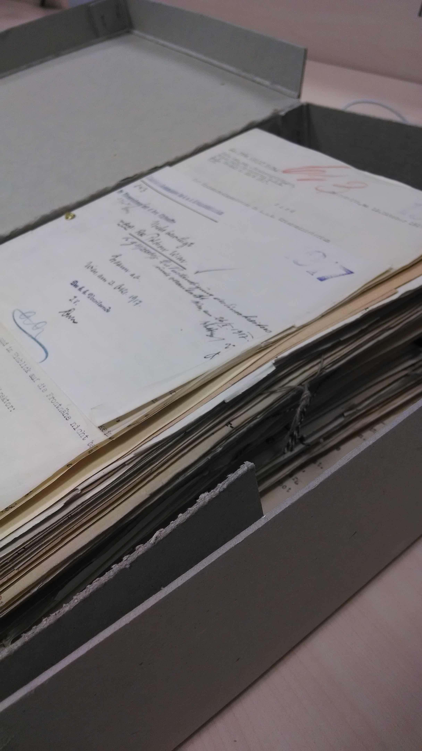
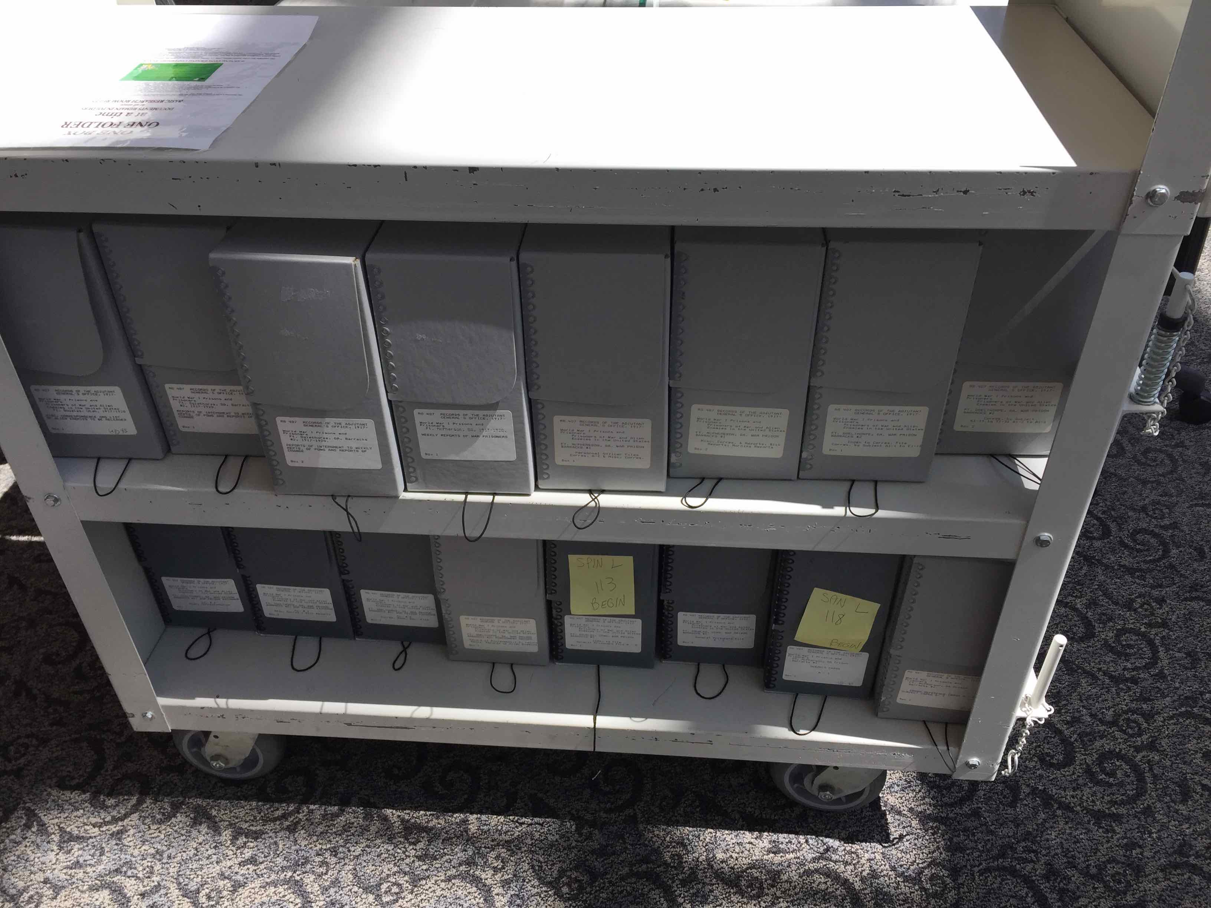
Austrian State Archives
U.S. National Archives

Slide 5


Bureau of Investigation
—Justice Department in Washington, D.C.
War Surveillance Office
Kriegsüberwachungsamt
—Imperial War Ministry in Vienna

Slide 6
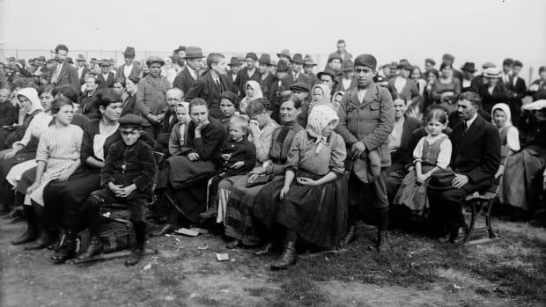

Slide 7
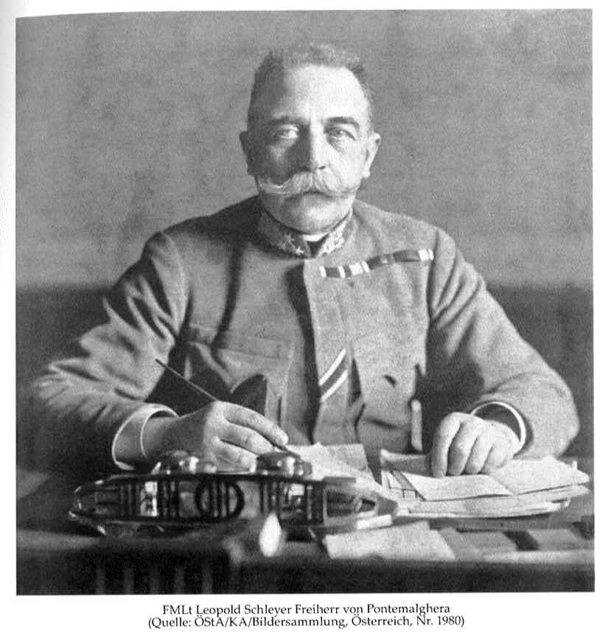
Field Marshal Leopold von Schleyer head of the War Surveillance Office

Slide 8
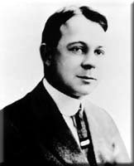
”the Chief,”
Bruce Bielaski
Director of the BOI

Slide 9
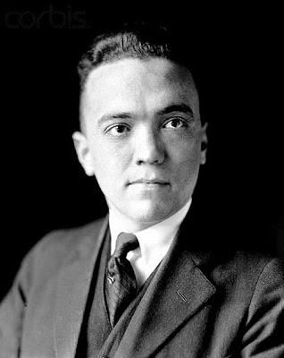
J. Edgar Hoover just after WWI

Slide 10
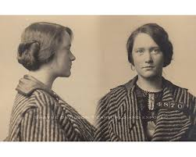

Slide 11

Bureau of Investigation

Slide 12
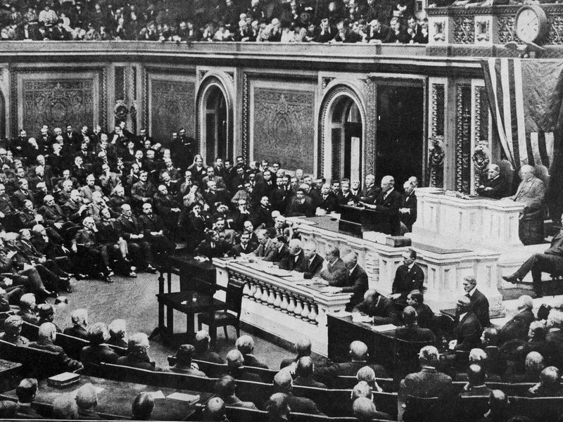

Slide 13

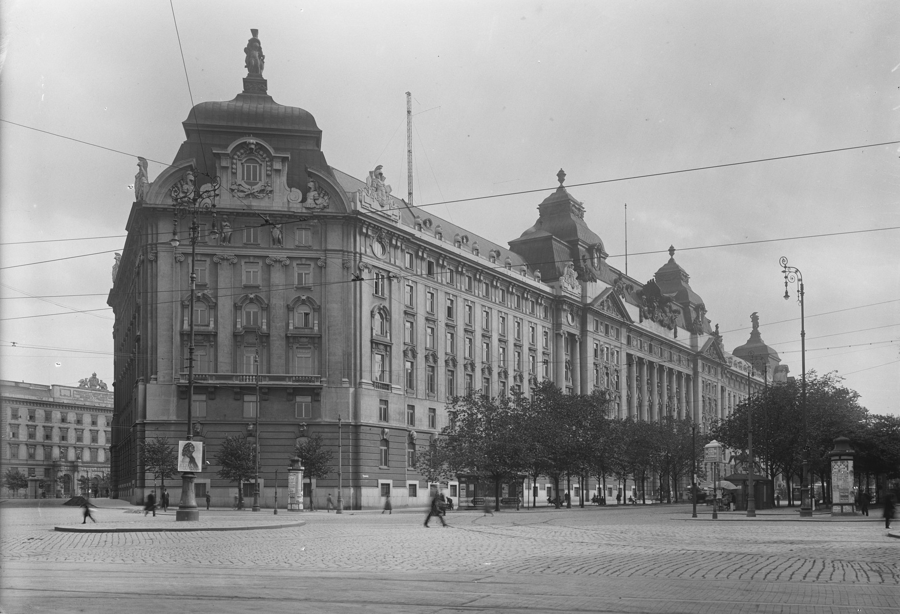
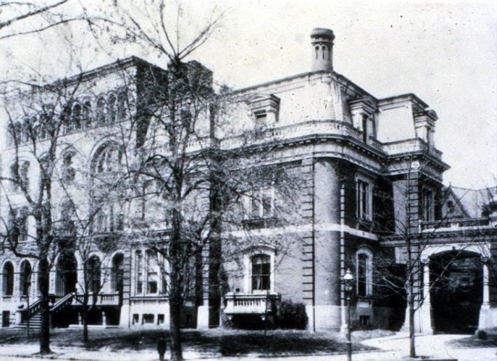
Justice Department
1435 K Street NW
Washington, D.C.
War Ministry
Stubenring 1, Vienna

Slide 14
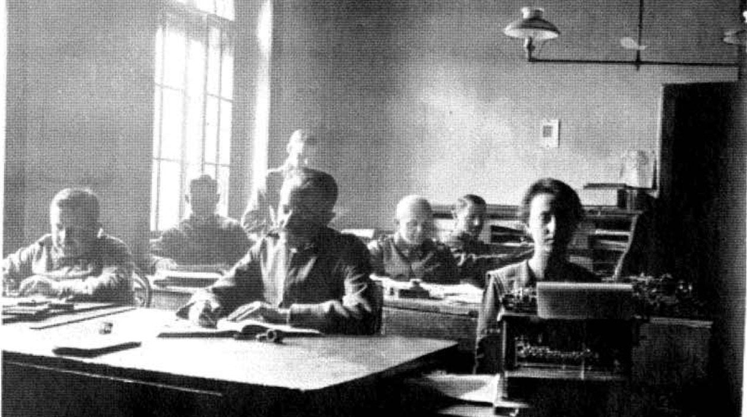
Bureaucrats Produce Security at the Kriegsüberwachungsamt, 1917

Slide 15
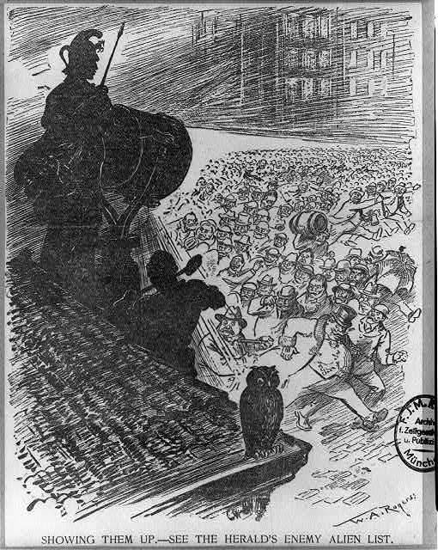
Showing Them Up--See the Herald’s Enemy Alien List
N.Y Herald April 12, 1917

Slide 16
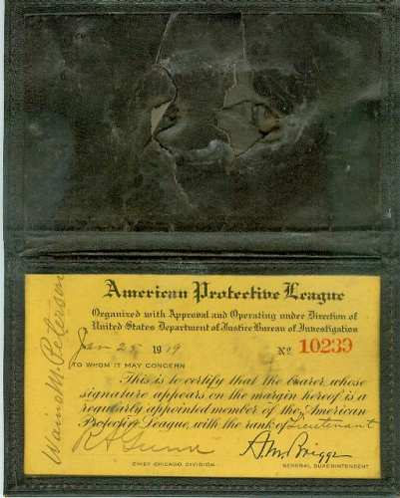

American Protective League:
Volunteer Patriot ID

Slide 17



American Protective League:
Patriotic Snoopers Complete With Badges

Slide 18
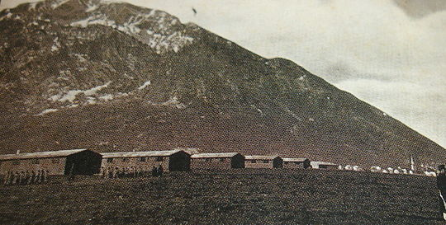
Thalerhof Internment Camp, Austria

Slide 19
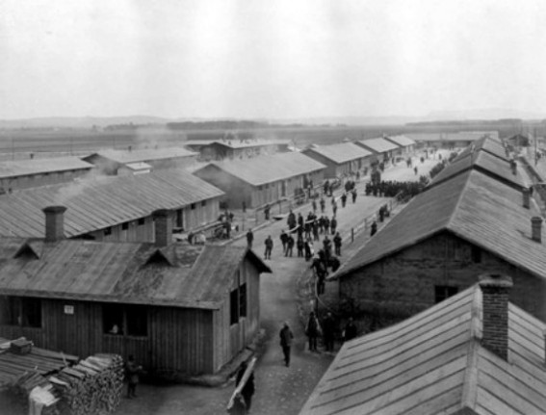
Inside Thalerhof Internment camp

Slide 20
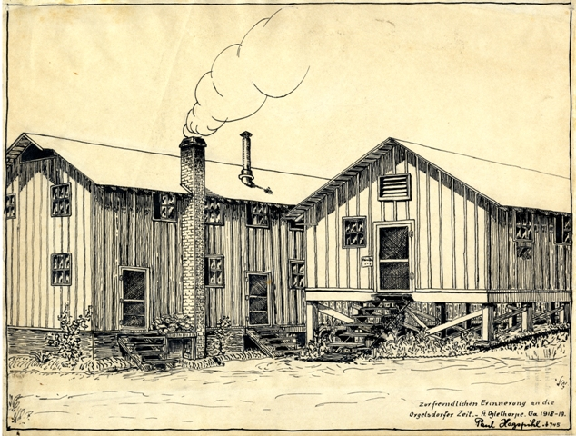
Internee art:
Fort Oglethorpe
Internment
Camp, Georgia

Slide 21
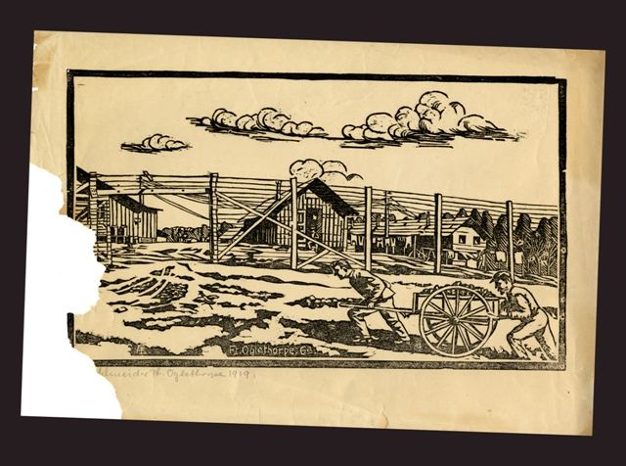
Fort Oglethorpe, GA

Slide 22
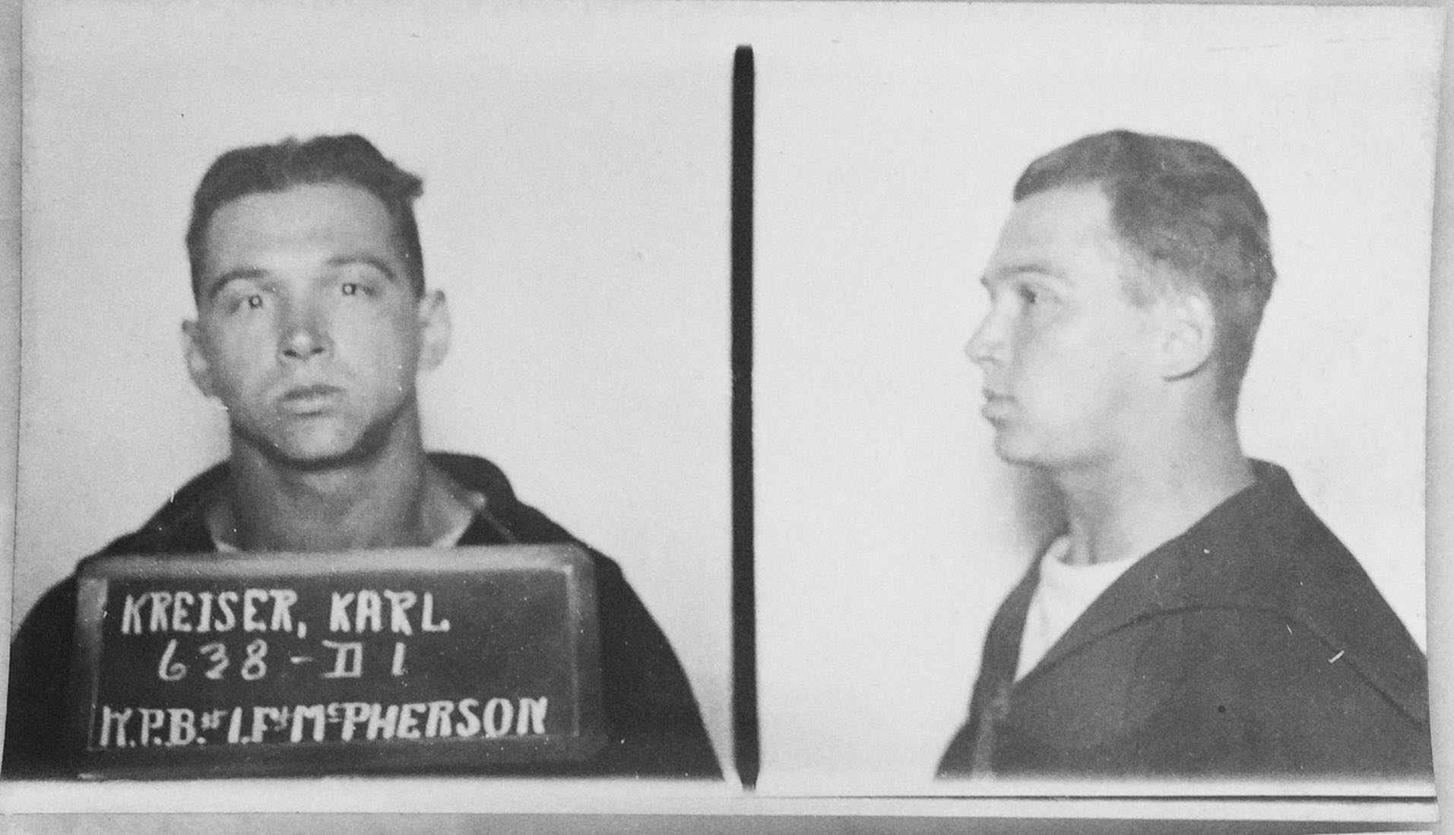

Slide 23
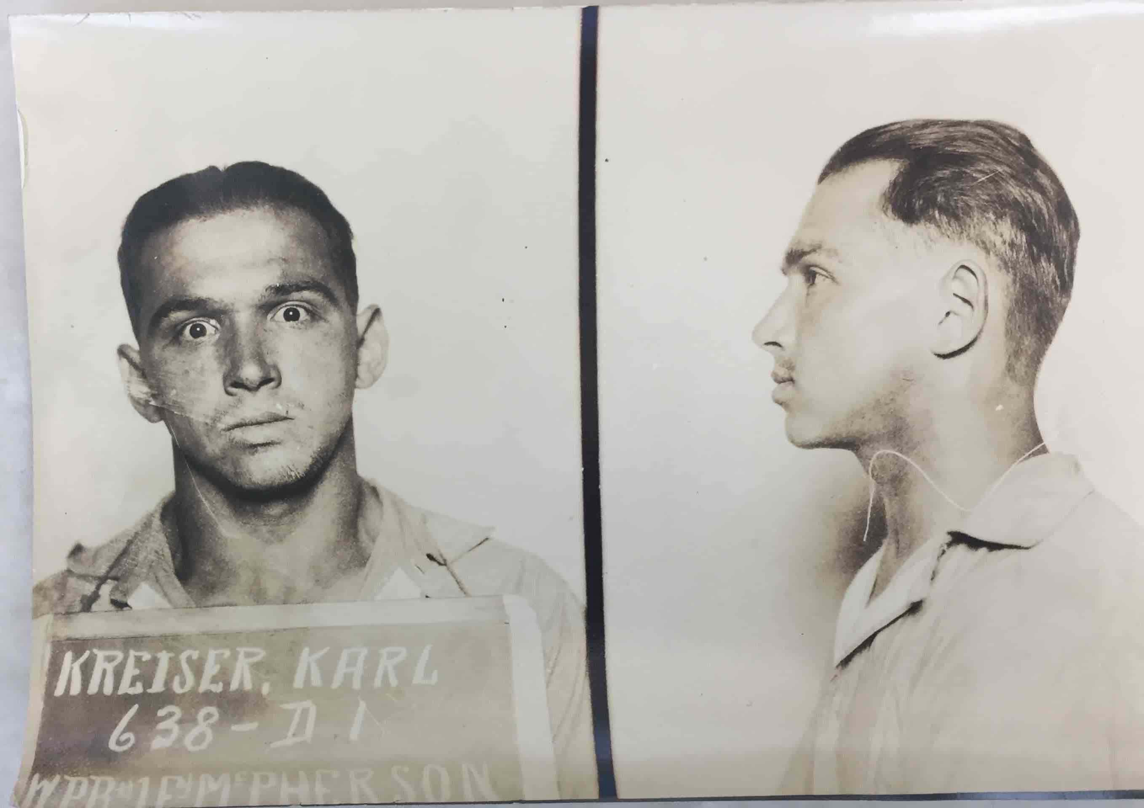

Slide 24
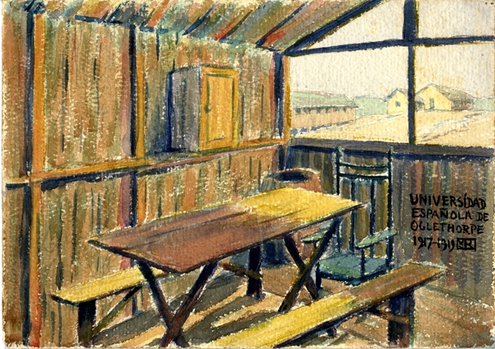

Slide 25
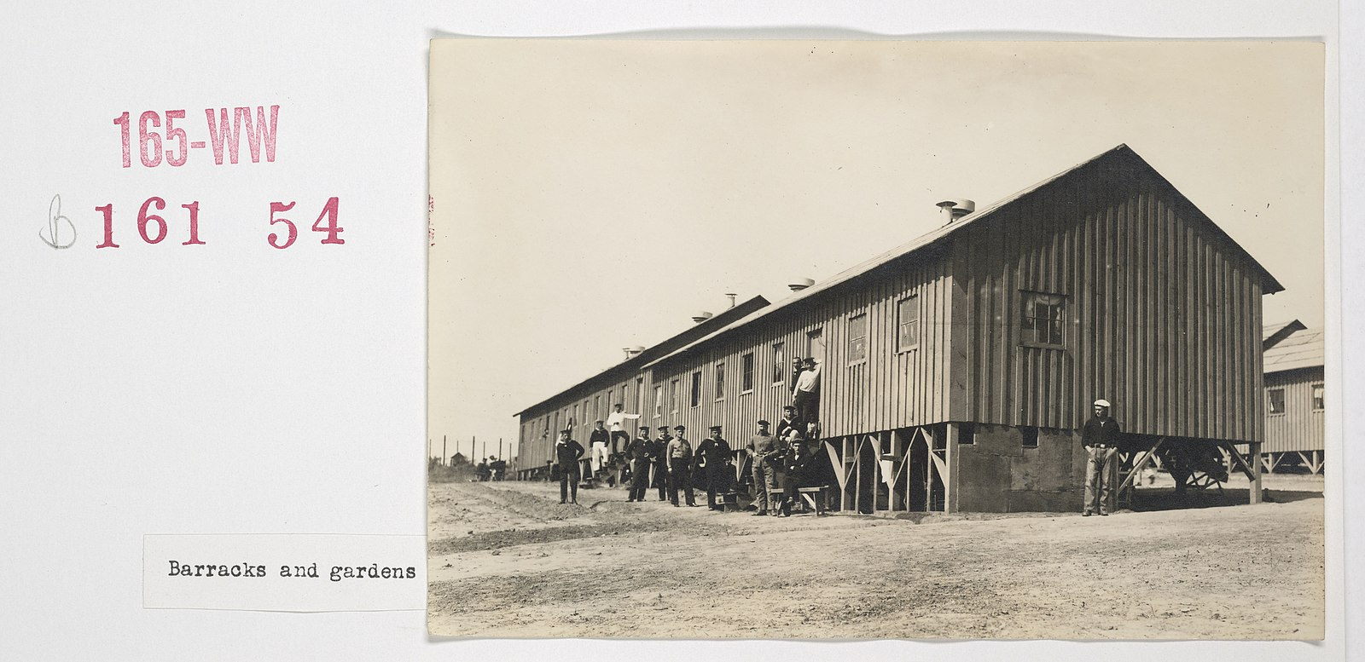
At Fort McPherson Internment Camp, Georgia

Slide 26
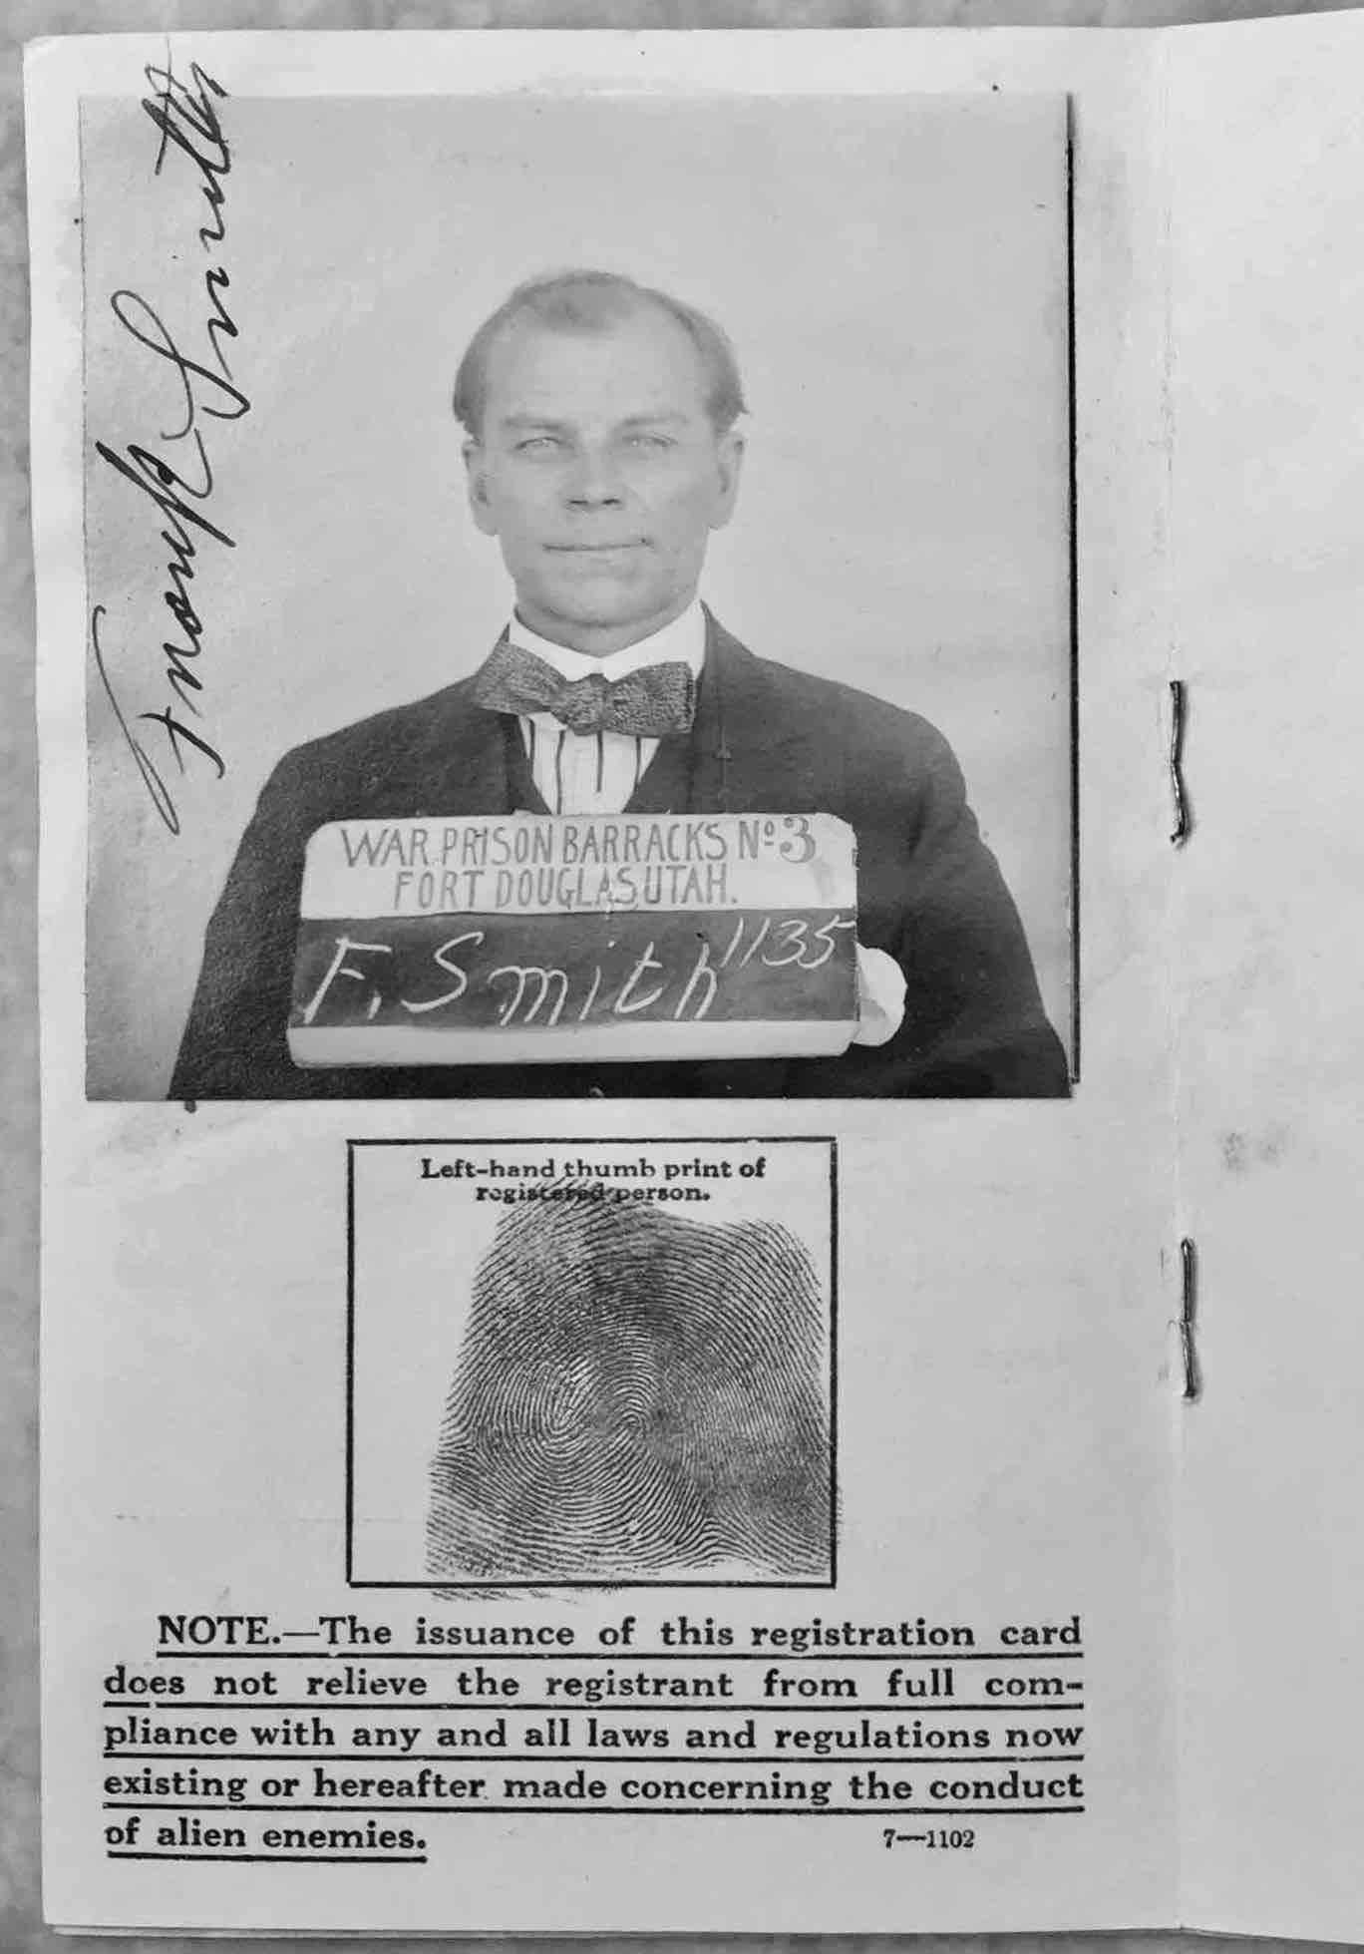
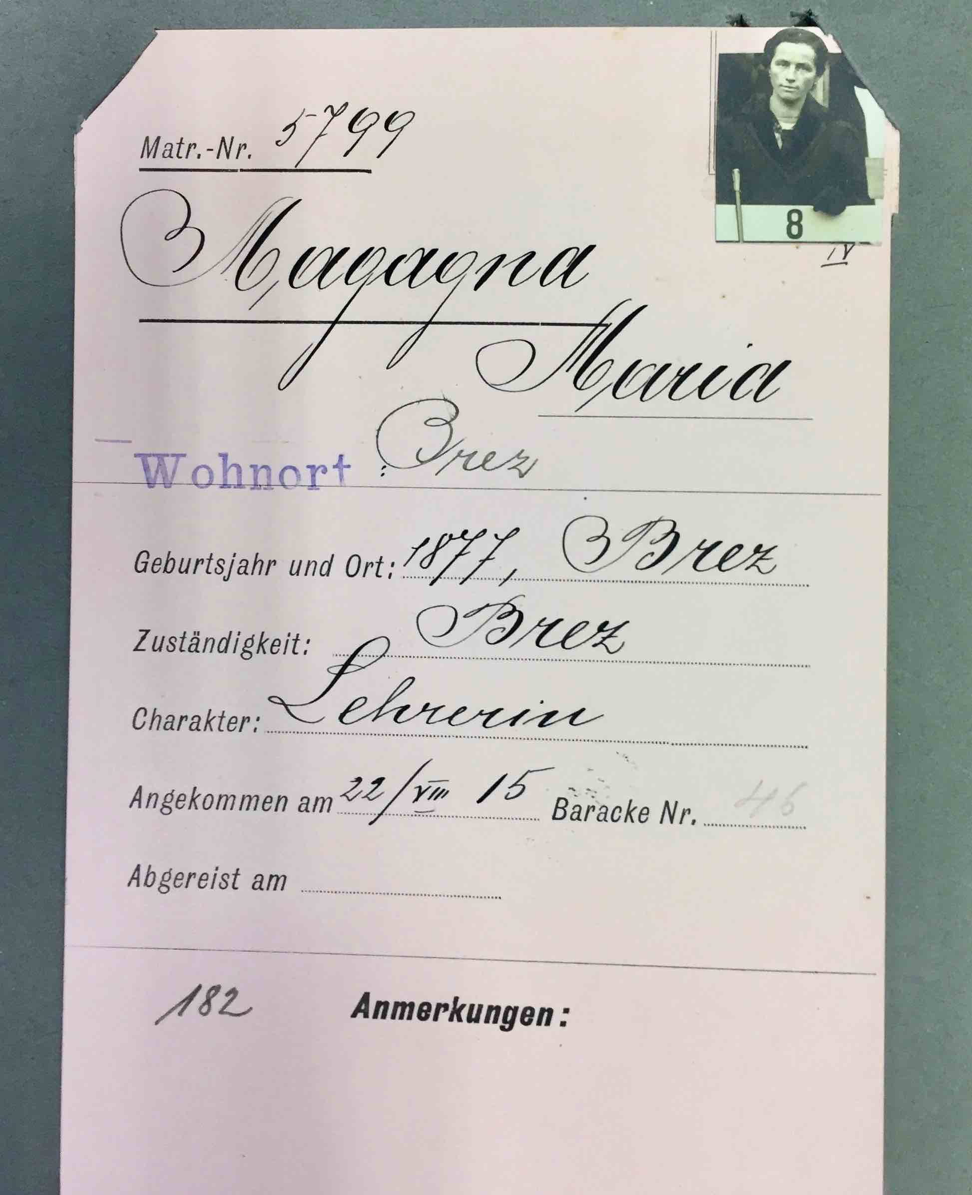

Slide 27
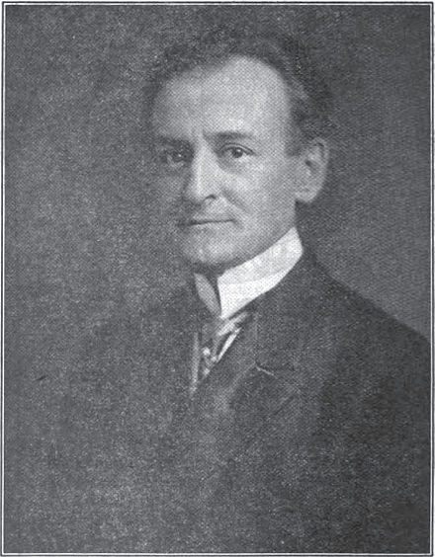
Karl Muck,
Conductor, Boston Symphony
Fort Oglethorpe Camp

Slide 28
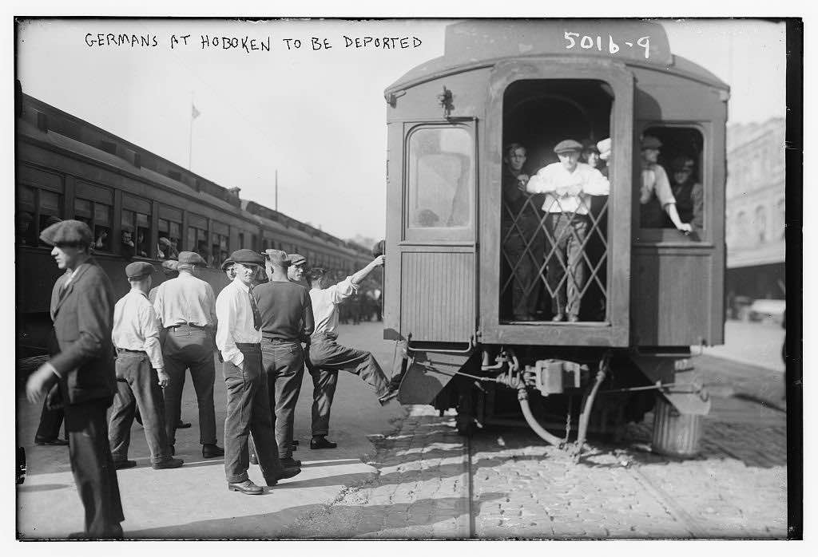

Slide 29
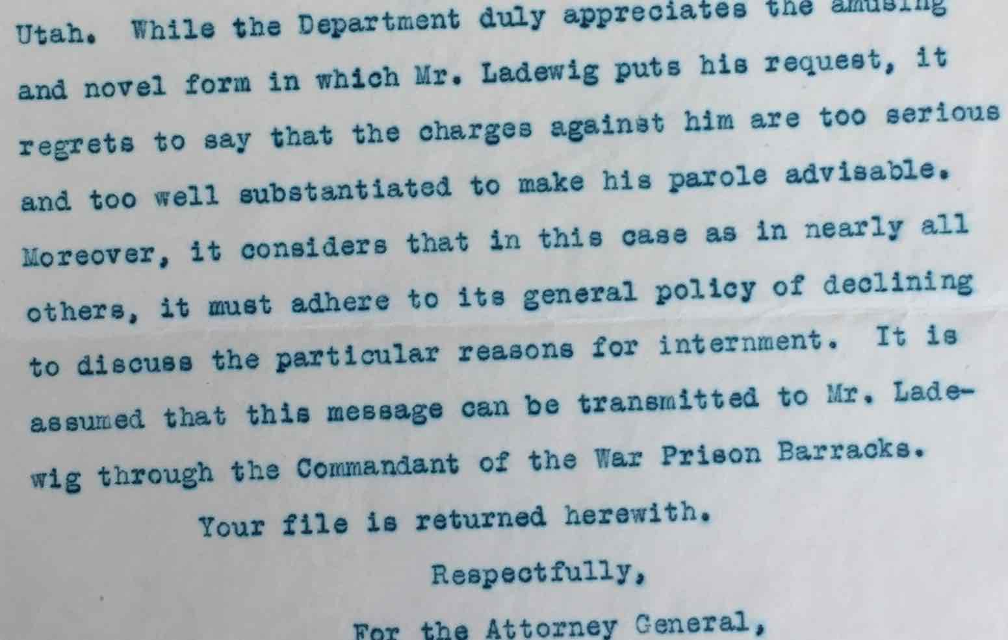
Justice
Dept. opinion in a petition for release…

Slide 30
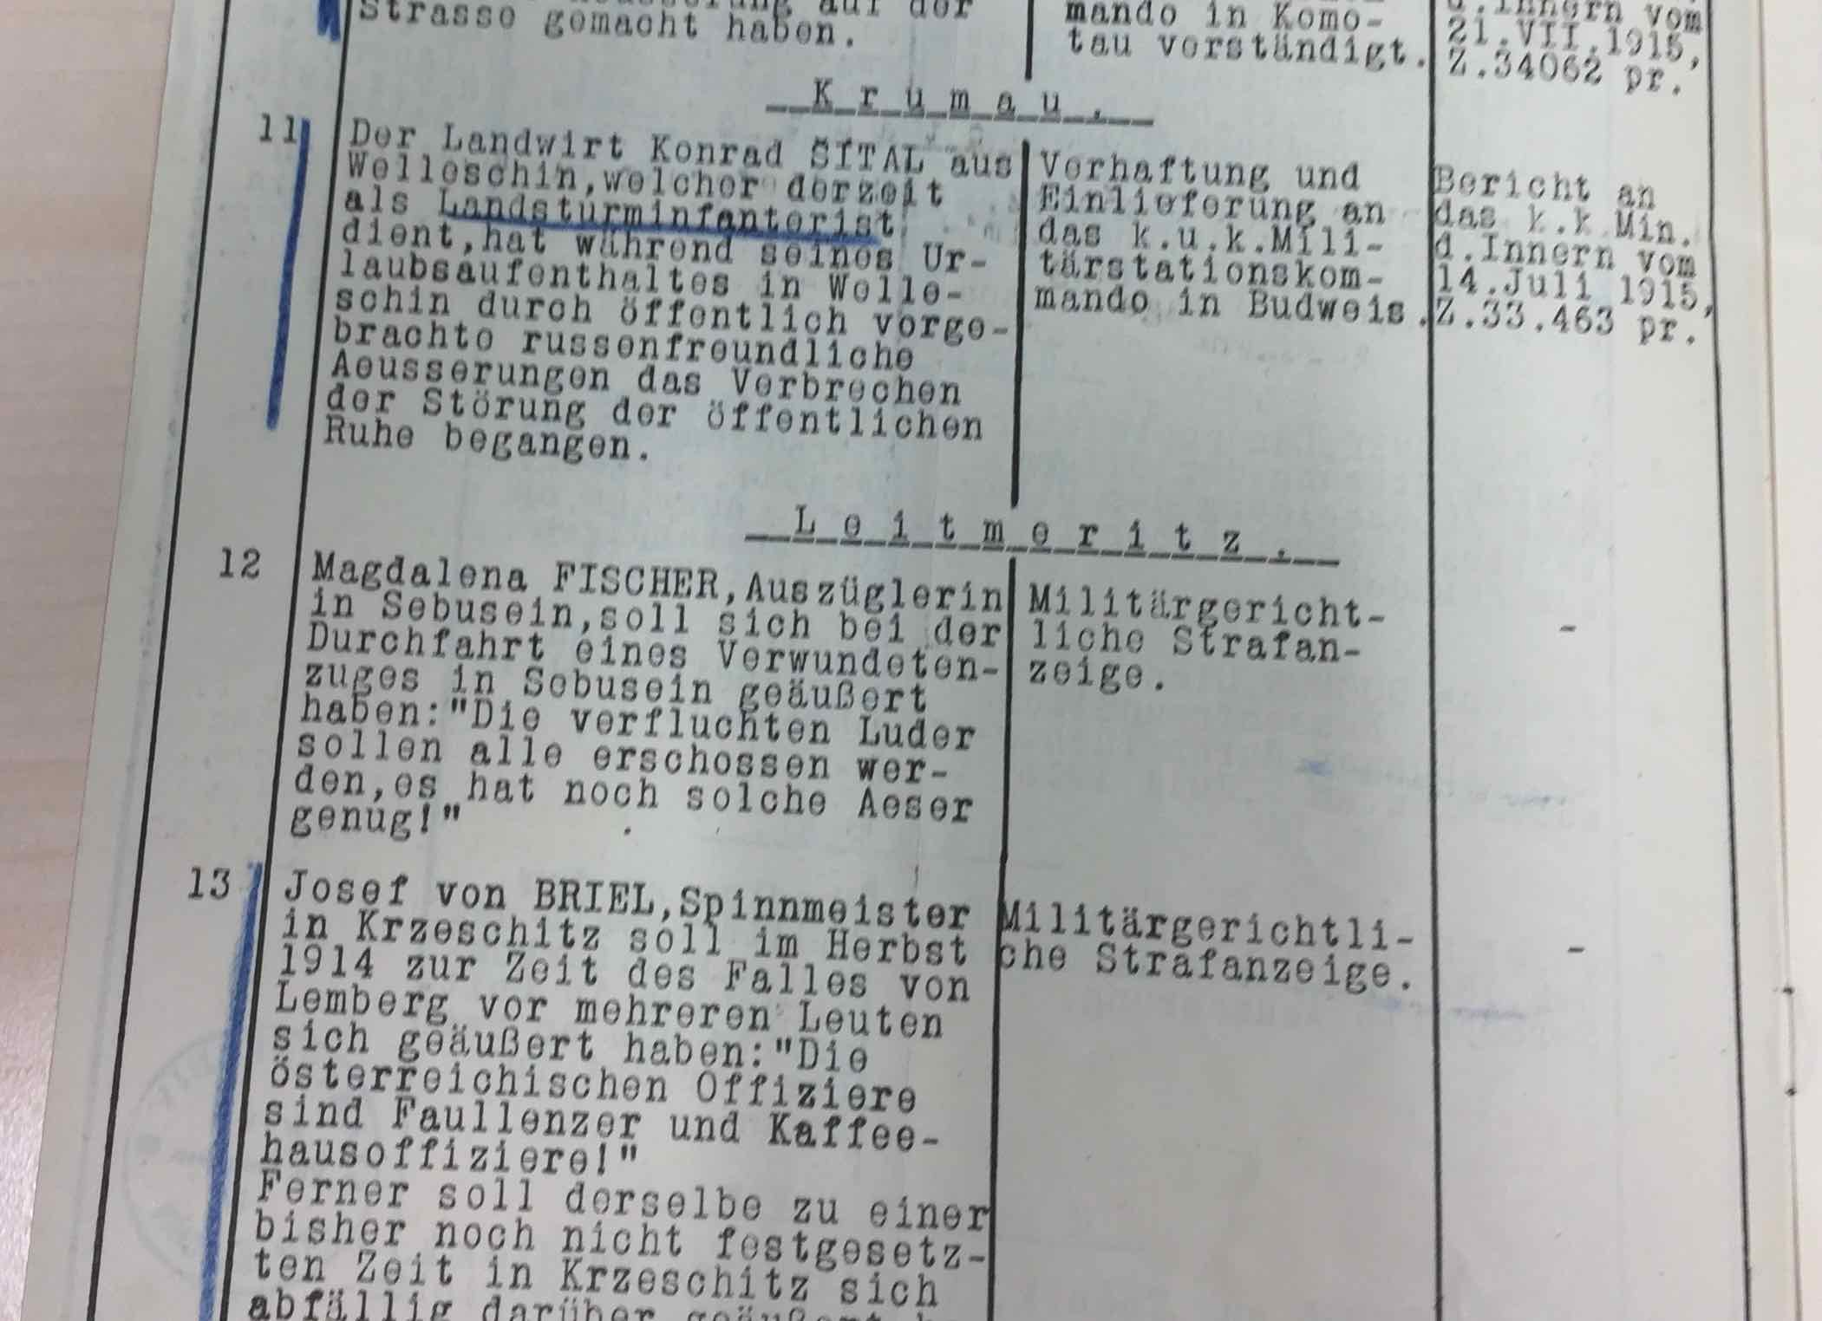

Slide 31
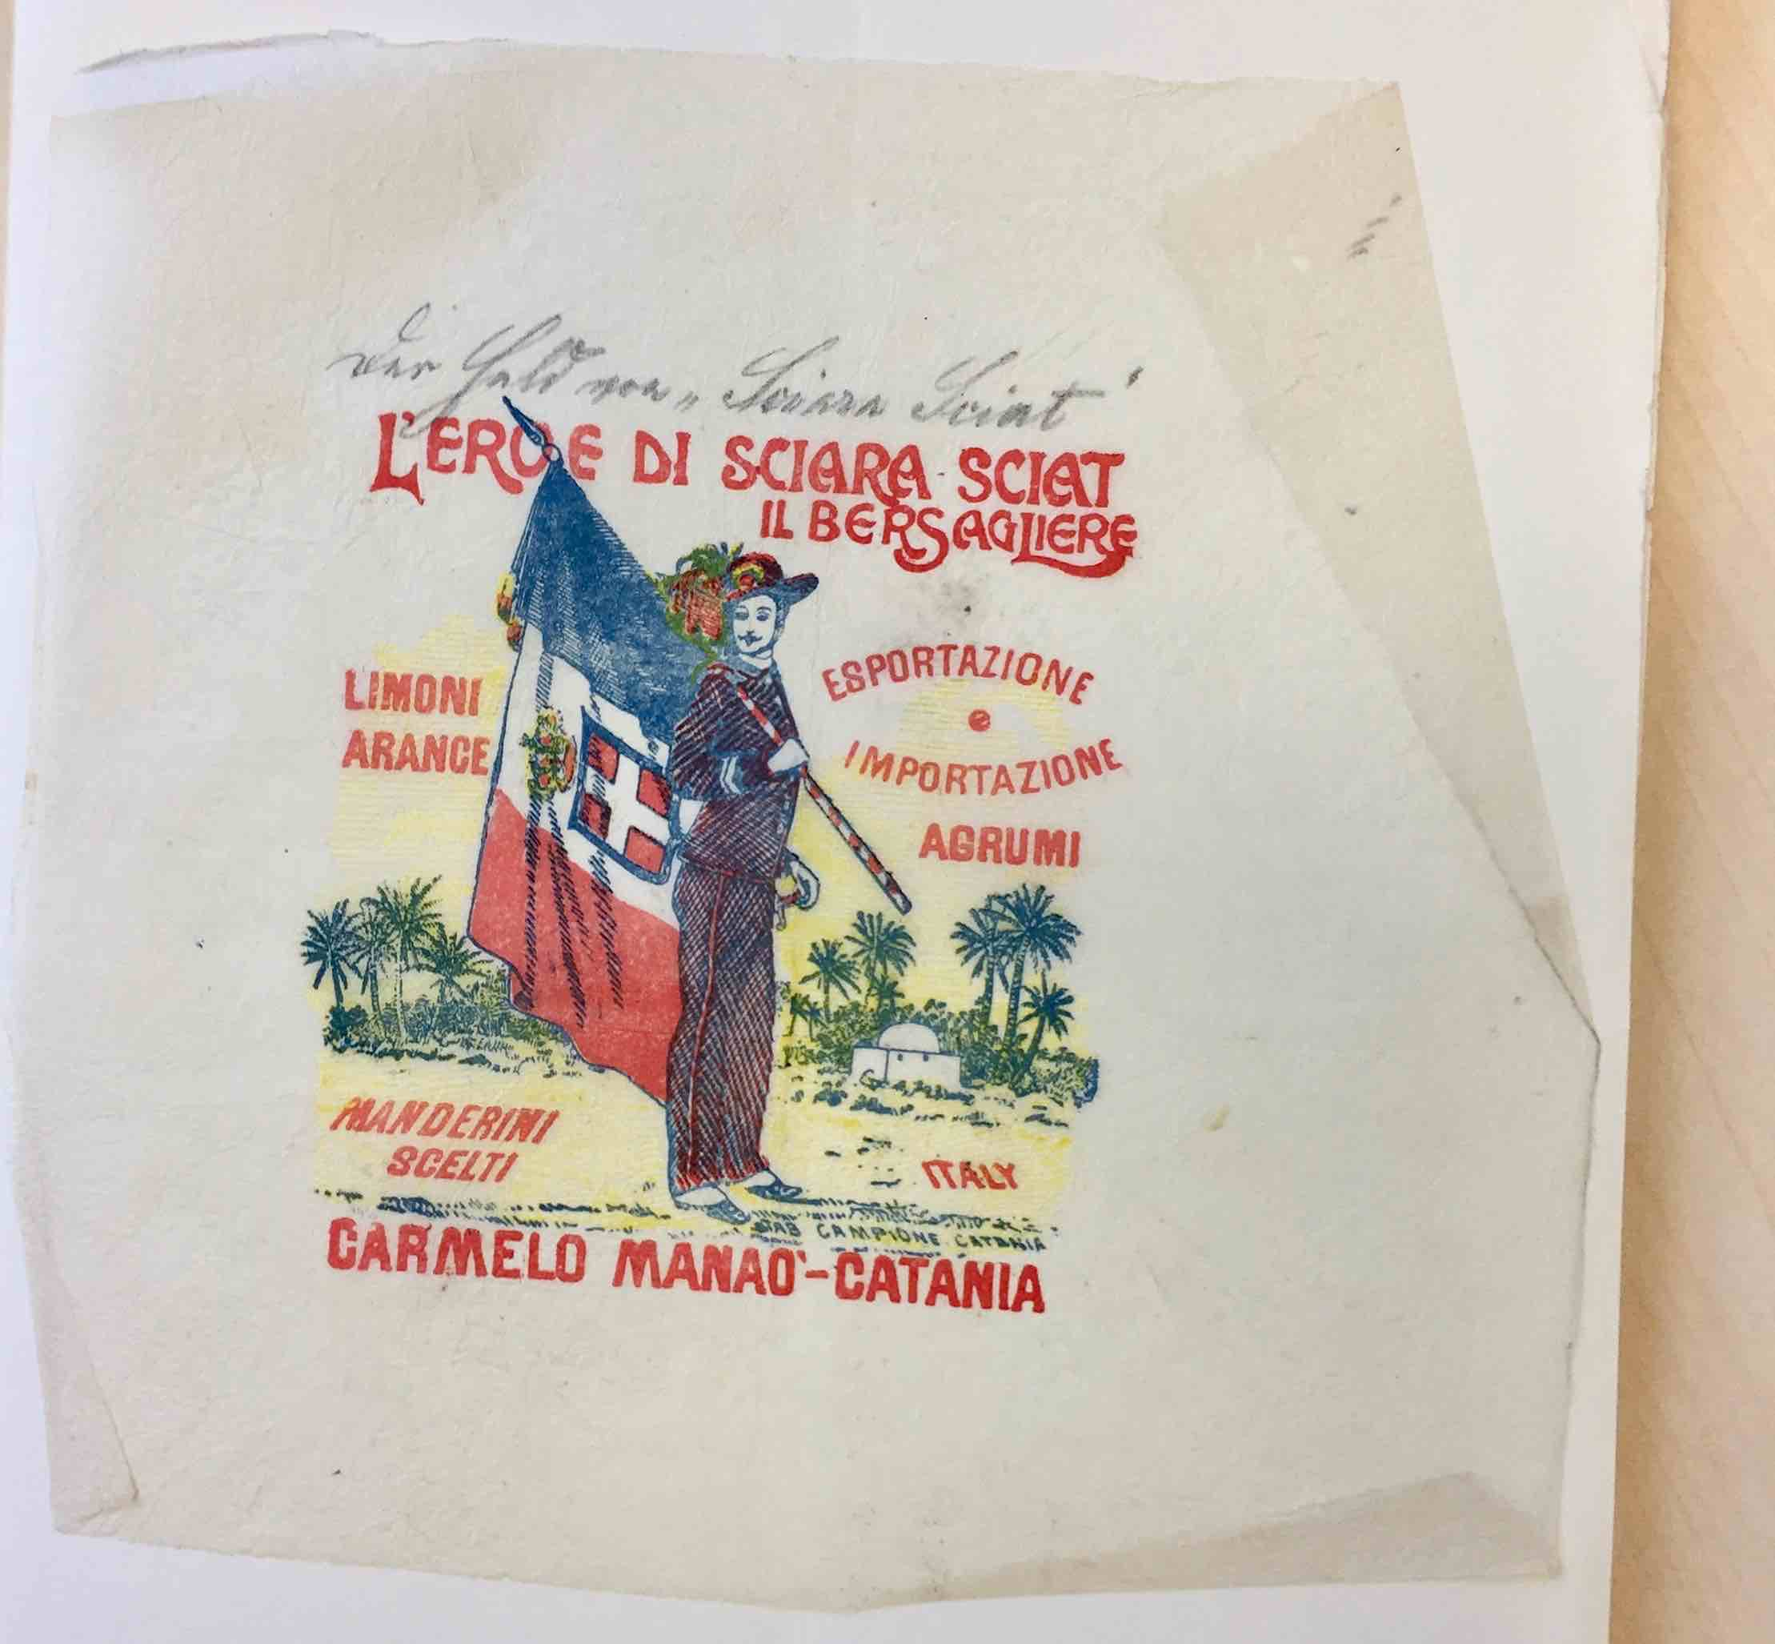
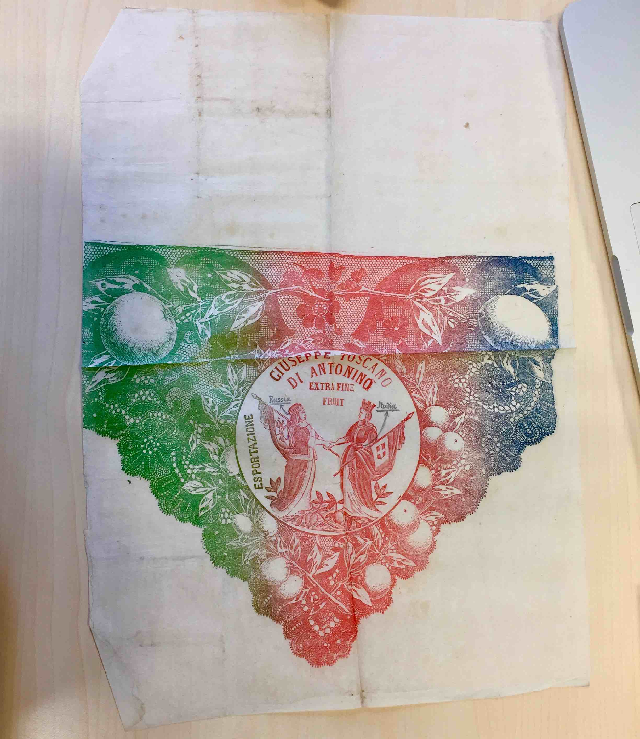

Slide 32
Mises in Omnipotent Government
Modern war is not a war of royal armies. It is a war of the peoples, a total war. It is a war of states which do not leave to their subjects any private sphere; they consider the whole population a part of the armed forces. Whoever does not fight must work for the support and equipment of the army. Army and people are one and the same. The citizens passionately participate in the war. For it is their state, their God, who fights.

Slide 33
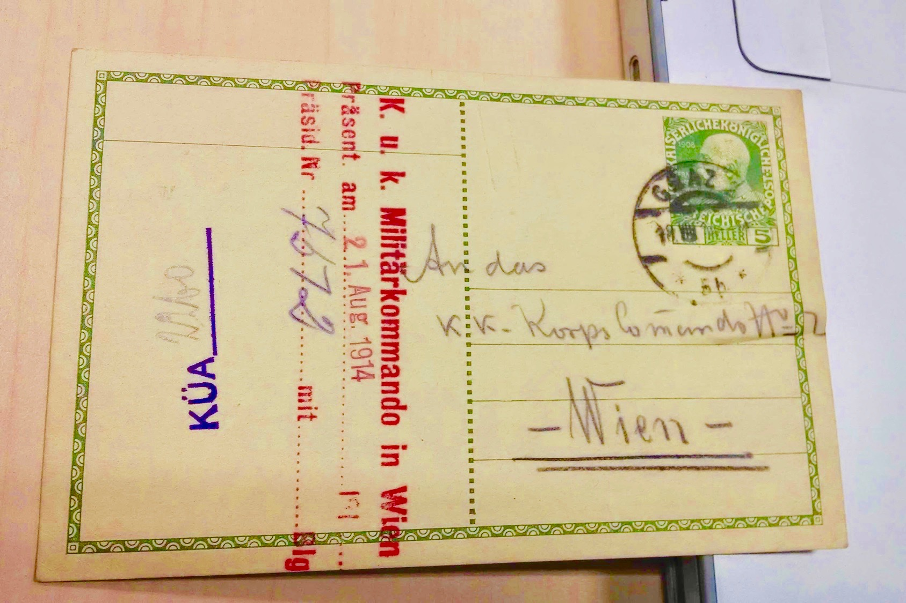

Slide 34
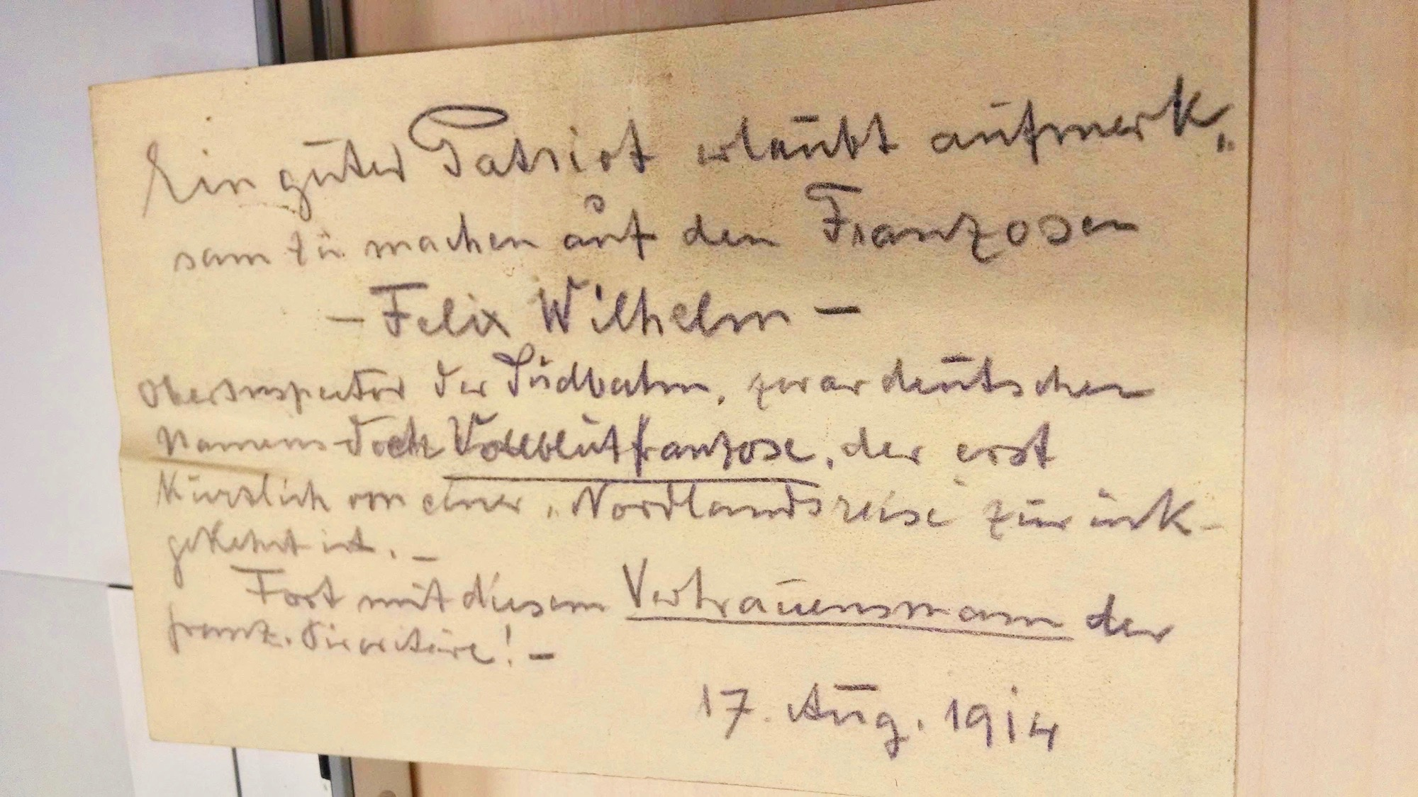

Slide 35
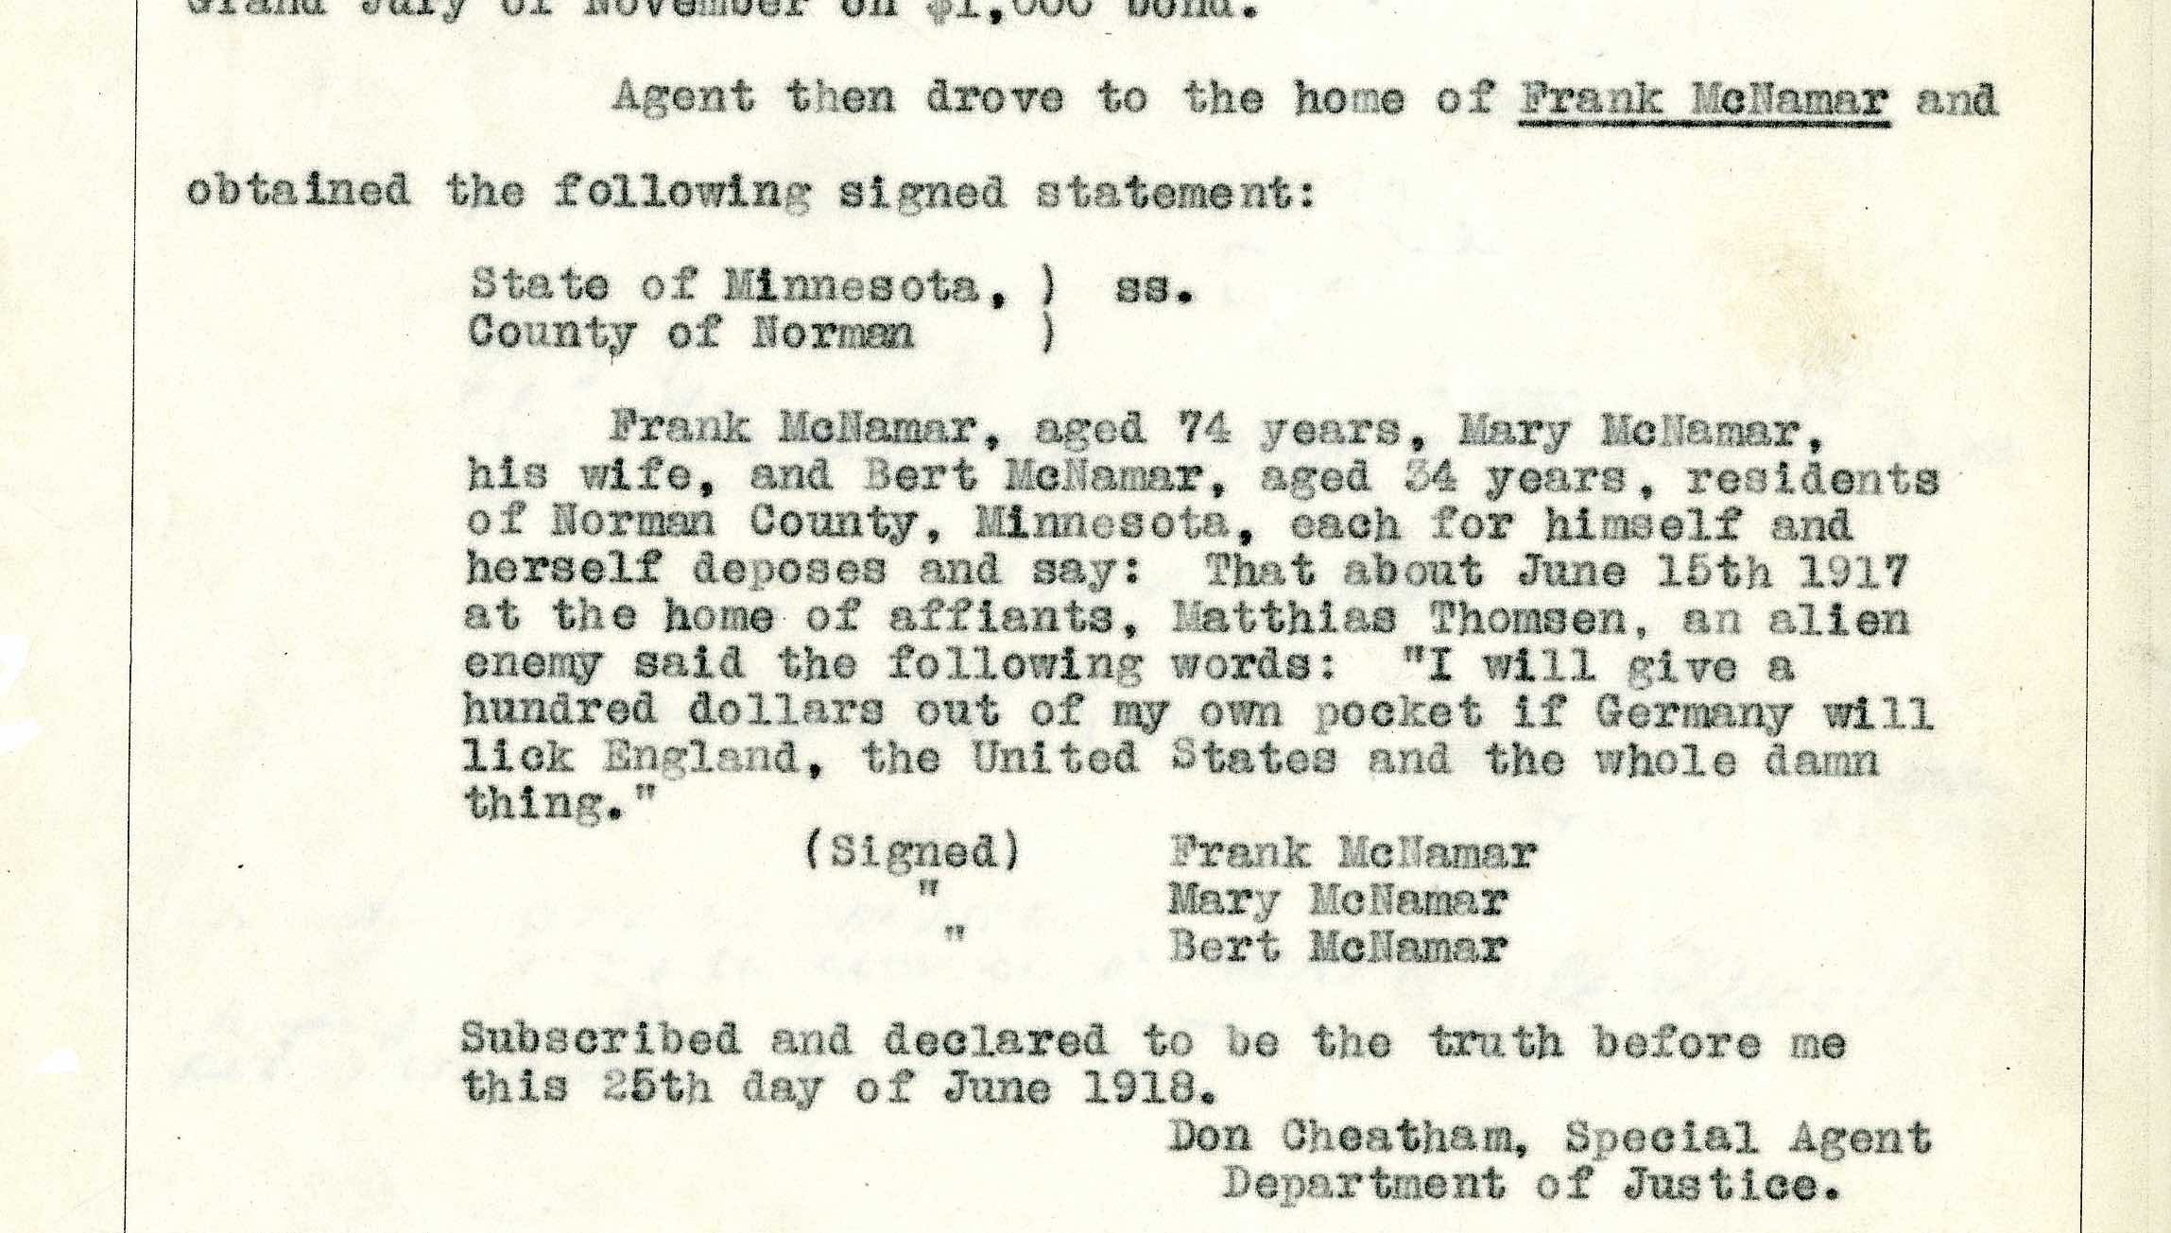

Slide 36
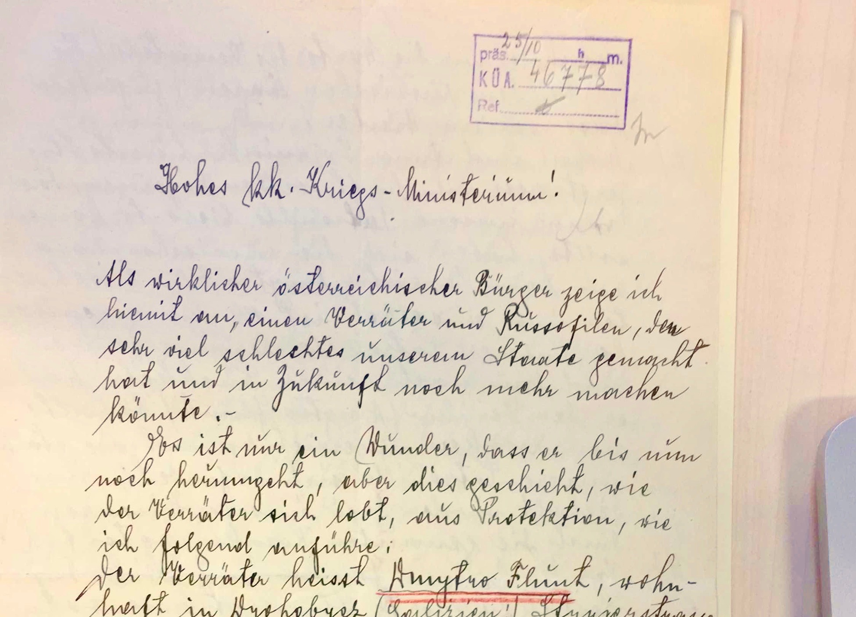

Slide 37
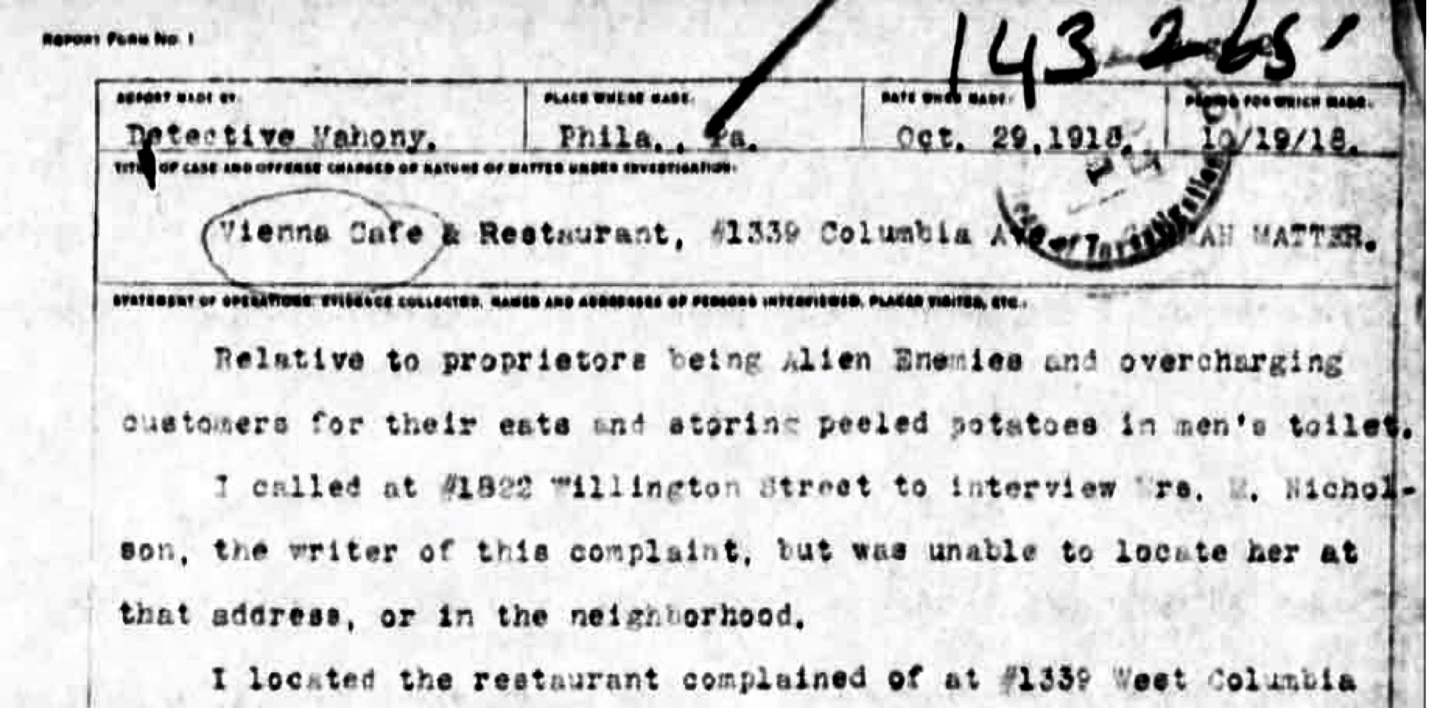

Slide 39
