Slide 1
Verdun and the Somme, 1916
Hunt Tooley, Hist 350

Slide 2
Failed Breakthroughs, 1915
Second Battle of Ypres and other attempted breakthroughs frustrated the opponents on the Western Front.
Churchill’s idea of Gallipoli was a costly failure
On the ocean, German U-Boats made Allied logistics highly dangerous
In the Middle East, the British garrison at Kut, in Mesopotamia, surrendered to the Turkish Army—a huge defeat
On the Eastern Front, the Germans kept winning

Slide 3
The German Plan at Verdun

Slide 4
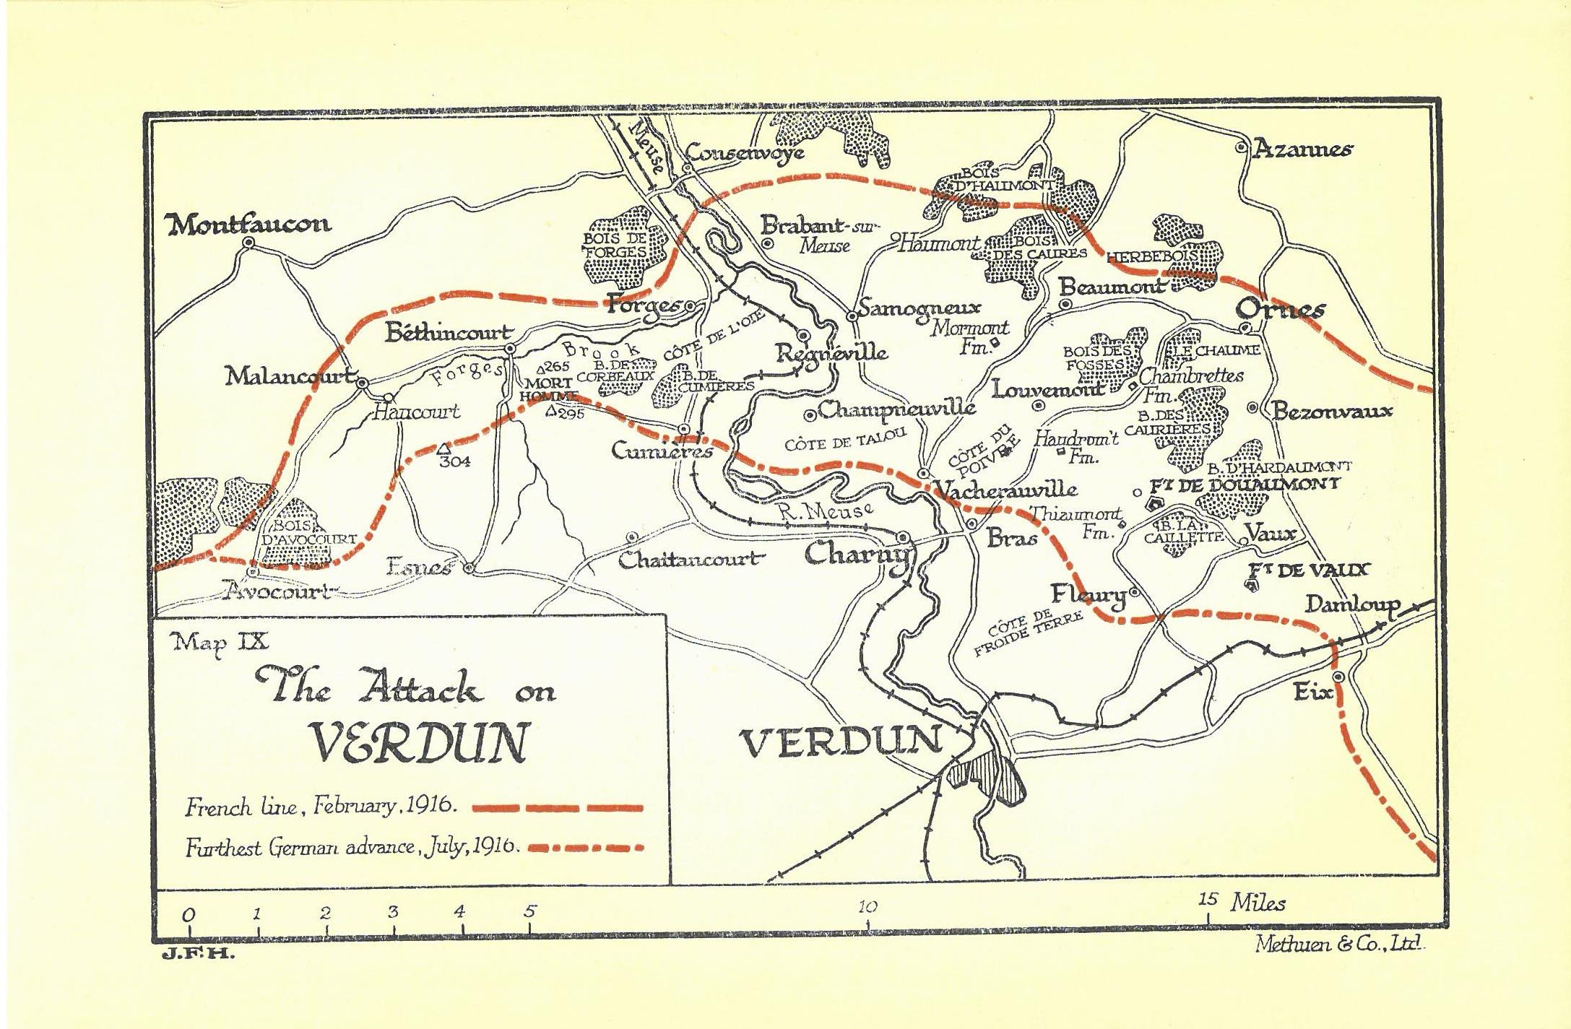

Slide 5
Demographic warfare
Erich von Falkenhayn:
Bleed Them Dry

Slide 6
300 Days: Germans 143,000 killed French 163,000 Killed
Under General Philippe Pétain, the French held

Slide 7
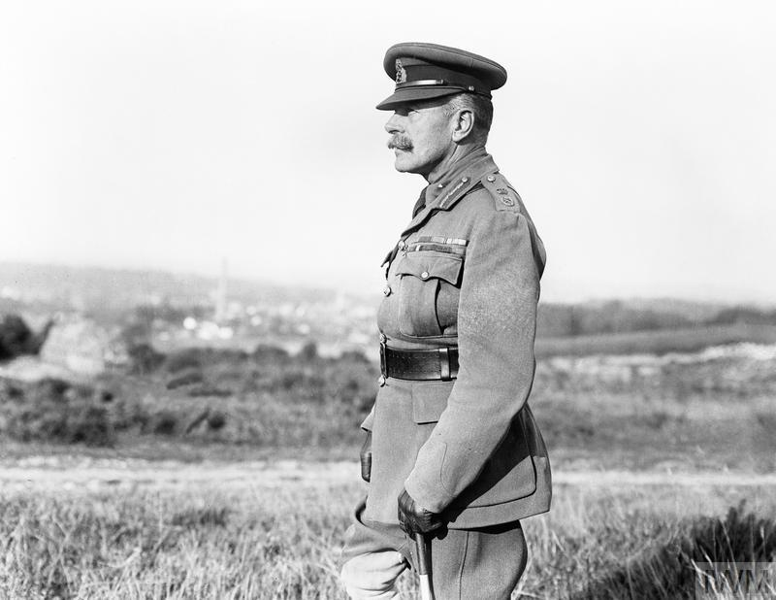
Field Marshall Douglas Haig

Slide 8
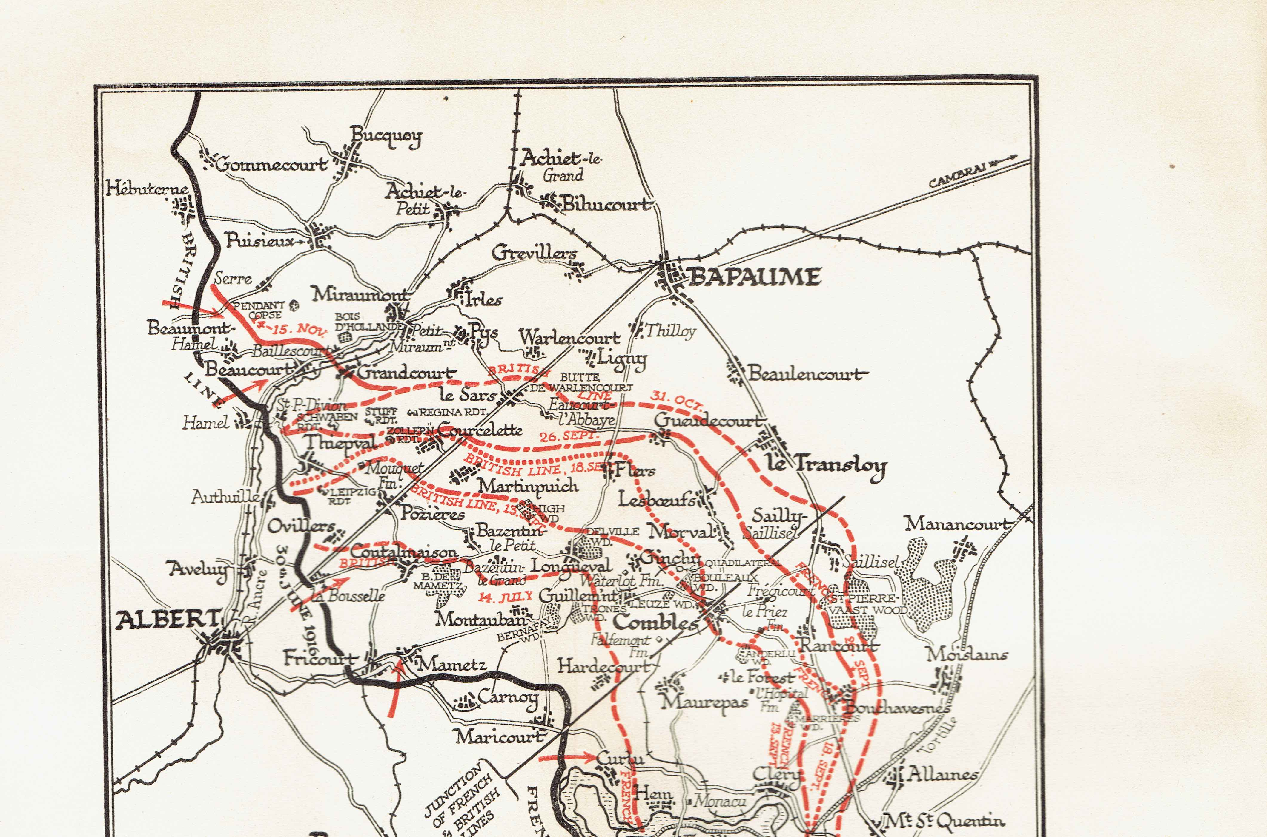
The somme

Slide 9
Plans:
Shell the German lines for a week
Many British and a few French divisions attack
Walk across No Man’s Land behind a walking barrage
Take the German lines.
Simple!

Slide 10
Some Somme results:
July 1, the first day, the British lose 20,000 dead, 60,000 casualties overall
German lines bend in a few places, but don’t break
In four and half months, the two sides suffered a roughly equal number of killed, wounded, captured, and missing: both sides together totaled 1.2 million men
The campaign was roughly a draw
The Germans lost some territory, most of which they recaptured in 1917

Slide 11
Note: The Pal’s Battalions
A great idea for recruiting in the fall of 1914: GO TO WAR WITH YOUR BUDDIES!
Mates from the same coal mines in Yorkshire, factory workers in Manchester, Football and and Rugby teams from the Midlands—all join in
They are ”trained” and ready to fight by July 1, 1916
Their home cities, towns, and counties suffer incredibly high losses at the Somme
Of an estimated 700 Accrington Pals who took part in the attack on Serre on July 1, 235 were killed and 350 wounded within the space of twenty minutes. Casualty total: 83%

