Slide 1
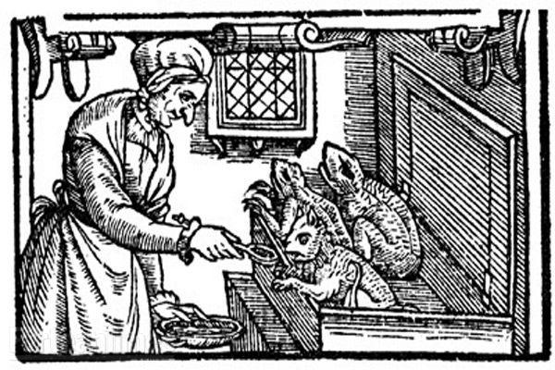
Witches!!

Slide 2
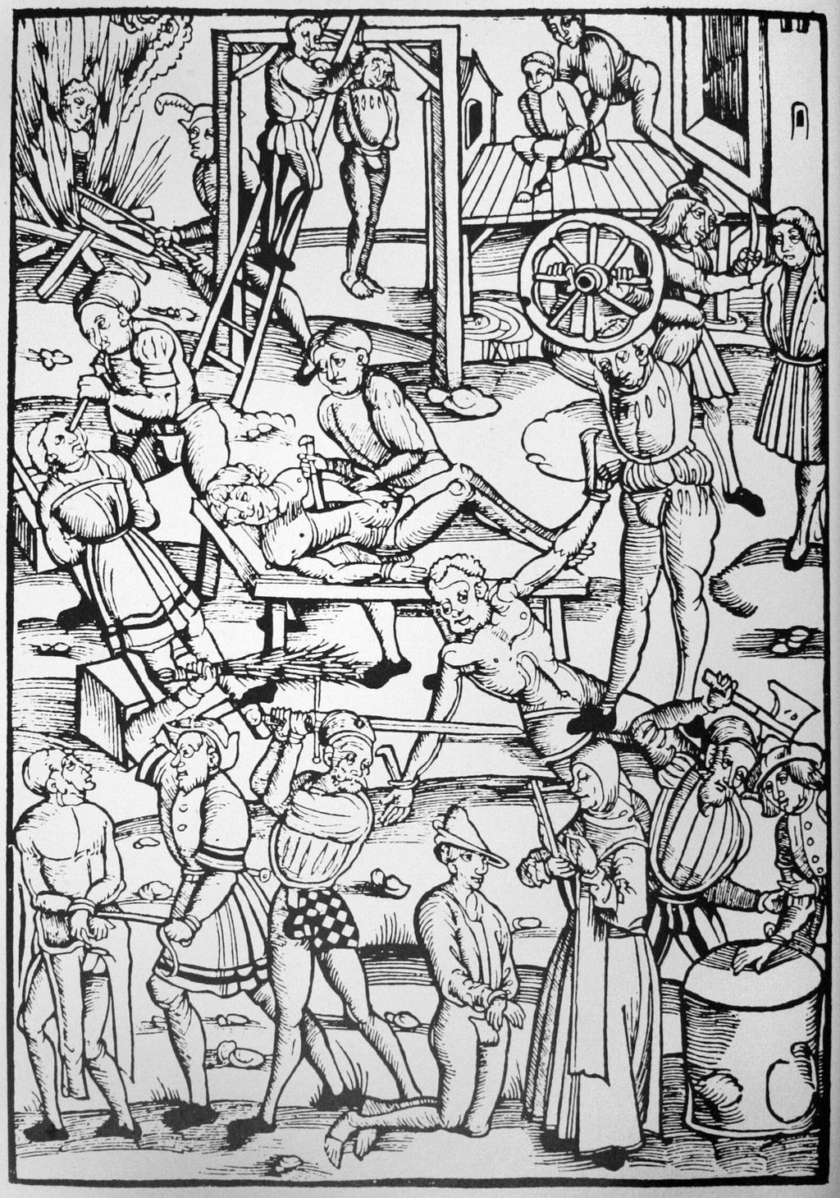
Brutality and a Hundred Years of Crisis

Slide 3
Think Crisis in the intellectual, nutritional, spiritual, political, and economic spheres in Europe:
Let’s say from around 1500 or 1525 to around 1640 or 1650.
OK, that’s more than a century, but a century sounds better than a 125 years of crisis or whatever

Slide 4
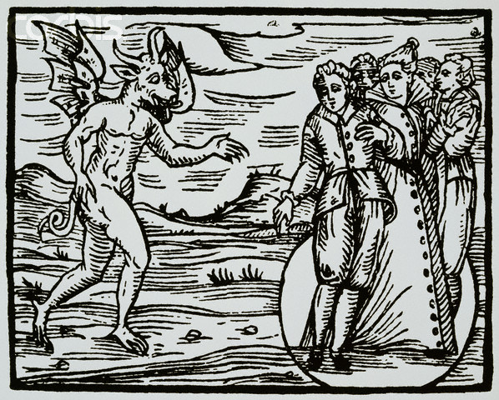
The Medieval Belief System, Magic, and the Devil

Slide 5
Medieval Period—Very Few Witch Concerns
Older belief systems incorporated potions, healing, herbalism, etc.
Most localities had “wise women” and “cunning men” who used herbs, spells, etc. to heal livestock and people and bless crops etc.

Slide 6
Something to think about
Weather and Climate

Slide 7
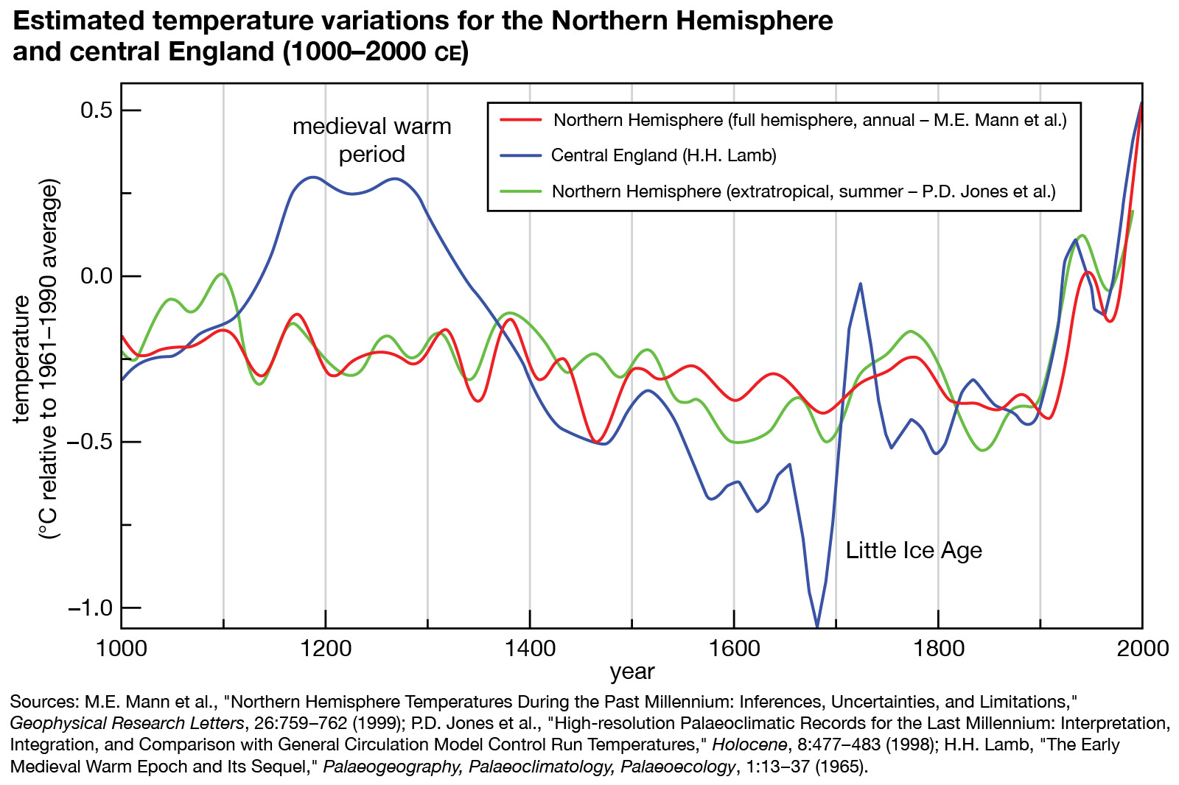
Weather Factor

Slide 8
Something to think about in connection with the witch craze
Social Factors
Economic Dislocation—Beggars
Peasant Uprisings

Slide 9
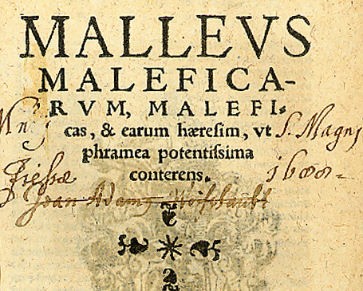
Heinrich Kramer:
Discredited, probably insane, Catholic clergyman in Speyer.
First ed. 1487
Summation: Witches are REAL!
Hammer them! Heresy and Sex are the issues!

Slide 10
Notes on Malleus Maleficarum
It was a gruesome and voyeuristic nightmare version of popular belief in witches and demons.
The Church pretty much rejected it.
But it caught on with all kinds of readers (printing helped).
In the end, it was almost always civil authorities, not the Church or the Inquisition, which proceeded with great cruelty against witches during the witch hunts.

Slide 11
Note on Witches and Women
Although even Kramer included men as potential witches, the vast majority of “witches” later condemned in the witch craze were women, as seen in the images to come.
1485--Kramer “investigated” the case of Helene Scheuberin in Innsbruck, who was on trial for killing a man by sorcery. The case fizzled, Scheuberin was released, and Kramer was expelled by a local bishop, partly because of his voyeuristic interest in the sex practices of Scheuberin and some other local “witches.” He left Innsbruck and wrote his book.

Slide 12
Biblical Texts Regarding Witches
Leviticus 19:31 Regard not them that have familiar spirits, neither seek after wizards, to be defiled by them: I am the LORD your God.
Leviticus 20:27 A man also or woman that hath a familiar spirit, or that is a wizard, shall surely be put to death: they shall stone them with stones: their blood shall be upon them.
Deuteronomy 18:10 There shall not be found among you any one that maketh his son or his daughter to pass through the fire, or that useth divination, or an observer of times, or an enchanter, or a witch...

Slide 13
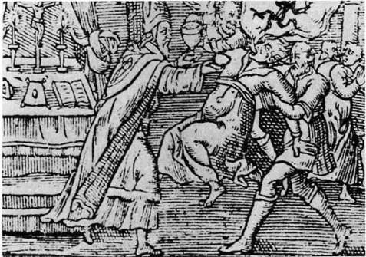
Thou shalt not suffer a witch to live.
Exodus 22:18

Slide 14
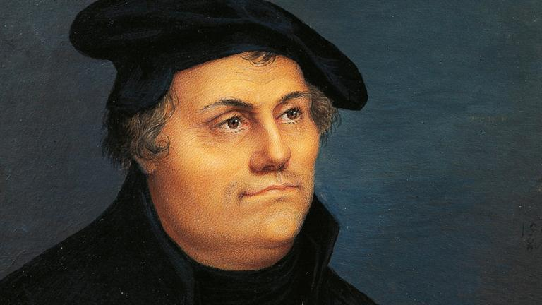
The Protestant Reformation
Luther’s 95 Theses—the opening of the reformation, 1517.
Henry VIII, Anglican Church, 1534
Calvin’s Institutes of the Christian Religion, 1536
St. Bartholomew’s Day Massacres, 1572

Slide 15
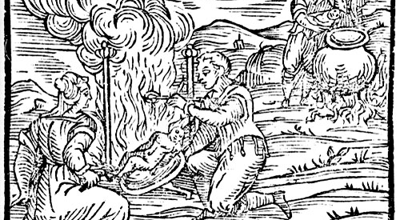
from Compendium maleficarum, 1603 by Francesco Maria Guazzo

Slide 16
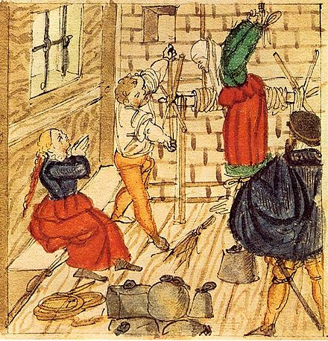
Results:
torture,
days’ long
interrogation,
death,
most
often by
fire

Slide 17
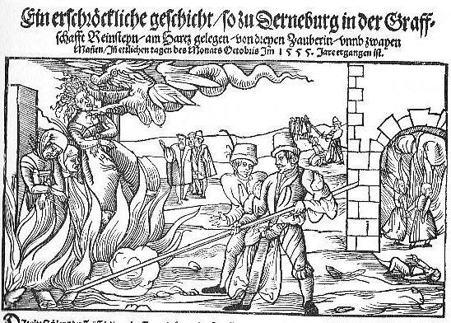
Central Germany 1555

Slide 18
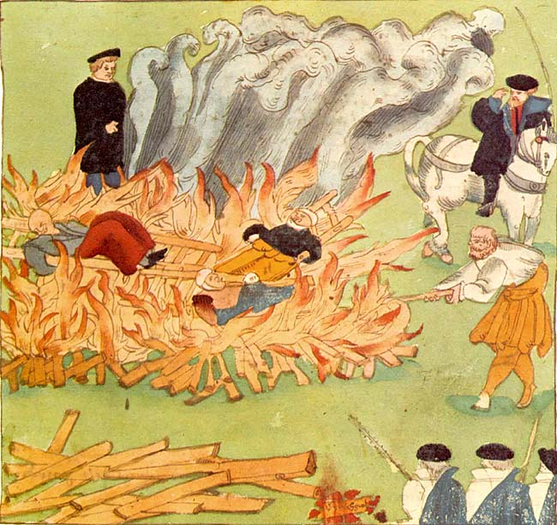
Switzerland
1585

Slide 19
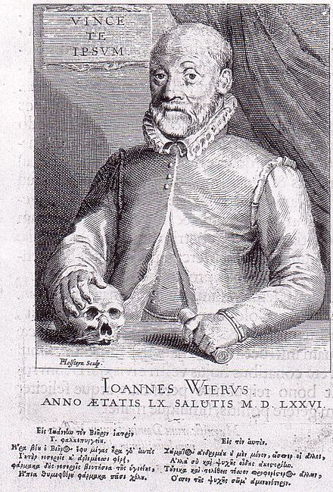
Johann Weyer
de praestigiis daemonum, 1563
a famous demon hunter downplays the idea of actual witchraft.

Slide 20
And to think...
The sixteenth century saw the beginning of the Age of Reason: Johann Weyer himself, Nicolas Copernicus, the beginnings of the rationality of the Scientific Revolution, and more.

Slide 21
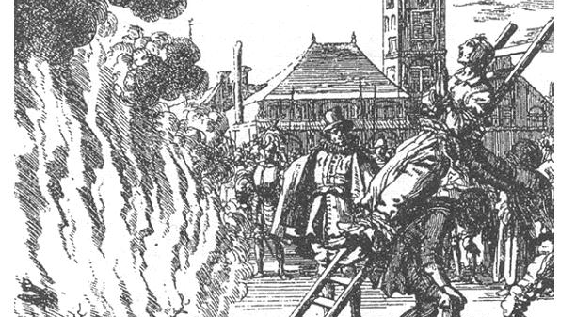
17th Century England

Slide 22
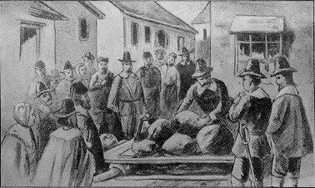
Salem Witch Trials
1692-93
Twenty executed, one pressed to death.

Slide 23
From 1500 to 1700
between 35,000 and 100,000 deaths in witch executions and torture in Europe
the great majority were women.
Witchcraft ceased being prosecuted in the eighteenth century nearly everywhere in Europe.

