Slide 1
Redshift Estimation and Photometric Classification of SDSS Quasars
Nathan Steinle
UTD Physics Department
Notes:
Hello everyone, I am Nathan steinle, a graduate student at the phys department here, and I’m going to talk about how I used machine learning to study quasars.
To start us off, I’m going to treat us with a little poem…….

Slide 2
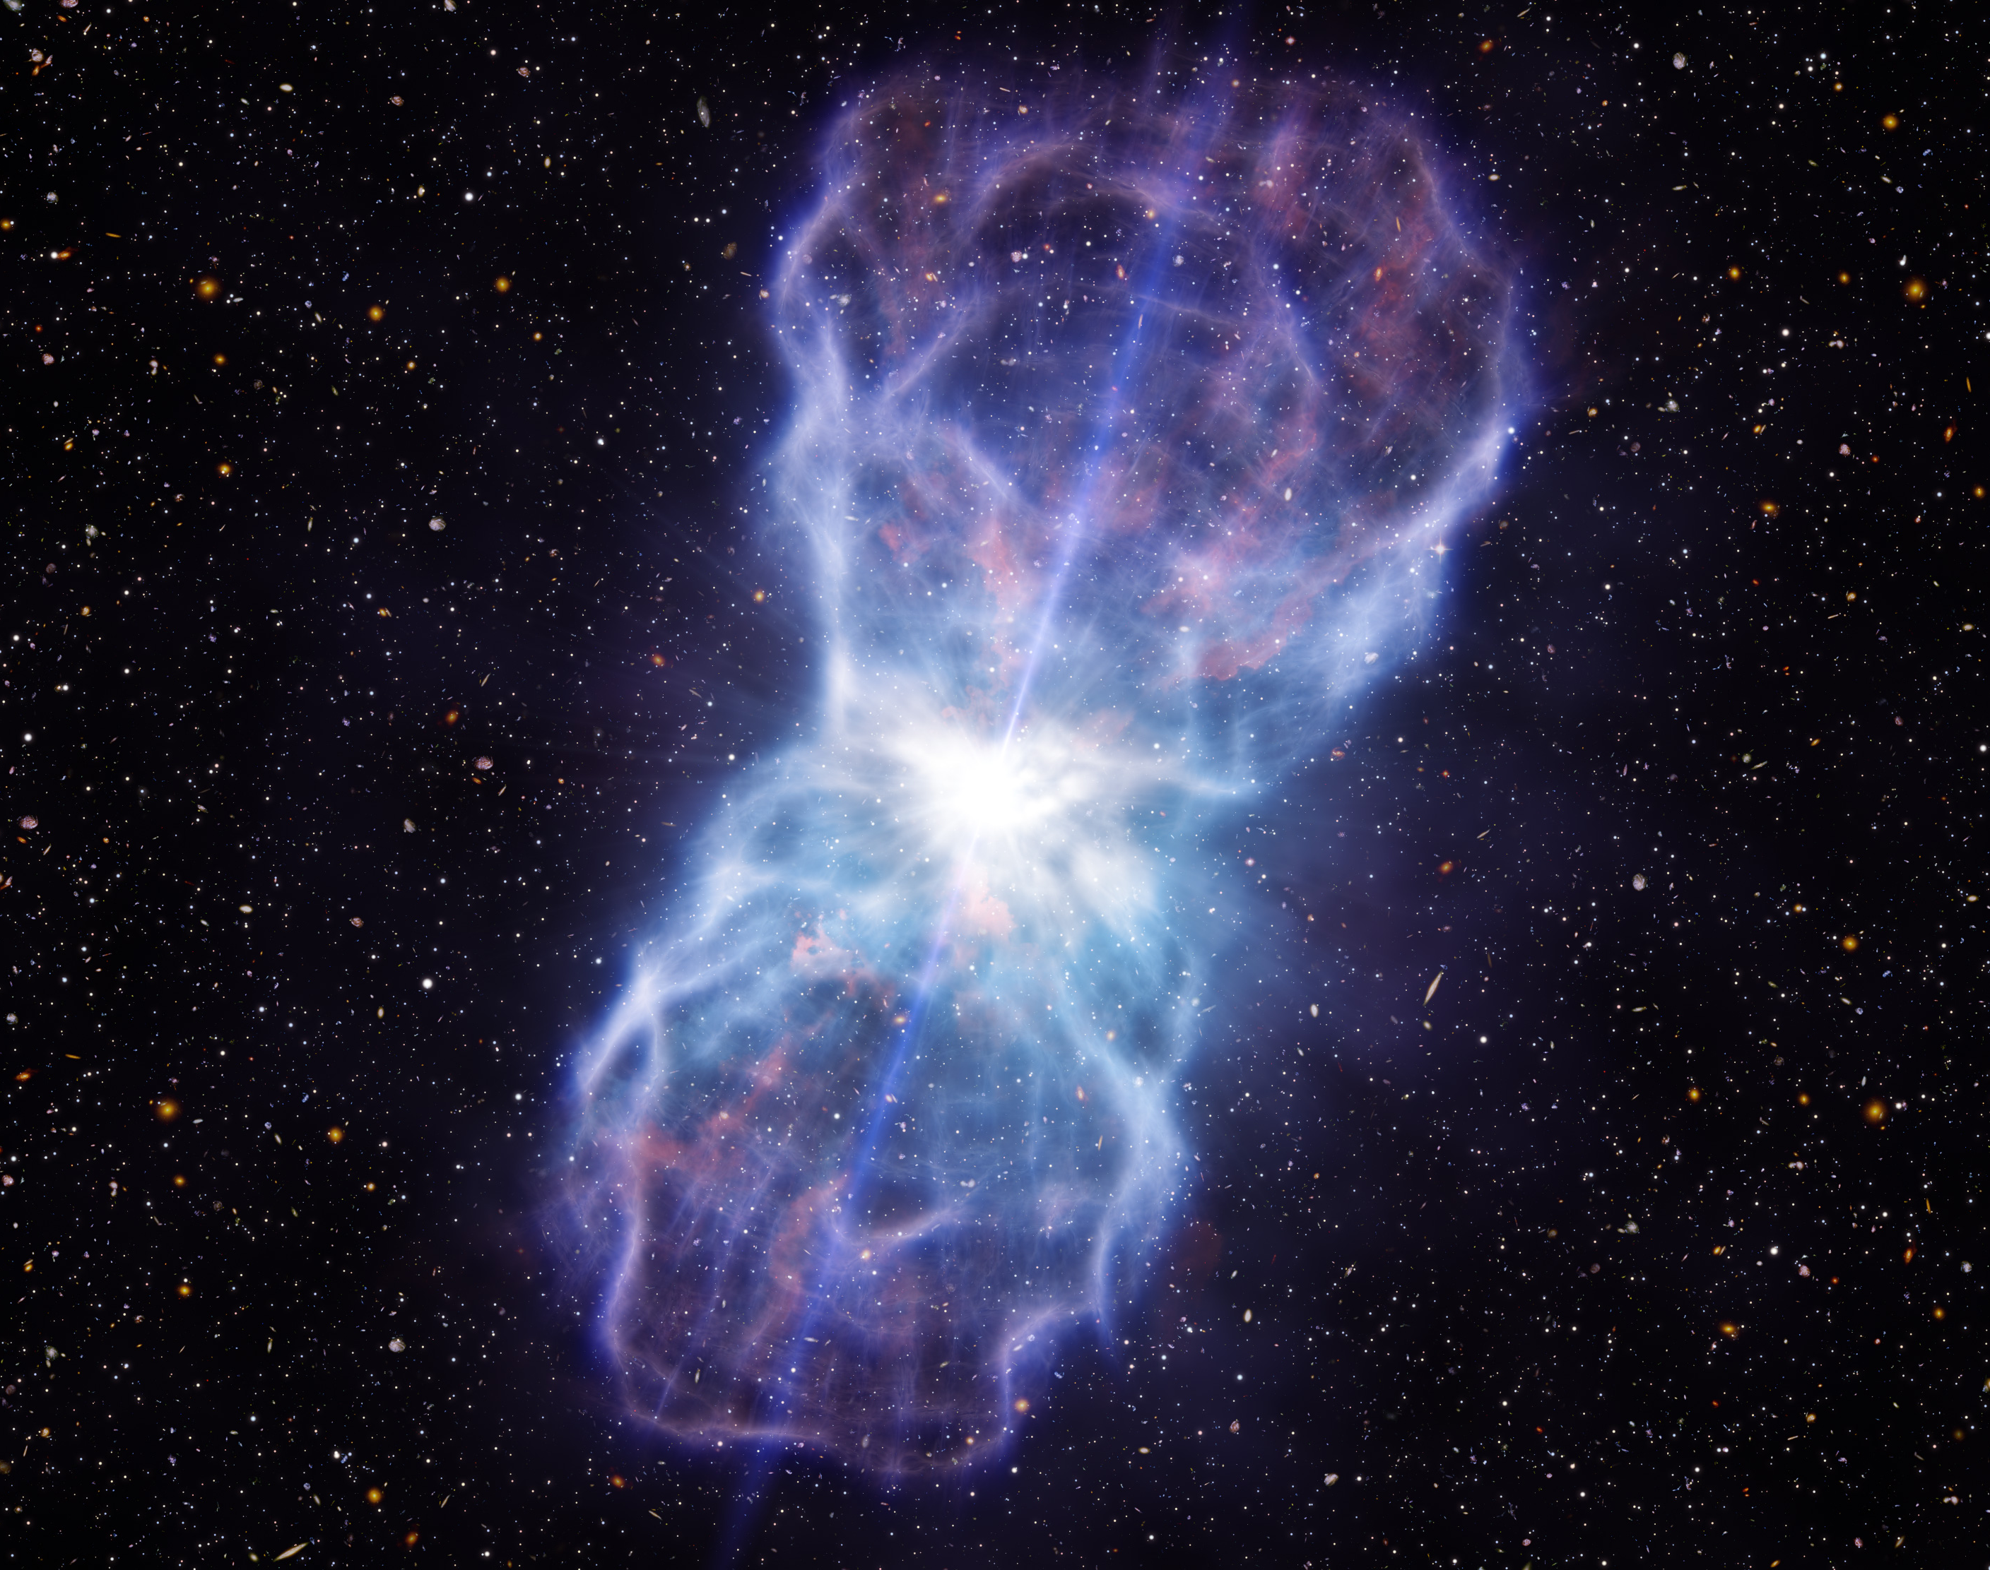
SDSS J1106+1939
Twinkle, twinkle, quasi-star, Biggest puzzle from afar. How unlike the other ones, Brighter than a trillion Suns. Twinkle, twinkle, quasi-star, How I wonder what you are! - George Gamow
Exploring the Cosmos, Louis Berman, Ch. 14, pg. 311, 1973
https://scitechdaily.com/scientists-discover-the-most-powerful-quasar-outflow-ever/
Notes:
Data reveals that a mass of approximately 400 times that of the Sun is streaming away from this quasar per year, moving at a speed of 8000 kilometers per second.
400 solar masses ejecting from this quasar per year.

Slide 3
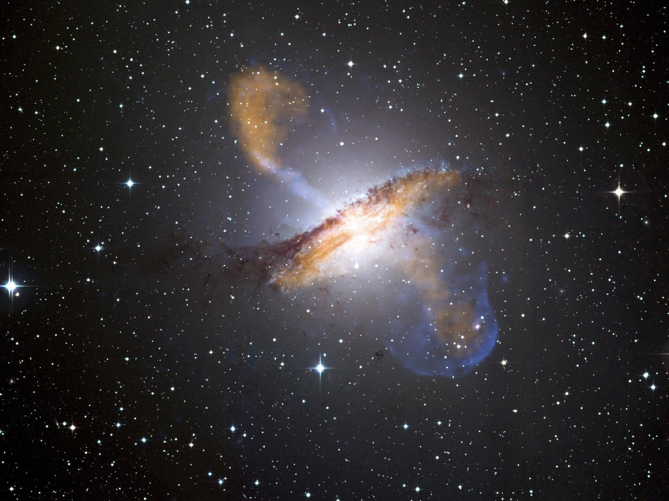
Quasars are the most active galactic nucleus (very high luminosity)
Nowadays, very large data sets:
Advanced Statistics
Big Data
Machine Learning
Centaurus A
http://math.ucr.edu/home/baez/doomed.html
Notes:
Quasars are perhaps the most interesting astrophysical objects we know of – probably because we know so little about what they are even though they are studied extensively. They are arguably the most vicious dynamical problem we’ve discovered. Their study is a highly active field of research, and it touches abroad: some quasars are driven by binary black hole merger events, like Hubble captured in the above image, and some quasar are so far away that their evolution can tell you things about the evolution of cosmological structure and such things, and so on….
So quasars are sitting around black holes at the centers of galaxies and other interesting phenomena, and nowadays we have access to numerous datasets with sample sizes that can be on the order of hundreds of thousands of objects. So advanced statistical techniques and big data methods are increasingly used. Today, I am going to tell you about how I used methods from machine learning to explore some of these data sets.
SDS survey data release 6 was used.

Slide 4
Roadmap
Dataset: SDSS Quasar Catalog Tenth Release
Random Forest to estimate redshifts using photometric data
which inputs are most important?
Use Self-Organizing Map for photometric classification
how are the quasars related by their photometry?
Notes:
It’s important to have as comprehensive a dataset as possible in machine learning algorithms: this is why I used SDSS, because they go thru great lengths to prune their catalogs.
which inputs are most important?
Another way to ask this question is, how does the quasar’s redshift depend on its brightness magnitudes?

Slide 5
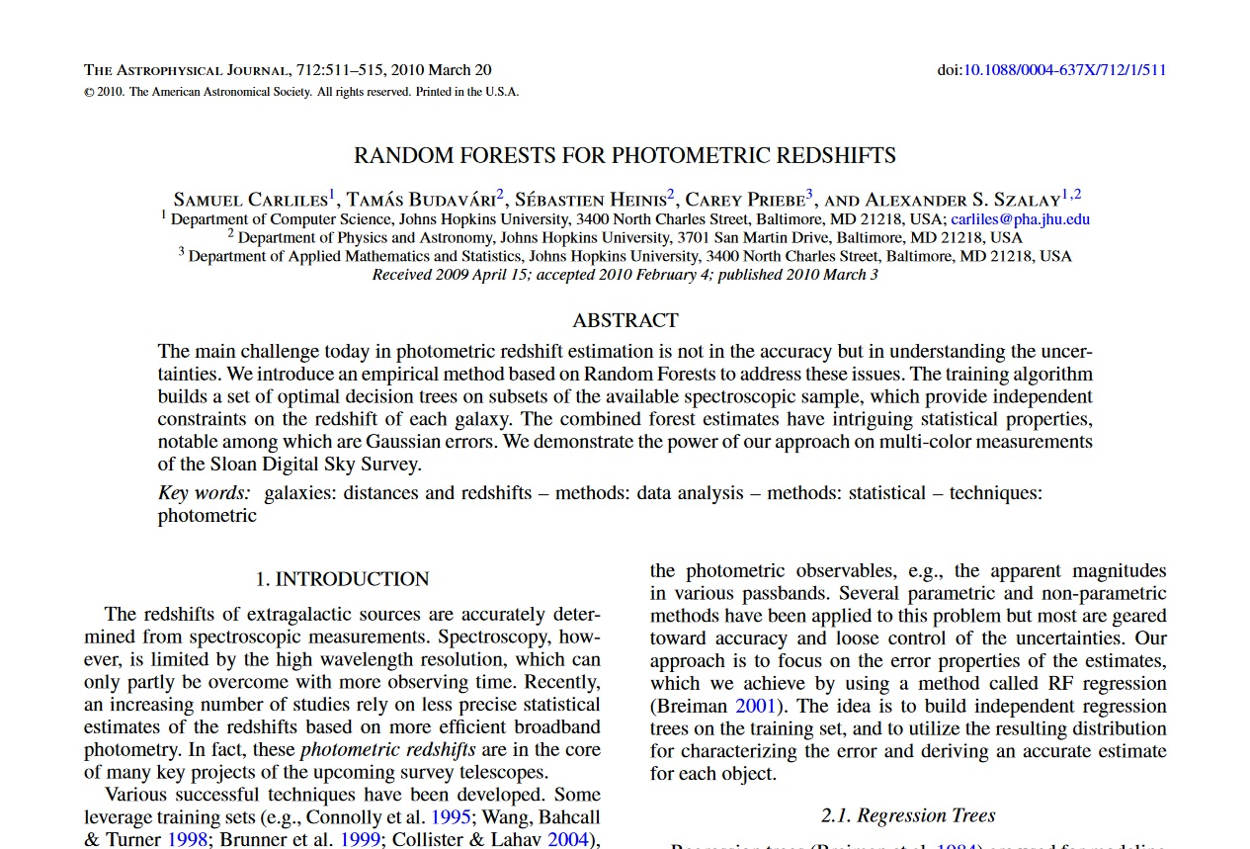
http://iopscience.iop.org/article/10.1088/0004-637X/712/1/511/pdf
Notes:
This is not novel: others have already used machine learning. The SDSS people use random forests to process the data! Previously ML has been used to separate quasars and stars from other objects in these massive surveys, and to perform redshift regression. This has been accomplished using neural networks, decision trees, and here is the only instance of someone using a random forest (

Slide 6
Photo-z Regression
 | u | g | r | i | z | Spec-z
Quasar 1
Quasar 2 | ↓ | ↓ | ↓ | ↓ | ↓ | ↓
Quasar 3
Split quasars into 6 bins according to redshift:
In each bin, have training set and indep. testing set.
Iterative error-reduction → truth vs estimate scatter diagrams
Ranking of inputs by relative importance
0 – 1.95 1.95 – 2.34 2.34 – 2.63 2.63 – 3.5 3.5 – 4.5 4.5 – 7.11
Spec-z
Photo-z
Notes:
The testing set is used for cross-validation.

Slide 7
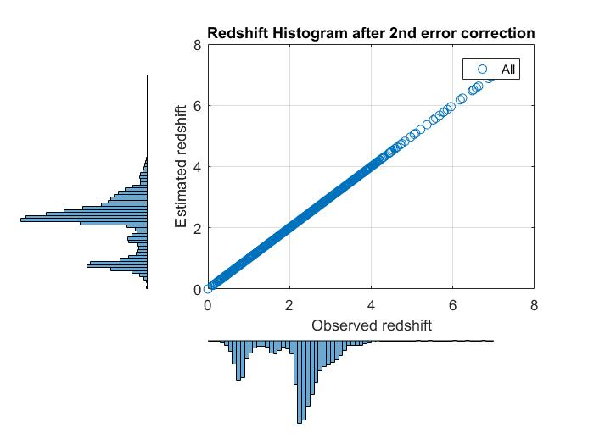
Notes:
This PDF histogram includes all six bins (ALL 160,000 quasars from the catalog). We can clearly see that the peak quasar activity is around Z = 2.5, and there are very few at high redshift.
Now, let me show you how I arrive at such a nice estimate, for bins 1 and 2, since I do not have enough time to show you the results for each bin.

Slide 8
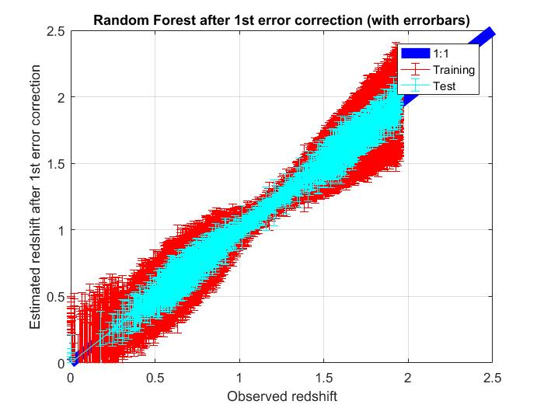
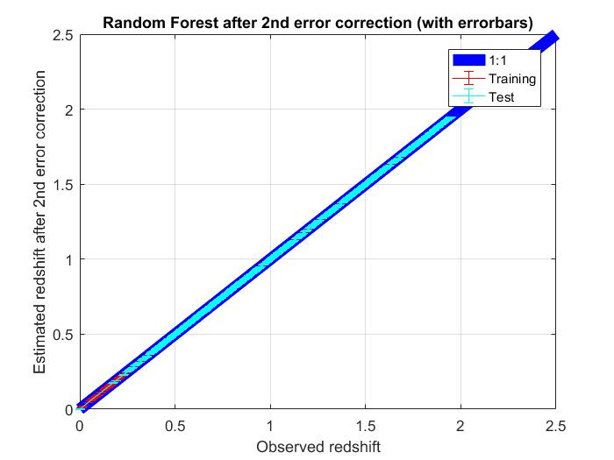
Bin 1
Notes:
the legends on these figures have a typo: instead of "test" they are actually validation data sets, which is an important distinction!!!

Slide 9
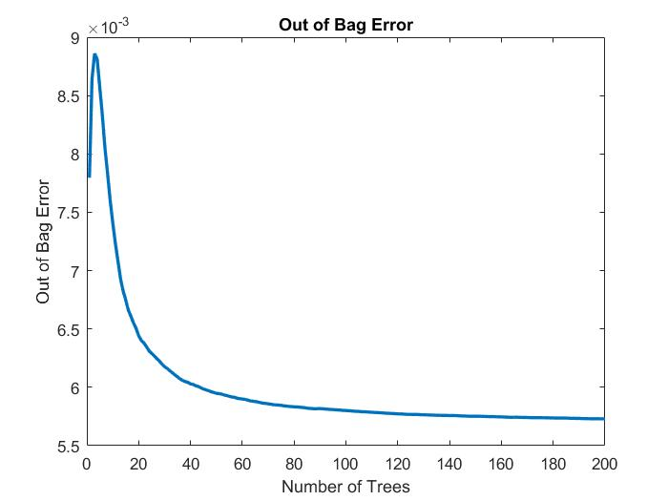
Bin 1

Slide 10
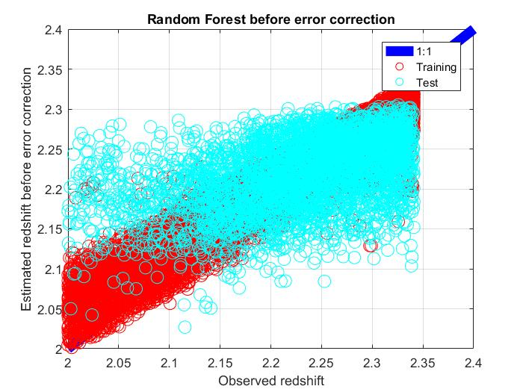
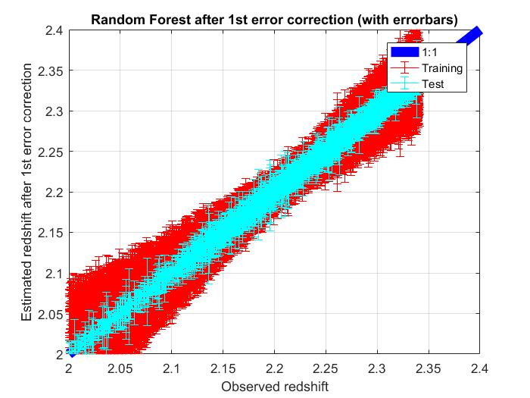
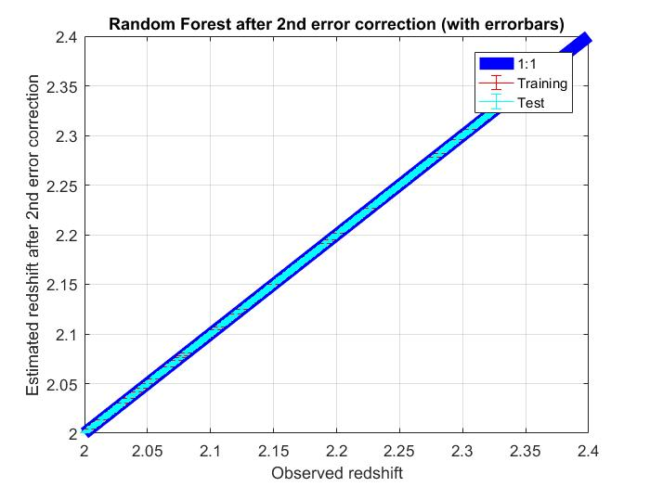
Bin 2
Notes:
the legends on these figures have a typo: instead of "test" they are actually validation data sets, which is an important distinction!!!

Slide 11
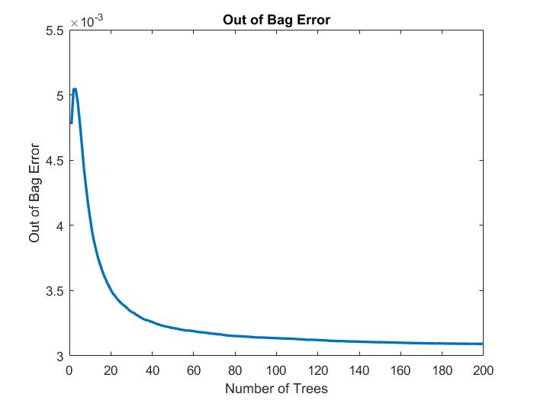
Bin 2

Slide 12
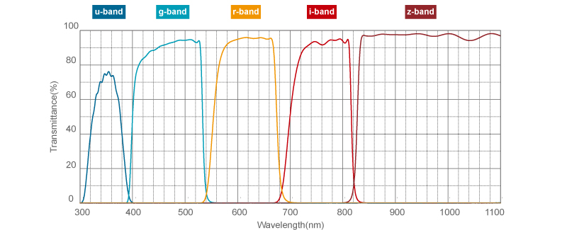
1)
IF we look at the first four bins (equal size N = 40,000), we expect them to have different “most important band” (m.i.b.)

Slide 13
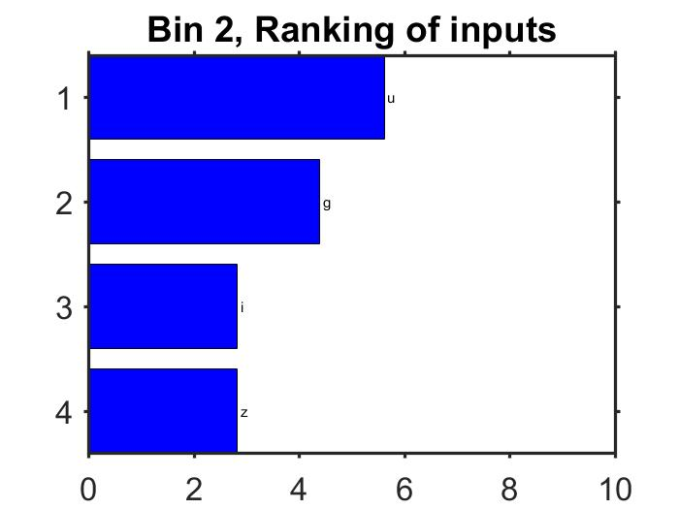
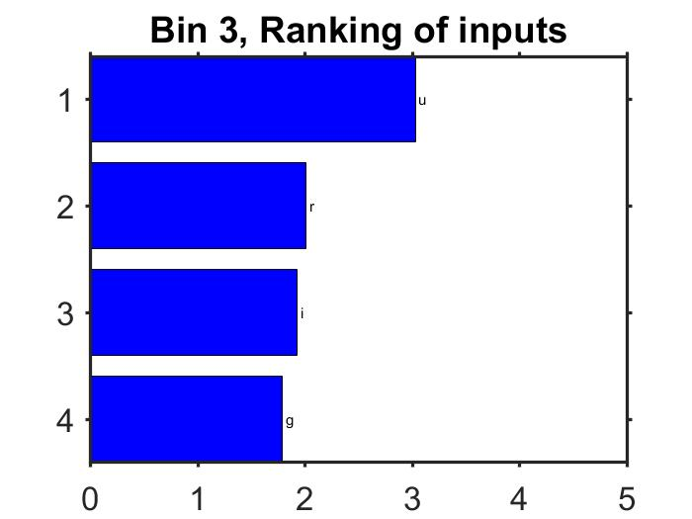
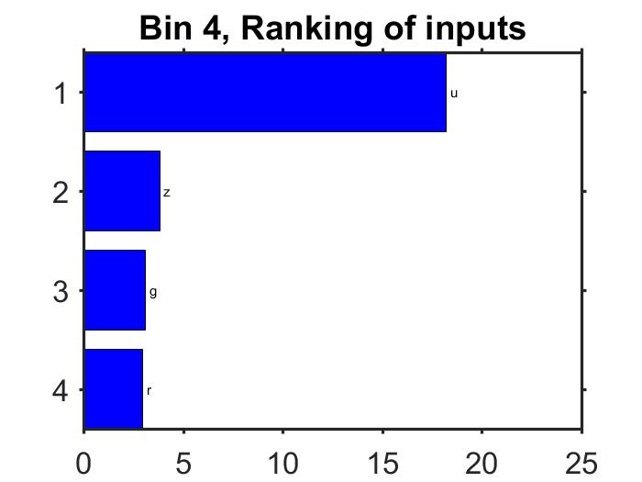
1)

Slide 14
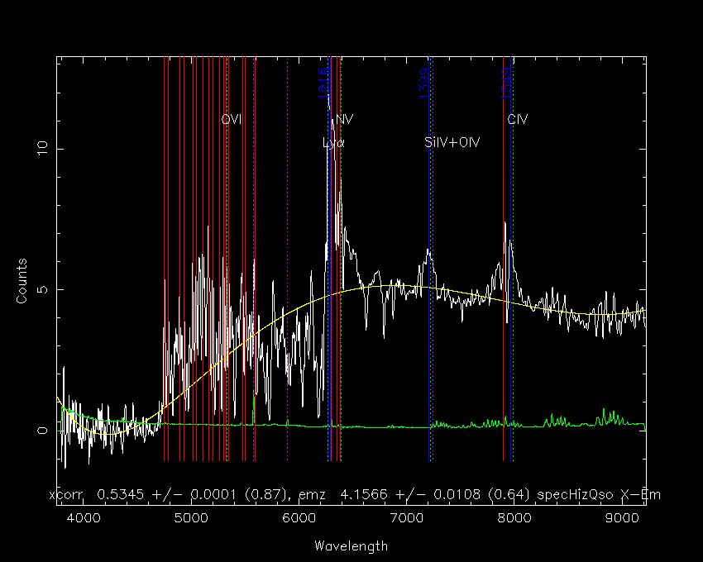
2) We can use high emission lines to guide expectation for most important band (m.i.b.)
→ In rest frame (lab) Lyα emission line is at 1215.67 Å
Z = 4.16 quasar
Cosmological redshift:
$λobs$ = $λems$(1 + Z)
$λobs$ = $λems$(1 + Z) = 6272.86 Å
This means I expect to observe the Lyα line in the r band
http://classic.sdss.org/gallery/gal_spectra.html
Notes:
So, since Lyalpha is the lowest and highest emission feature in a typical quasar’s spectrum, we can use the Lyalpha emission line as a flagpost as to what we should expect the m.i.b. to be.
Thus, I expect the band covering 6200 Å (which is r) to be most important for estimating redshift because that’s where a major emission line is located.

Slide 15
2)
For a given bin, have range of redshift and corresponding wavelength range we expect to find Lyα
Bin # | Z-spec range | Expected Lyα range (Å) | Expected m.i.b. | Calculated m.i.b.
1 | 0 – 1.95 | 1215 – 3587 | u | u
2 | 1.95 – 2.34 | 3587 – 4061 | u/g | u
3 | 2.34 – 2.63 | 4061 – 4416 | g | u
4 | 2.63 – 3.5 | 4416 – 5470 | g | u
5 | 3.5 – 4.5 | 5470 – 6686 | g/r | g
6 | 4.5 – 7.01 | 6686 - 9738 | i | i

Slide 16
Outliers
Exp. m.i.b. = g
Calc. m.i.b. = u
Exp. m.i.b. = g
Calc. m.i.b. = u
Notes:
The third and fourth bins are outliers, in that the calculated m.i.b. differs from the expected m.i.b. These bins are worth understanding better since they are the redshifts where quasars are most active. I do not yet know if this is an artifact of the analysis or physical.
Sneaking suspicion is that there are quasars sitting on the boundary that skew this: for instance, bin three has quasars with Lyalpha at 4061 and the cut off for band g is 4000.

Slide 17
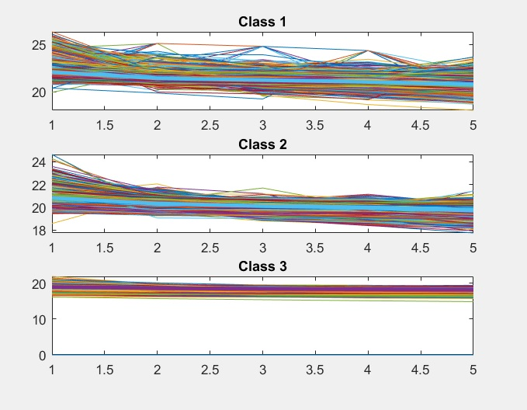
Classification
Unsupervised classification:
Self-Organizing Map classifies objects by photometry into minimum number of classes

Slide 18
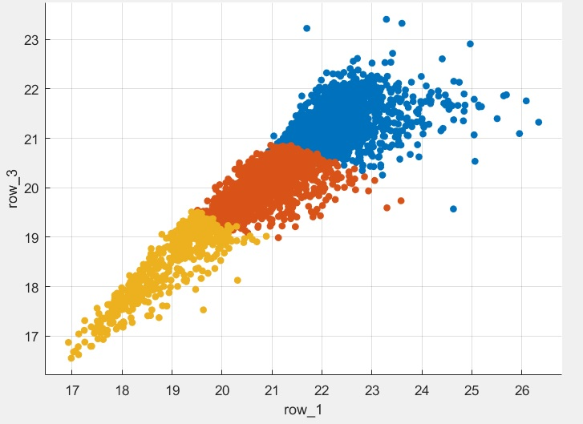
Plot of r vs u bands
All other bands produce similar structure

Slide 19
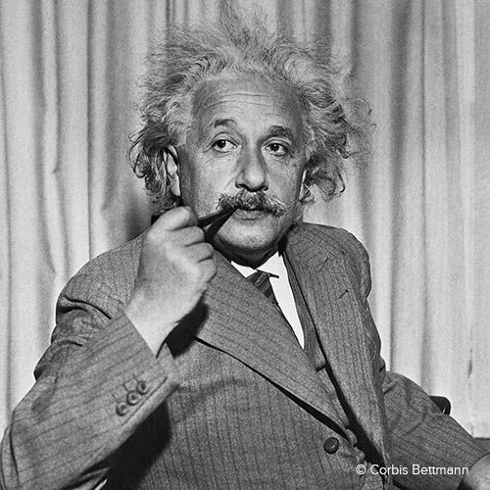
Thank you for listening!

